Slide 1
Proactive Accessibility – How to Get Started.
Melissa Soules – Director of Disabilities Services.
Trevor Johnson-Steigelman – Assistant Professor of Physics.
Jeff Dugan – Instructional Designer.
By the end of this talk, you will be able…
To understand how accessibility features improve the operation of Assistive Technology Devices.
To use the features in Microsoft Word to make more accessible presentations.
To use the features in PowerPoint to make more accessible presentations.
To interpret the feedback from the Ally features in Blackboard.
Documents available at https://coachesoftech.com/shares
@htrevorj
This presentation is licensed under a
Creative Commons
Attribution-NonCommercial-ShareAlike 4.0 International License.

Slide 2
JAWS Example - Poorly Formatted Document
https://youtu.be/61eL3eGDotI

Slide 3
JAWS Example - Better
https://youtu.be/24cI1SJYpb4

Slide 4
Kurzweil Example - Poor
https://youtu.be/EO-8_T8RbNM

Slide 5
Kurzweil Example - Better
https://youtu.be/fMHBNsxZmAI

Slide 6
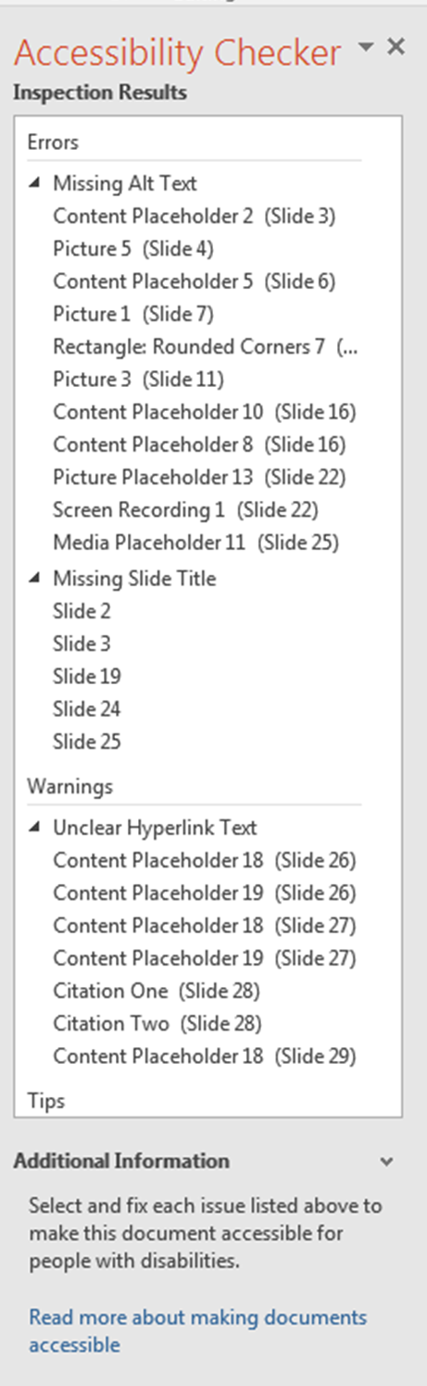
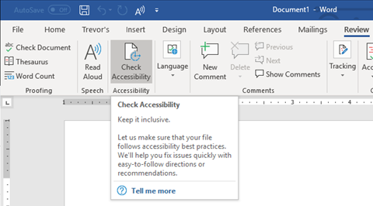
Built-in Accessibility Checker.
In Office 2016 (the version available on campus), you can find the accessibility checker under…
File\Info\Check for Issues\Check Accessibility.
In newer versions, this tool is located in the “Review” Tab.

Slide 7
Accessibility Checker In Action.
Microsoft Office has a built in Check Accessibility tool.
The tool will point out errors that you can fix to improve the document’s accessibility.
The tool checks for…
Missing Alt Text.
Missing Slide Titles.
Link Text.
Contrast Problems.
It will also explain how these fixes help.

Slide 8
How do I add alt text to an image? Note: This one you will want to write down.
Note: In more recent updates of PowerPoint, you can right click on the image, and use “Edit Alt Text…” from the context menu.

Slide 9
Alt Text.
Alternative text is text that can take the place of an image.
Screen readers will say “Image” and then read your Alt Text descriptions.
Do not say “Picture of…” at the beginning of alternative text.
You should also try to describe the image in the regular text of your document. This helps all students.
Notes:
Alternative text is text that takes the place of an image.
Screen readers will say image and then read your alt-text description.
Do not say “Picture of”.
You don’t need to describe colors, backgrounds, etc. Describe the main point of the image.
Try to describe the image in the regular text of your presentation. I’ve found that doing this helps all of my students It helps my write better lab manuals and problem descriptions.

Slide 10
Accessibility Guidelines.
Universal Accessibility Guidelines.
Use Accessible Fonts.
Use Headings.
Use List Features.
Be Aware of Reading Order.
Add Alternative Text to Images.
Be Aware of Contrast and Color.
PowerPoint Specific Guidelines.
Only use “Placeholders”.
Overuse Punctuation.
Use Slide Titles.
Use List Features.
Replace Equations with Images and Alt-text.
Notes:
There are lots of details to accessibility, but there are some main areas that you can focus on…
Use accessible fonts.
Use Headings.
Use List features.
Be aware of the reading order.
Add alt-text.
Be aware of contrast and color.
For Powerpoint, you should specifically be aware of a few things.
Use placeholders.
Overuse Punctuation.
Use slide titles.
Use list features.
Replace equations with images and alt-text.

Slide 11
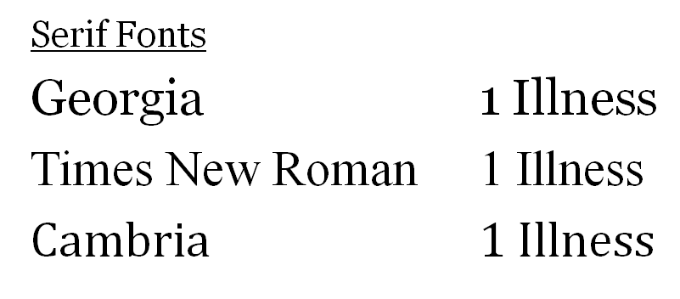
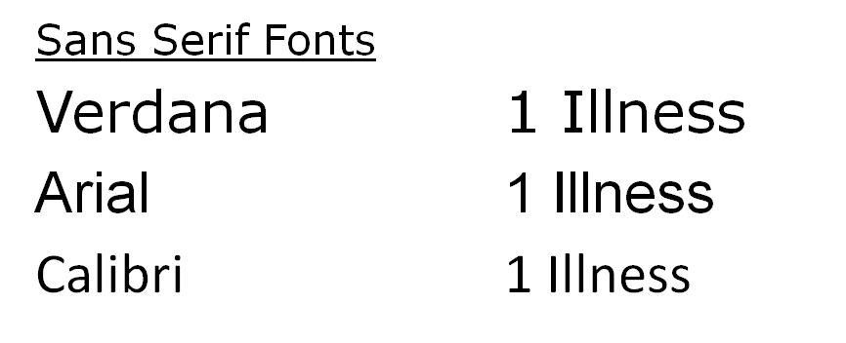
Accessible Fonts.
Preferred Fonts.
Use Verdana and Georgia in most documents.
They have the highest accessibility ratings, and they are also “universal”, available on Macs, PCs, and most other operating systems/devices.
Other Fonts.
It is okay to use other fonts, but it is a good practice to embed the fonts in the document. Go to File\Options\Save and click the “embed fonts”option.
Notes:
Let’s start by looking at fonts.
The preferred fonts are Verdana and Georgia.
These have high accessibility ratings, and are nearly universal.
You can see here how Georgia font distinguishes ones, capital I’s, and lower case l’s.
For san-serif fonts, those without the little flares at the edges, Verdana does the best.
Cambria and Calibri are good fonts, but they aren’t automatically found on Macs or online.

Slide 12
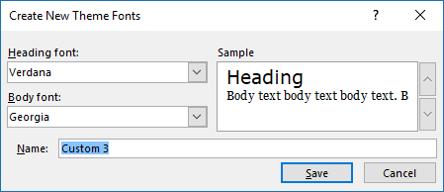
Setting Default Fonts.
To set the custom fonts, choose
View\Slide Master\Fonts.
Notes:
You can set the default fonts by clicking on view, and choosing the slide master.
Within the Slide Master tab, you can find the fonts setting in the background group.
You can thus set up the default heading and body fonts.

Slide 13
Color and Contrast.
Color
can
enhance
your
slides.
https://www.reddit.com/r/mildlyinfuriating/comments/6chdqg/this_unintentional_demotivating_yoga_mat/
Notes:
People often try to get fancy by using gradient backgrounds. This can be a huge accessibility problem, and not just for those with verified visual impairments.
As you can see, nothing is possible. This is an unmotivating yoga mat, in which the IM in impossible blends in with the background.

Slide 14
Color Impairment.
https://www.reddit.com/user/luccyVeins .
https://i.redd.it/c1c5u0dhret01.jpg .
http://enchroma.com/test/ .
Notes:
There are many different types of color impairment. If you use color as an exclusive way to highlight something like new vocabulary words, you might hide them from some students. You might also cause contrast problems if you have pink letters highlighted in blue.

Slide 15
Contrast Tips.
Provide sufficient contrast.
Specify both foreground and background.
Be careful of background gradients and color combinations.
Be careful of background images.
Notes:
Here are some tips to help you with contrast.
Provide sufficient contrast. The idea that grey text on a grey background is good for your eyes is a lie.
Make sure that you specify both the foreground and the background colors.
Be careful of gradients and color combinations.
Avoid using background images, they usually make at least some text illegible.

Slide 16
Placeholders.
When a screen reader reads a PowerPoint slide, it will only read the alt-text for images or words typed into “Placeholders”.
Some screen readers will not read items placed into text boxes.
Notes:
Basic PowerPoint slides have placeholders. These are the spots where you put in text and/or images.
You must use these for text items. Most screen readers won’t read things in text boxes.

Slide 17
Changing the Layout.
You can change the layout of a slide by right clicking in a blank part of the slide, and then choosing “Layout” from the context menu that appears.
Notes:
Each PowerPoint template has a set of layouts that you can choose by right clicking on the slide.
Try using one of these for your slides. You can adjust the sizes if you need to do so.

Slide 18
Adding Placeholders.
To add a new placeholder, you need to go into the Master Slide ribbon.
An easier option is to copy and paste an existing placeholder. (There needs to be something already in the placeholder for this to work.)
You can create custom layouts in the Slide Master.
Right click between two layouts and choose “Insert Layout”.
or click on “Insert Layout” in the Ribbon.
Notes:
You can add new placeholders by going into the Slide Master, then choosing “Insert Placeholder”.
It might be easier to just copy and paste an existing placeholder.
You can also create custom layouts by going into the Slide Master.

Slide 19
Slide Titles.
Make sure that every slide has a unique title.
This allows users of screen readers to skip ahead.
The accessibility checker will warn you about missing titles.
Avoid using the same title two or more times.
Example Problem.
Example: Speeding Up.
Example: Slowing Down.

Slide 20
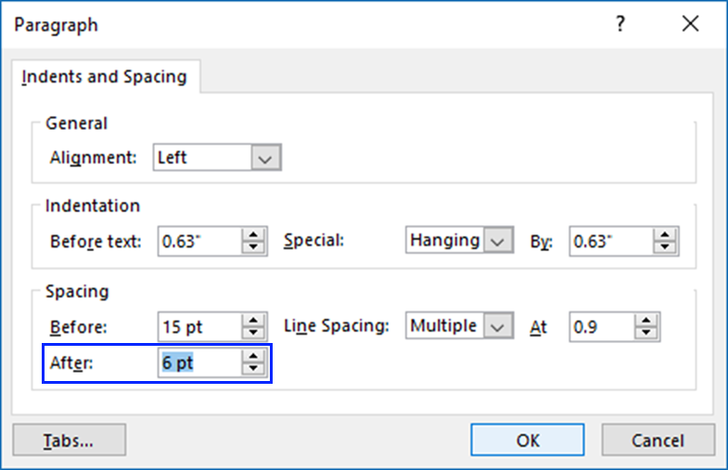
List Tags.
List Tags identify a block of text as a list.
Readers will say “bullet” and then read the text.
Add a period to cause a pause at the end.
Avoid Multi-level lists. There is no distinction for screen readers.
Adjust the spacing with “Line Spacing Options rather than adding blank lines.

Slide 21
Reading Order.
Except when jumping between headings, screen readers are linear.
This means that you need to be careful of the placement of tables, charts, and images.
Home\Arrange\Selection Pane
The Selection order is “upside down”. The first item is located at the bottom.
Think of painting: the most recent addition is on top.
You can rename the items, but this seems to affect what the SR reads.

Slide 22
Screen Readers and Equations.
Readers don’t read Equations.
Accessible Math isn’t an option yet.
MathML has compatibility problems.
Inserting Equations.
Use Insert\Equation to make equations.
Copy and paste as an image.
Give the image alt-text in “Mathglish” or Nemeth Code.
Mathglish Tips.
The variable “a” should be written as A in the alt-text description.
Spell out operations like minus.

Slide 23
Animations and Accessible Files.
Screen Readers do not trigger with animations, but walls of information can be hard to follow.
Accessible Files.
It is recommended that you print a pdf version of the slideshow and include it as the accessible version of a presentation.
I don’t like this idea, it smells of “separate, but equal”. However, the PDF will tend to be more accessible.
In addition, the file doesn’t seem to be as accessible to me.
I recommend that you save a “PowerPoint Show” version for students.

Slide 24
Using Accessibility Features in Blackboard – Blackboard Ally
Interfacing with Blackboard
Alternate File Versions
What Ally Checks for
Ally in Action
Source: Ally Quickstart
https://help.blackboard.com/Ally/Ally_for_LMS/Instructor

Slide 25
What Ally's Feedback Looks Like.
Each object in Blackboard is scored with one of the following colored barometer symbols.
The colors and needle indicate how well the object scored.
The instructor is then given a step by step guide on how to fix the problem.

Slide 26
Alternative Formats for All Course Files
Ally automatically creates a variety of alternate formats for the files uploaded to your Blackboard course.
Many file types are available.
These files provide accessibility features right from the start with no work on the instructors end.
But, preparation helps.
Format | Format Advantages
OCRed PDF. Automatically extracted text. | Improved scanned documents. Better reading and text search.
Tagged PDF. Structured PDF for Assistive Tech. | Improved navigation structure. Essential for screen readers.
HTML. For Browser and Mobile. | Customize your text. Adapts text to mobile screen sizes.
ePub. Reading on tablets and e-book readers. | eBooks on tablets. Annotating and highlighting.
Electronic Braille. BRF version for electronic braille displays. | Read more quickly. Essential for visual impairments.
Audio. MP3 recordings of text. | Listen and learn on the go. Engage different modalities.

Slide 27
What Ally Recommends (and is Checking for)

Slide 28
Ally in Action Example 1: Alt Tags
When an image is flagged with poor accessibility score by Ally, instructors will have a breakdown of the rationality and possible fixes right in Blackboard.
The issue with the image to the left is that it did not contain a Alt Tag.
The instructor simply needs to add the Alt tag to the box provided by Ally, hit Add, and the problem is solved.

Slide 29
Ally in Action Example 2: Seizure Inducing Images
Ally flags potentially harmful images, including seizure inducing .gif files.
When this type of image is found Ally will prompt the instructor to remove the file all together.
If the instructor chooses to keep the file, it will be flagged as potentially harmful.

Slide 30
Review
Screen Readers allow students with visual impairments to hear what is typed on the screen.
Universal Accessibility Guidelines.
Use Accessible Fonts.
Use Headings.
Use List Features.
Be Aware of Reading Order.
Add Alternative Text (Alt-text) to Images.
Be Aware of Contrast and Color
PowerPoint Specific Guidelines
Only use “Placeholders”.
Overuse Punctuation.
Use Slide Titles.
Use List Features.
Replace Equations with Images and Alt-text

Slide 31
Reference Materials
Screen Readers
https://www.nvaccess.org/
https://www.freedomscientific.com/Products/Blindness/JAWS
https://www.kurzweiledu.com/
WebAIM (Web Accessibility in Mind) has useful information on Accessibility.
https://webaim.org/techniques/alttext/
https://webaim.org/techniques/powerpoint/
Microsoft Accessibility
https://www.colorado.edu/accessibility/resources/creating-accessible-content/universal-design-measures-checklist-microsoft-powerpoint
https://www.ssa.gov/accessibility/checklists/word2010/listFormatting.htm#collapsible=howToTest
http://blogs.wright.edu/learn/accessibility/word/images-in-microsoft-word/
Ally Information
https://help.blackboard.com/sites/default/files/documents/2018-05/Ally-QuickStart-Canvas2018_FINAL.pdf

