Slide 1
Getting Comfortable with the Uncomfortable: Ways to Address Debating and Difficult Topics in the Classroom
Dr. Katrina Fulcher-Rood, CCC-SLP, BCS-CL
Associate Professor
Department of Speech-Language Pathology
SUNY Buffalo State College

Slide 2
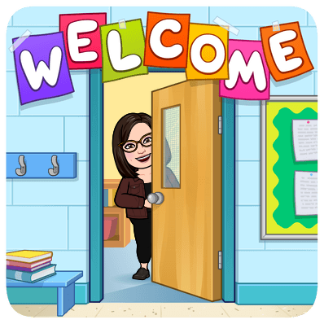
Welcome!
About Me
Associate Professor
Speech-Language Pathologist
Qualitative researcher
Implementation scientist
Book lover
Harry Potter nerd
Musical geek

Slide 3
Overview
Group brainstorm
Why discuss difficult topics?
Building class community/unity
Establishing ground rules
Strategies for having difficult conversations
Mediation of difficult conversations

Slide 4
Brainstorm
Raise your hand, or in the chat window….
Do you like having difficult conversations in your classroom? Why or why not?

Slide 5
Brainstorm
Raise your hand, or in the chat window….
What topics are the most difficult to have in your classroom?

Slide 6
My history with difficult conversations…

Slide 7
Should we discuss difficult conversations in our classrooms?
From “On Difficult Conversations” by Derisa Grant
”…this framing is potentially learner-centered, as it acknowledges that the discomfort of these “difficult” conversations must be braved to serve student learning and well-being. And, given the recent widespread protests over the murders of George Floyd, Breonna Taylor and Ahmaud Arbery, among others, professors who seek to carry on with business as usual, without broaching topics such as systemic racism and anti-Blackness, risk appearing tone-deaf and out of step with the current historical moment.”
“The reality, however, is that all students benefit when a multiplicity of identities are reflected in the classroom, whether in the curriculum or elsewhere….“Difficult” allows us to dismiss and avoid -- to further marginalize those who surface identity by labeling them myopic or as promoting identity politics. Yet all course content reflects identity politics.”

Slide 8
Steps that I have followed…
Create classroom community and unity
Strong instructor presence
Discussions about difficult discussions
Identity reflection
Setting ground rules
Practice
Reflection
Mediation when needed

Slide 9
Creating a Classroom Community and Culture
To establish classroom community, you must start immediately and continue throughout the semester
First 2 – 4 classroom sessions
Icebreakers
Introduce yourself
Small group discussions and problem solving
Continued throughout the semester
Check-ins
Vent time
Space for questions, study groups, and connection with classmates

Slide 10
Instructor Presence
Having students feel and understand that you as the instructor are working along side them throughout the course
The perception that you are “being there”
You are a real-life human being who can be counted and depended on
Reducing feelings of isolation or being disconnected
Physical and visual presence AND your take on course material

Slide 11
Instructor Presence
Use of announcements
Weekly wrap ups/summary
Reaching out to struggling students
Give students information about you
Communication and feedback policies
Giving your perspective
Participating in course discussions
Personalization of communication and feedback

Slide 12
Let your students know…it may be difficult
Discussion / introduction in syllabus
Ask them to review the syllabus and what topics are they the most nervous to talk about and why
Reflection on what they do when faced with a difficult conversation
Reflection / discussion about do they feel having difficult conversations is beneficial and why or why not

Slide 13
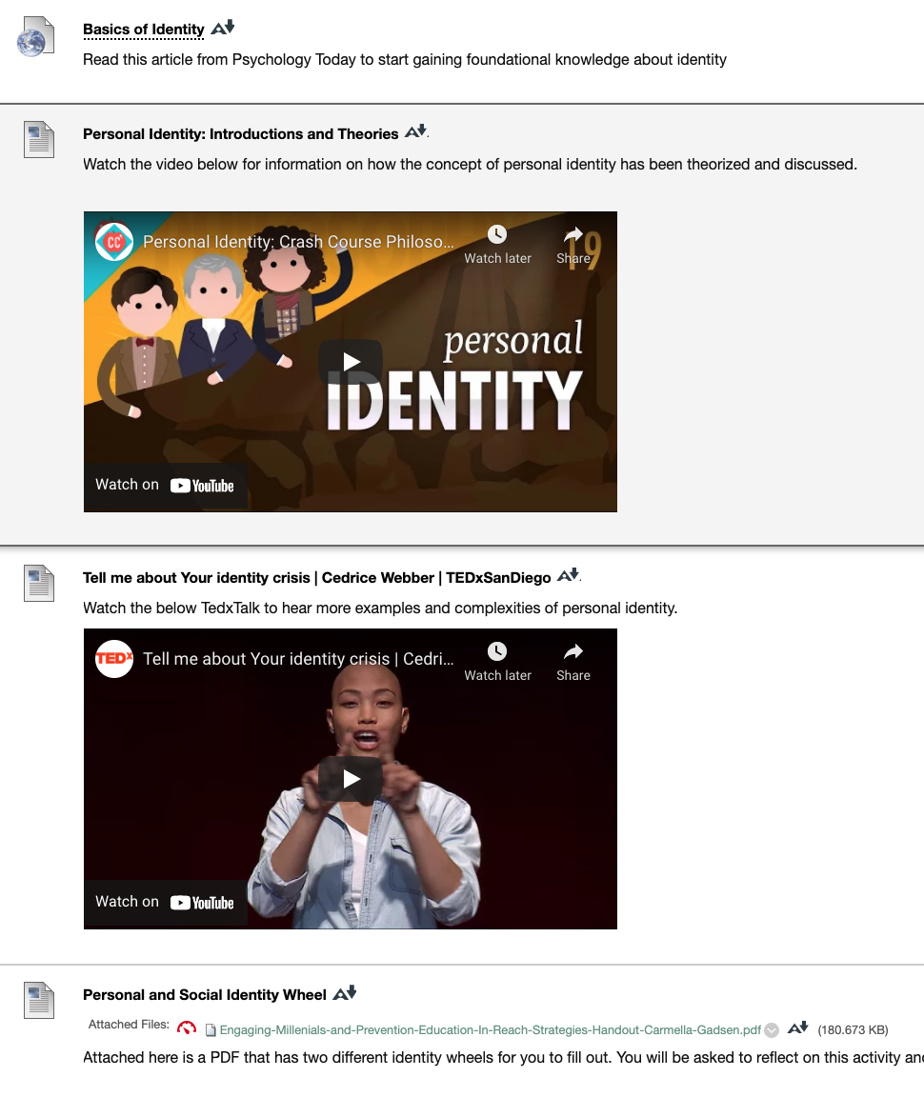
Understanding Personal Identities

Slide 14
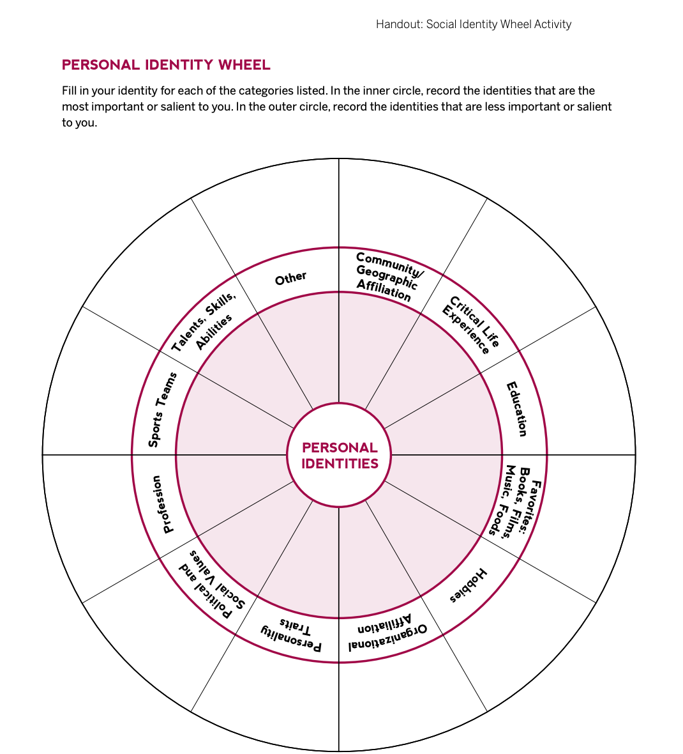
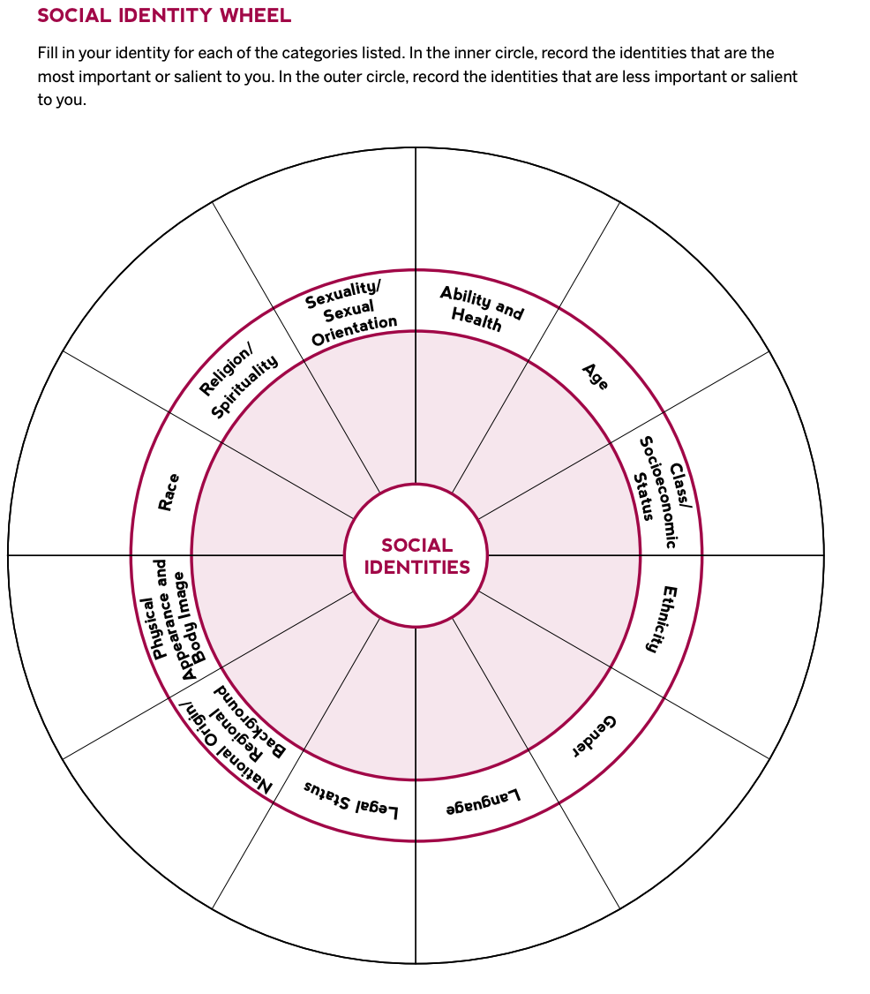

Slide 15
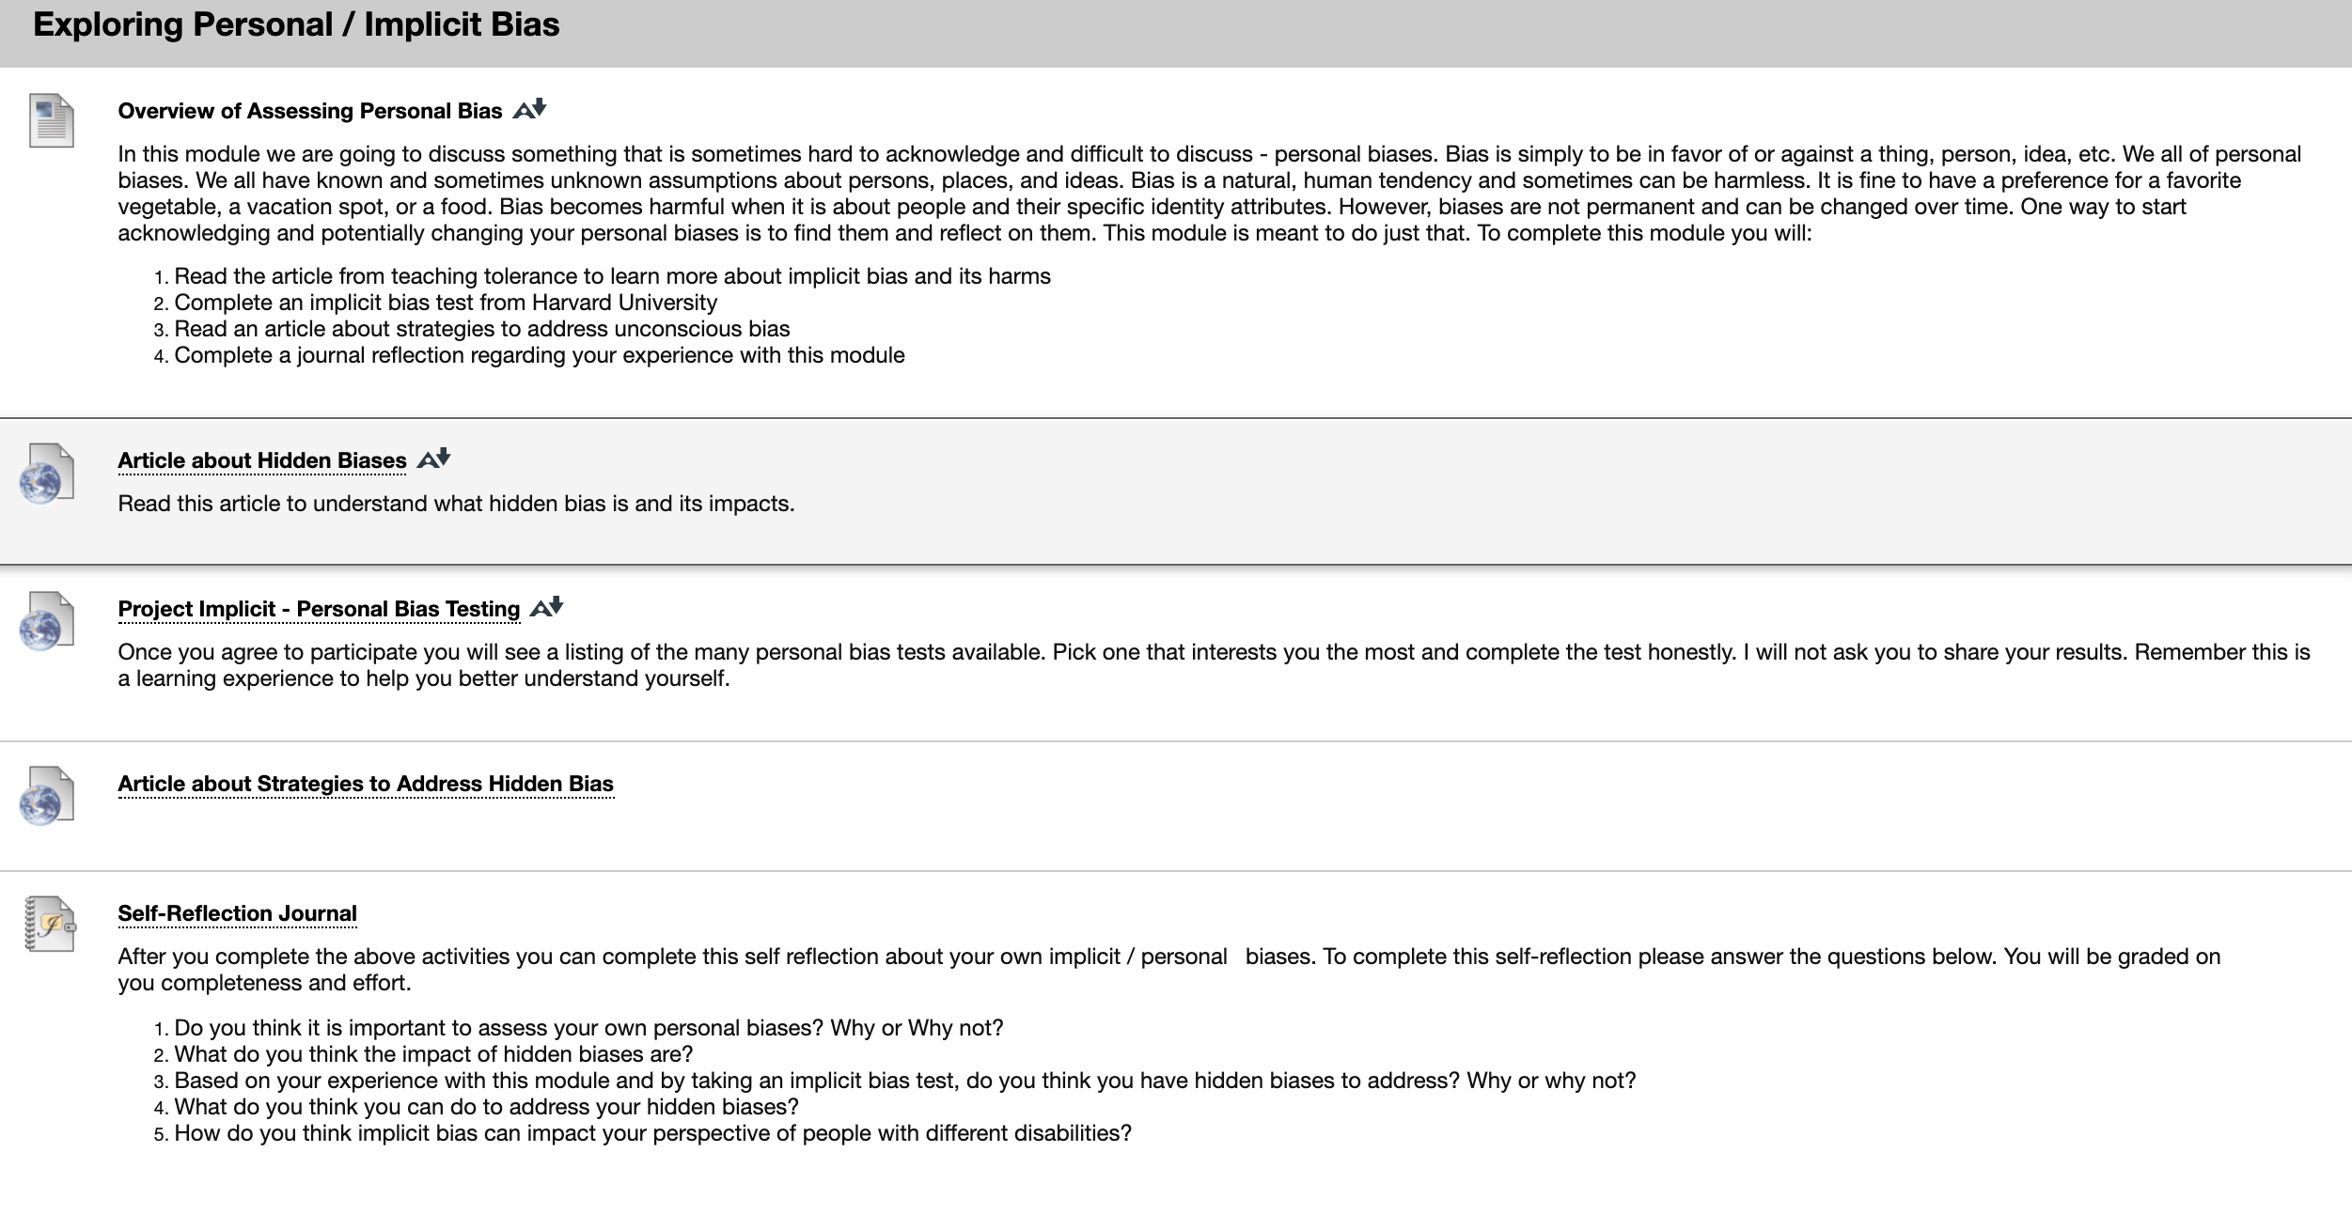
Assessing Personal Bias

Slide 16
Setting Ground Rules
These ground rules should be made and set with your students
For each discussion you should set and state objectives and goals
Techniques to establish rules:
Discussion
3 jars technique

Slide 17
Setting Ground Rules
Listen respectfully, without interrupting
Allow everyone the opportunity to speak
Criticize ideas, not individuals or groups
Avoid inflammatory language, including name-calling
Ask questions when you don’t understand; don’t assume you know others’ thinking or motivations
Connect back to course concepts whenever possible
Don’t expect any individuals to speak on behalf of their gender, ethnic group, class, status, etc. (or the groups we perceive them to be a part of).
Maintain confidentiality
Taken from: Indiana University, Center for Innovative Teaching and Learning
Vanderbilt University Center for Teaching

Slide 18
Setting Ground Rules
Taken from: Kent State University: “NAVIGATING DIFFICULT CONVERSATIONS IN THE CLASSROOM”

Slide 19
Practice and Modeling
Practice discussion and using ground rules in a “low stakes” setting
You have to model these rules and desired behaviors when you are teaching and discussing yourself
Provide tips for having challenging conversations
Use role play

Slide 20
Practice and Modeling

Slide 21
Okay, now let’s have the conversation!
Complete a warm-up or pre-discussion activity
Have prompts/discussions prepared
After giving prompt, make sure that everyone has a chance to discuss
Small group discussion first and brainstorm and then a group leader
Talking chips technique
Manage discussion (later topic)
Provide follow-up and synthesis
Be sure to know appropriate resources to refer students to
Have a way to check in and follow up with individual students

Slide 22
Discussion Strategies
Establish time limits
Fishbowl exercise
Allow for pause time or cool-off time
Use literature/evidence to support

Slide 23
Managing Discussions
In the moment, when topics may get heated:
Have a way to signal a time out
Be sure to give students a chance to rephrase or restate
Address difficulty
Have a cool-off or emotion check in
Deferral processes if needed
Always provide time for structured reflection
Private journal reflections
Exit tickets

Slide 24
Questions?
fulchekr@buffalostate.edu
https://docs.google.com/presentation/d/1zNIWjtrB_dQeTakOUcahL4S0m88dUif5/edit?usp=sharing&ouid=110638061378828172114&rtpof=true&sd=true

Slide 25
For recordings and other resources, please visit:
www.suny.edu/OTTER

