Slide 1
Creating Connections for Student Retention
Dr. Michelle L. Currier – SUNY Canton

Slide 2
The Institution
27% Non- Traditional
26% Self- identify as Non-White
SUNY Canton:
Approx. 3,200 FTE
66% Economically Disadvantaged
46% First Generation College Students
Notes:
Cori
Describe our students
Applied programs – not as research-based as many curriculum
Colleger’s Mission is focused on accessible, affordable education
Mention Admissions

Slide 3
The Department
Homeland Security B.Tech
500+ Students
Criminal Justice Department
Law
Enforcement Leadership
B. Tech
9 FT
Faculty
Criminal Investigation
B Tech.
Criminal Justice AAS
Notes:
Cori
Describe our students
Applied programs – not as research-based as many curriculum
Colleger’s Mission is focused on accessible, affordable education
Mention Admissions

Slide 4
The Problem(s)
Why don’t students know about CJ clubs?
Why do my students always say, “I didn’t know”...?
Lack of Awareness re: Requirements,
Expectations, Procedures
Low (or No) Participation
Missed Deadlines
No Advising
….or Late Advising
Closed out of Classes
Why Did we only get 3 applications for the CJ SCholarship?
Why aren’t my students signing up for advising appointments?
Notes:
Michelle

Slide 5
The Problem(s)
All of the aforementioned “problems” equal one very concerning issue: RETENTION
Retention remains a topic priority at colleges, yet institution initiatives aimed at improving student retention continue to be plagued by significant communication barriers.
Notes:
Michelle

Slide 6
The Concept
How to tackle the issue of retention when the “problems” seem to be communication-based?
Relationship Building
Perceived Quality
Student Satisfaction
Trust
Student “loyalty” = retention (Hennig-Thurau, Langer & Hansen, 2001)
Notes:
Michelle

Slide 7
The Concept
Relationship-Building - which improves perceptions of quality, satisfaction, trust, and loyalty --is often overlooked as a critical variable in student success….yet satisfaction has a greater effect on students’ grades than obtaining grades has on student satisfaction (Kuh, Kinzie, Buckley, Bridges, & Hayek, 2006).
Notes:
Michelle

Slide 8
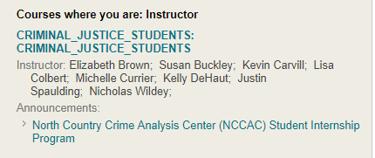
The Intervention
The SUNY Canton Criminal Justice Department designed and implemented a program aimed at communication collaboration between faculty and enrolled students through the college’s online learning platform --Bb.
Notes:
Michelle

Slide 9
Relationship-Building Through Bb
Through cooperation with the SUNY Canton Online Learning Team all fall 2018 criminal justice students enrolled in one of the four departmental degree programs were registered in a newly created BlackBoard course titled “Criminal Justice Students.” Criminal Justice Department faculty were then added with instructor privileges for the creation of groups to align advisor with semester advisee listing.
Notes:
Michelle

Slide 10
Relationship-Building Through Bb
Communication collaboration using a BlackBoard shell was designed to target three main areas of frequent correspondence barriers experienced by the college, department, and between faculty and students.
Notes:
Michelle

Slide 11
Relationship-Building Through Bb
The first area addressed was an institutional communication plan to disseminate all relevant college documents through the BB course announcement and email portal. Currently the college sends notifications of relevant information, including term registration, financial aid deadlines, campus activities, etc. through email, but with changing technological demands students do not use this medium as a main form of exchange.
Notes:
Michelle

Slide 12
Relationship-Building Through Bb
The second area addressed was a departmental communication plan between CJ faculty members and all registered students in one of the four degree programs. Currently faculty members are responsible for communication among their respective advisees, but it has been difficult for a consistent level and quality of correspondence to occur.
Notes:
Michelle

Slide 13
Relationship-Building Through Bb
The third area addressed was a criminal justice student body communication plan. This sought to remediate the current shortcomings of criminal justice students’ strategies to spread information relevant to club membership, fundraisers, and events through word of mouth.
Notes:
Michelle

Slide 14
Relationships
Proposed Benefits:
More Personal
Easily Accessible
Single POA
Student Identity
Connections to Dept. Faculty
More Inclusive/Better Serves OL Students
Academic
Services
Registration
Info
Institutional Communication
Graduation
Info
Communication
in Bb
Events
Advising
Internship
Info
Student Communication
Clubs
Job
Announcements
Faculty/Dept.
Communication
Activities
Events, Training
& Scholarships
Notes:
Michelle

Slide 15
Relationship-Building Tools
Announcements
Email
Course Messages
Bb App and Notifications
Content (Information Repository)
Groups
Notes:
Signage for cell phones/quiet areas
Students are allowed to use phones downstairs

Slide 16
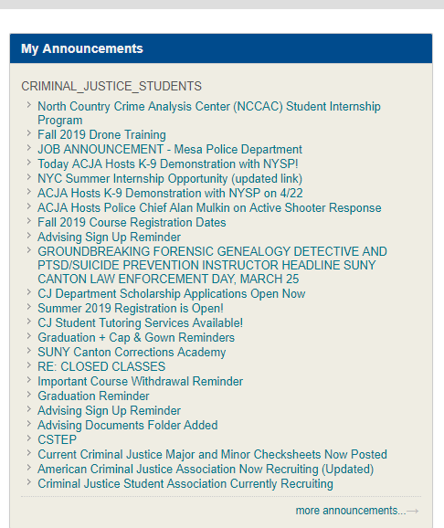
Announcements
Notes:
Signage for cell phones/quiet areas
Students are allowed to use phones downstairs

Slide 17
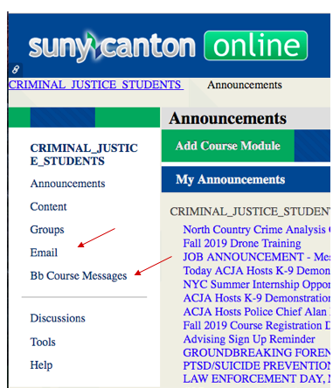
Email and Course Messages
Notes:
Signage for cell phones/quiet areas
Students are allowed to use phones downstairs

Slide 18
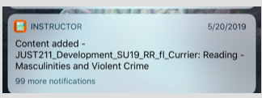
Bb App and Notifications
Notes:
Signage for cell phones/quiet areas
Students are allowed to use phones downstairs

Slide 19
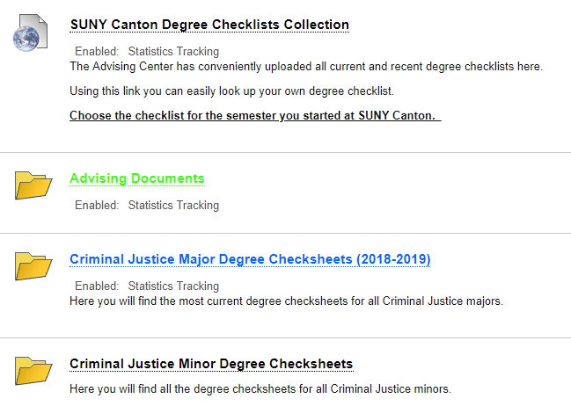
Content
Notes:
Quiet area
Strategic furniture and strategic placement – individual and group
Weeding project
Elimination of rarely-used titles – over 25% of the collection
Creation of usable space
Immediately fill space with furniture, tried different configurations until more long-term plan was enacted
Even with new spaces, the openness of the building allowed noise to travel
Sound Panel project - Michelle

Slide 20
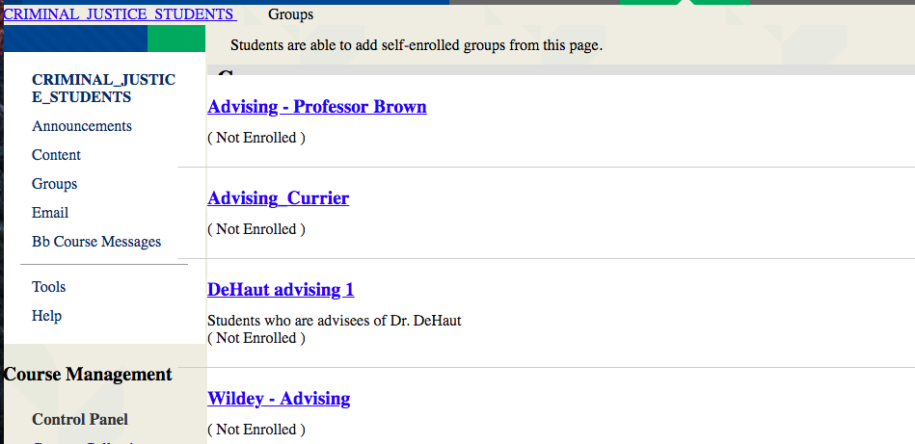
Groups
Notes:
Quiet area
Strategic furniture and strategic placement – individual and group
Weeding project
Elimination of rarely-used titles – over 25% of the collection
Creation of usable space
Immediately fill space with furniture, tried different configurations until more long-term plan was enacted
Even with new spaces, the openness of the building allowed noise to travel
Sound Panel project - Michelle

Slide 21
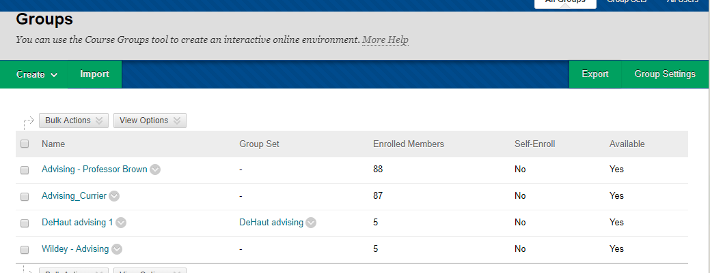
Groups (the Faculty View)
Notes:
Quiet area
Strategic furniture and strategic placement – individual and group
Weeding project
Elimination of rarely-used titles – over 25% of the collection
Creation of usable space
Immediately fill space with furniture, tried different configurations until more long-term plan was enacted
Even with new spaces, the openness of the building allowed noise to travel
Sound Panel project - Michelle

Slide 22
Results
Preliminarily, students have responded positively.
Faculty have reported:
Improved advising signups
Smoother advising transactions
Increased responsiveness to events, trainings, announced opportunities
Better communication with fully OL students
Notes:
Michelle

Slide 23
Next Steps
2019-2020 Academic Year:
Expansion of relationship-building and communication efforts
More student involvement/ownership
Customization
Expanding groups
Use of Collaborate Ultra
Notes:
Michelle

Slide 24
Limitations
(and other considerations)
Your Bb Instance
People Resources
How Your Students/ Faculty
Use Bb
Department
Sentiment
SUNY Canton
OL Techs
& IT
Time Resources
Bb Skills & Comptencies
Commitment
Notes:
Michelle

Slide 25
Questions?
FAQ….

Slide 26
Contact Information
Dr. Michelle Currier is faculty in Criminal Justice at State University of New York at Canton; and the chair of Canton’s Online Learning Advisory Committee (OLAC).
currierm@canton.edu

