Slide 1


FYE and Guided Pathways: A Synergistic Relationship
Dr. Michele Campagna
Westchester Community College
SUNY Student Success Summit
October 28-30, 2019
1

Slide 2

Guided Pathways
Like FYE, Guided Pathways advocates for comprehensive academic programs and services to improve student learning and success
Began as a community college movement, yet many four-year campuses have adopted its principles
Focuses on moving from narrow interventions to scalable, sustainable, and systemic institutional change

Slide 3

FYE & Guided Pathways
Guided Pathways advocates for thoughtful and early major selection and planning
Considering that student-major mismatch can cause completion delays and student attrition, early major exploration is essential
FYE programs can bolster pathways programs by helping students choose their majors, complete educational plans, and explore careers

Slide 4


Rationale for Guided Pathways
“Cafeteria model” of disconnected courses, degrees, and support services Unclear paths to degree completion
Attrition, excessive credits, or delayed completion, particularly for first generation students and students of color
Depleted financial aid for community college students, complicating their ability to transfer
Students may be underprepared to transfer, enter a career, or continue to graduate studies

Slide 5
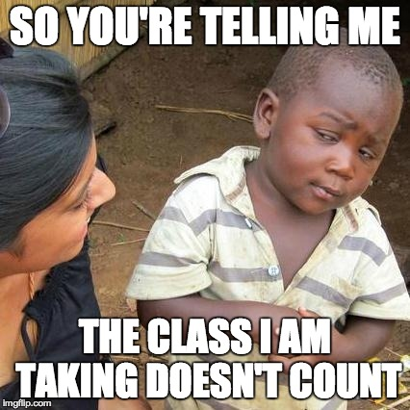
How many times have you had this conversation?

Slide 7
Need for a Holistic Approach
Institutions and their staff are sliced into departments, offices, ranks, and roles
Structure creates barriers to student learning and success
Integration of academic and student engagement needed for students develop holistic educational plans

Slide 9
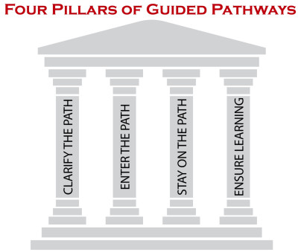
CLARIFYING THE PATH: Mapping paths to student end goals
ENTERING THE PATH: Intake and academic advising,
STAYING ON THE PATH: Intrusive academic advising and academic support
ENSURING LEARNING: Learning with intentional outcomes
HOLISTIC STUDENT SUPPORTS
EQUITY, SOCIAL MOBILITY, ECONOMIC HEALTH

Slide 10

HELPING STUDENTS CLARIFY THEIR PATHS
FYE & GUIDED PATHWAYS

Slide 11

“Know Thyself”

Slide 12

FYE Strategies for Clarifying Paths
High school outreach (pre-advising)
Help students develop an early understanding of onboarding processes and their purpose
Program maps to teach students about degree options, career paths, transfer options, and paths to completion
Mandatory pre-orientation and/or orientation for incoming students
Introduce academic, career, and social experiences, processes, and resources
Create an “academic identity”
12

Slide 13

FYE Strategies for Clarifying Paths
Non-cognitive and career assessments
Self-assessments and intake processes for students to identify their values, interests, and abilities
Assigned academic advisors
Provide all students with a point-person as they transition to the institution
Team approach to address ratios (faculty advisor, professional academic advisor, coach, career counselor)
13

Slide 14


HELPING STUDENTS GET ON THEIR PATHS
FYE & GUIDED PATHWAYS
14

Slide 15
“I always wanted to be somebody, but I should’ve been more specific.”
—Lily Tomlin

Slide 16

FYE Strategies for Entering Paths
Bridge K12 to Higher Education
Establish strong K12 and higher ed partnerships to assure early remediation in the final year of high school
Redesign traditional remediation as an accelerated route to programs of study to encourage early exploration of academic and career options (ex: math and English pathways)
16

Slide 17

Early Program Entry
CCRC’s research found a strong correlation between early program entry (passing three courses in a program area) and completion or transfer.
More than half who entered a program in their first year earned a credential or transferred within 5 years.
For those who did not enter a program until their third year, the success rate was around 20%
Students who earned at least 8 college credits in a program area within the first year were 20% more likely than those who did not to earn a credential or transfer within seven years.

Slide 18

FYE Strategies for Entering Paths
First-Year Experience Programs
Peer leaders, learning communities, co-curricular programs, applied learning experiences
First-Year Seminar
Holistic curriculum with academic, personal, career, and social learning outcomes
Aligned to degree plans or meta majors to enable students explore paths and determine fit
Include in a learning community
Educational planning assignments and activities
18

Slide 19

FYE Strategies for Entering Paths
Create On-Ramps to Meta Majors and Degree Plans
Integrate and contextualize instruction to build academic and nonacademic foundational skills and coursework in gateway courses
Continue integration and contextualization throughout the college-level curriculum
19

Slide 20

FYE Strategies for Entering Paths
Establish Transfer Pathways and Educate Students on these Opportunities
Optimize applicability of community college credits to university majors
Establish transfer agreements that create pathways and options for students to attain baccalaureate degrees
Start informing students of transfer opportunities during onboarding and in their first year
20

Slide 21


HELPING STUDENTS STAY ON THEIR PATHS
FYE & GUIDED PATHWAYS
21

Slide 22

Does your advising office look like this?

Slide 23

Academic Advising ≠ Registration

Slide 24

FYE Strategies for Staying on Paths
Strong intrusive and developmental advising processes
Case management
Embed academic advising into students’ pathway experience by connecting advising to the curriculum and institutional policies
Use appropriate technology to help students make informed choices and to clarify transfer and career opportunities at the end of their chosen college path
24

Slide 25

FYE Strategies for Staying on Paths
Ensure students develop an academic plan with predictable schedules
Utilize intake processes and embed academic and non-academic supports to promote persistence.
Use analytics to monitor students who are on and off track and intervene when needed
Utilize alerts and referrals
Review institutional policies and practices that may create obstacles for students
25

Slide 26


ENSURING STUDENTS ARE LEARNING
FYE & GUIDED PATHWAYS
26

Slide 27
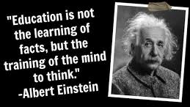

Slide 28

FYE Strategies to Ensure Learning
Curricular Approaches
Establish program-level learning outcomes aligned with the requirements for success in employment and further education in a given field
Align pathway courses and expected learning outcomes to ensure they provide foundational knowledge and skills
Apply the results of learning outcomes assessment to improve the effectiveness of teaching across programs and pathways
28

Slide 29

FYE Strategies to Ensure Learning
Co-curricular Approaches
Integrate service learning and other applied learning experiences to enhance instruction and career education in courses across programs of study
Complement classroom learning with out-of-classroom experiences that enrich student’s understanding of the curricula
29

Slide 30


Slide 31
Sample Academic Map
Middlesex Community College, Lowell, MA

Slide 32
References
Bailey, T. (2017). Guided Pathways at community colleges: From theory to practice. Diversity & Democracy, 20(4). AAC&U, p.2.
Bailey, T., Jaggars, S. S., & Jenkins, D. (2015). What we know about guided pathways. New York, NY: Columbia University, Teachers College, Community College Research Center.
Cuseo, J.B., Thompson, A., Campagna, M., & Fecas, V. (2016). Thriving in College and Beyond: Research-Based Strategies for Academic Success and Personal Development. Kendall Hunt, Dubuque:IA.
Jenkins, D., & Cho, S. W. (2012). Get with the program: Accelerating community college students’ entry into and completion of programs of study (CCRC Working Paper No. 32). New York, NY: CCRC.
Jenkins, D., & Cho, S. W. (2014). Get with the program… and finish it: Building guided pathways to accelerate student completion (CCRC Working Paper No. 66). New York, NY: Columbia University, Teachers College, Community College Research Center.
Jenkins, D., & Weiss, M. J. (2011). Charting pathways to completion for low-income community college students (CCRC Working Paper No. 34). New York, NY: CCRC.

Slide 33
References
Kopko, E.M., Ramos, M., Karp, M., Mechur, J. (2018). Why do some community college students use institutional resources differently than others in program selection and planning? (CCRC Working Paper No. 101). New York, NY: Columbia University, Teachers College, Community College Research Center.
Shapiro, D., Dundar, A., Huie, F., Wakhungu, P.K., Yuan, X., Nathan, A. & Bhimdiwali, A. (2017, December). Completing College: A National View of Student Completion Rates – Fall 2011 Cohort (Signature Report No. 14). Herndon, VA: National Student Clearinghouse Research Center.
Wergin, J. (2006). Forward. In L. A. Braskamp, L. C. Trautvetter, & K. Ward (Eds.), Putting students first: How colleges develop students purposefully (pp.1-18). San Francisco, CA: Jossey Bass.

Slide 34



THANK YOU
Dr. Michele Campagna
Michele.Campagna@sunywcc.edu

