Slide 1
The Business of Starting a Teaching & Learning Center
…or revitalizing an established center

Slide 2
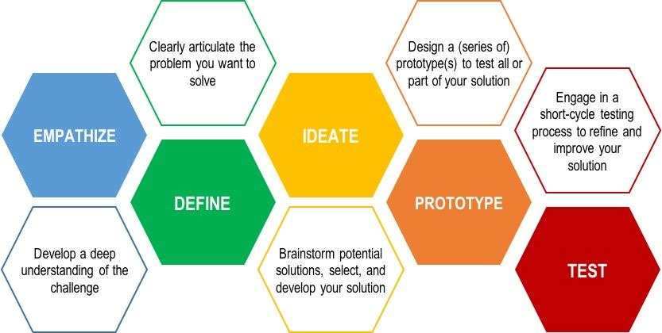
Design Thinking Approach
Using the Stanford Model for Design Thinking we will create a roadmap for our work in a Teaching & Learning Center.
REFLECT

Slide 3
Finding Out
What are the challenges and the needs of your campus community?

Slide 4
What are some ways we can “find out”?
Every campus and group of “customers” has a culture…with needs, shortcomings, strengths and passions. Tap into them all to understand the work to be done!
?
Market Research…
History
Context
Trends
Shared Experience
Interactions/Interviews/ Focus Groups
Intentional
Unintentional
Visits/Observations
Questionnaires/ Surveys
Your Gut
Group Ideas….
EMPATHIZE

Slide 5
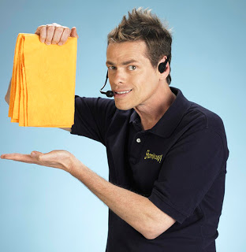
Define
Articulate the problems you want to solve, needs you could meet and the opportunities you want to offer.

Slide 6
What are some of the problems, needs, opportunities?
?
Every winning “product” has solved a problem, met a need, or encouraged you to take advantage of an opportunity! What issue(s) will be your focus?
Problems…
Time
Space
Silos
Needs…
Training
Technology
Organization
Resources
Opportunities…
Trends
Passion
Group Ideas….
DEFINE

Slide 7
Take a Number!
Organize your ideas into a chart or charts creating a structure to prioritize from.
Bring chaos to conception.
P/N/O | Audience | Ideas | Roadblocks | Resources | Framework | Time | Promotion | Benefit | Assessment | Now What

Slide 8
Now what?
Brainstorm potential solutions, select and develop opportunities.

Slide 9
What can we do…possibilities…
IDEATE
Once you have a handle on the problems, needs and opportunities you are ready to start brainstorming products to meet market needs!
?
Potential ideas…
Programs
Working Sessions
Better Communication Tools
Partners
Participate in Department Projects / Committees
Turn Roadblocks into Hurdles
Offer Incentives
Create Pathways
Brainstorming & Teamwork
Safe Space
Mutual Respect
Assigned Tasks
Deliverables
Group Ideas….

Slide 10
30 Circles

Slide 11
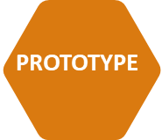
Design
Create a program, event or opportunity for your audience.

Slide 12
What are some “products” we could roll out?
Planning to meet the needs, solve the problems and create opportunities has led you to this…
?
The stuff…
Programs
Tech Talks
Diversity
Leadership
Pedagogy
Healthy U
Open Hall
Services
Working Groups
Reading
OER
The Buzz
Get the word out
Quick
Fun
Group Ideas….
PROTOTYPE

Slide 13
Put it out there…
TEST
Hold some events, workshops, offer programs, services, space, resources.

Slide 14
Experiment with programming…
?
Put it out there and see, hear, and feel the response…
The thing is…
Promotion
Flyers
Personal Invites
Campus News
Guerrilla Marketing
Packaging
Descriptions & Info
Time
Space
Benefits
Demo Day
Quality
Relevance
Tracking
Group Ideas….

Slide 15
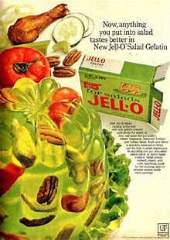
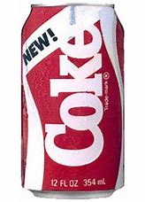
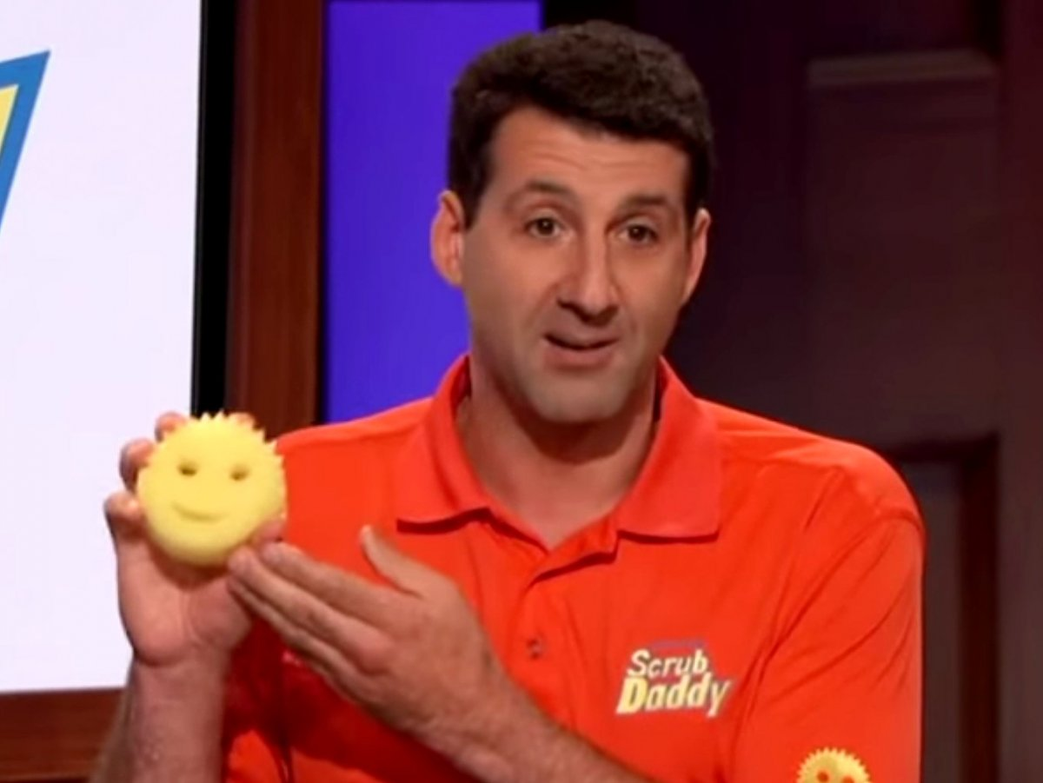
Products that Tanked & Stanked!

Slide 16
Make Improvements
REFLECT
Reflect ways to improve experiences, protocols and possibilities.

Slide 17
Reflection
?
What worked? What didn’t work? Now what?
Now What?
If you built it did they come?
REFLECT
Back to the drawing board
Rework
Reframe
Table
Expand
Capture momentum
Celebrate
Why did they attend?
Good Content
Right Time
Incentives
Mandatory
Supported
Can you find out why they didn’t attend?
Right content/Wrong Time
Past Bias
Poorly Communicated
Not Mandatory
Not Relevant
Not Supported (peers, boss or management)
“Politics”

Slide 18
Business Minded Considerations
Think like a company when targeting your audience with your “products”.

Slide 19
Take it from big and small business…
IDEATE
Use business examples to guide your process.
Have a …
Business Plan
Vision/ Mission/ Goals
Elevator Speech / Slogan
Systems
Assessment Plan
Enlist Partners (You need a power player & an influencer)
Marketing Plan
Getting the Word Out/ Communication is King
Create a Buzz
Know your Target Audience
Launch Plan
Roll-out
Build Value
Reboot…revisit the above items…
Group Ideas…
?

Slide 20
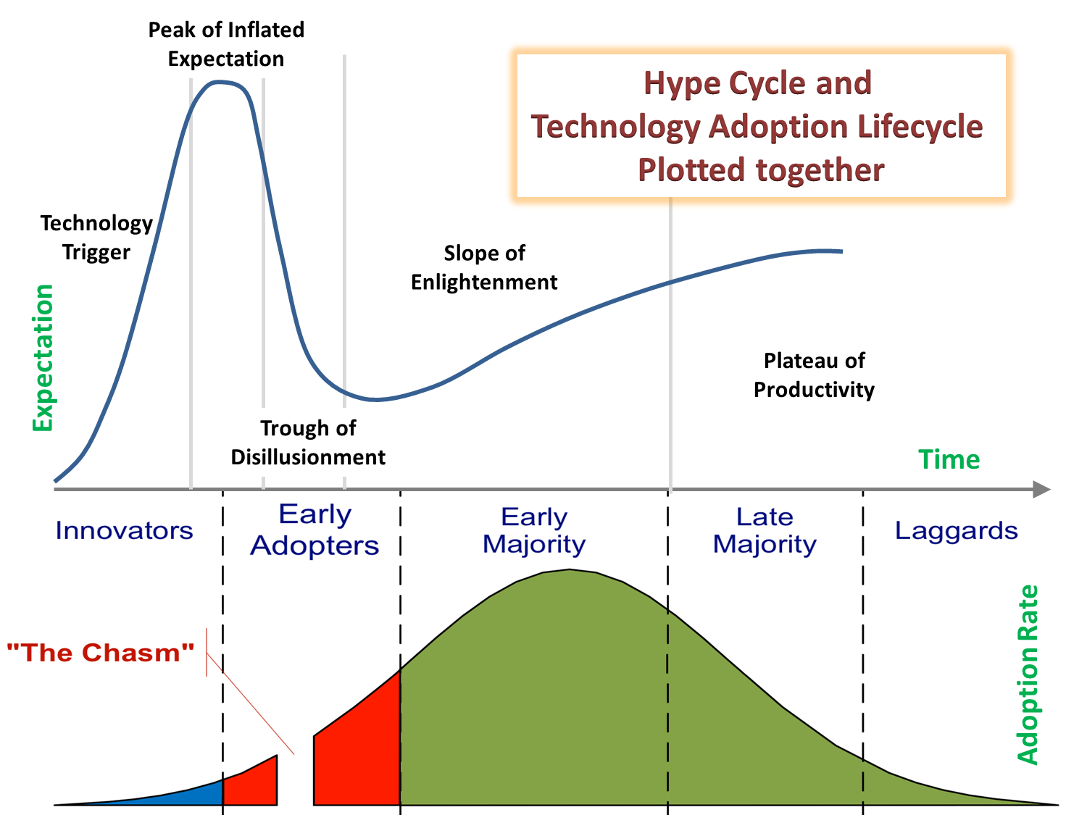
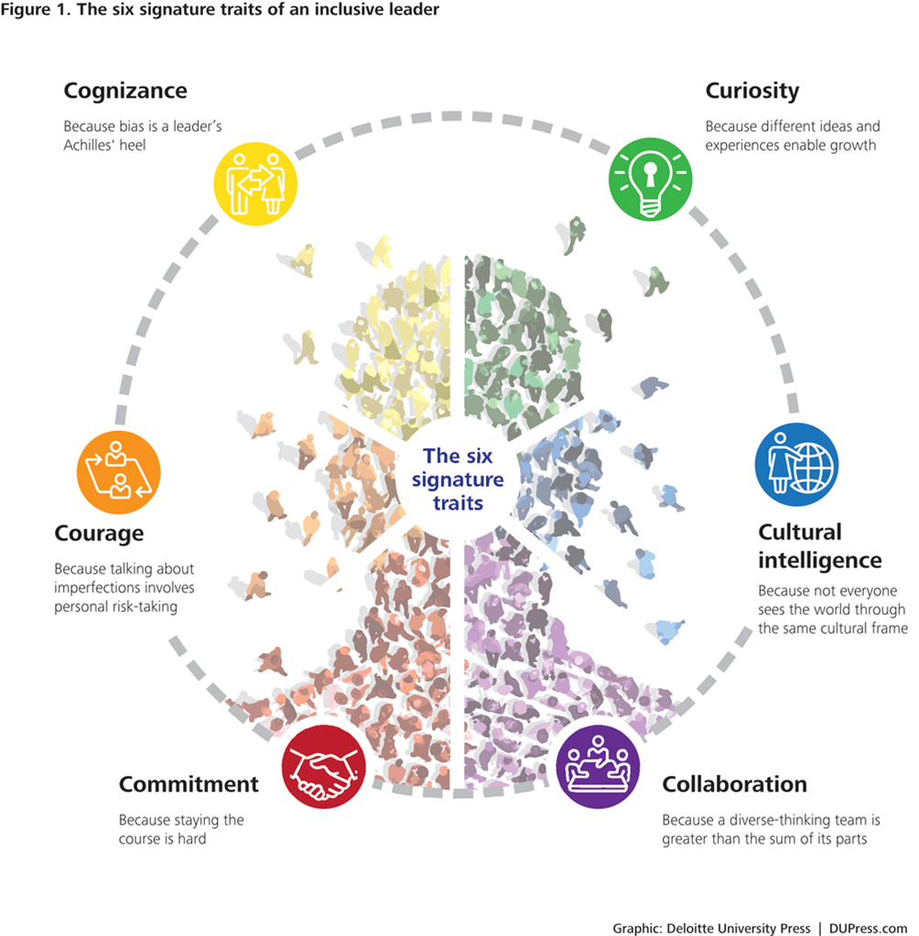
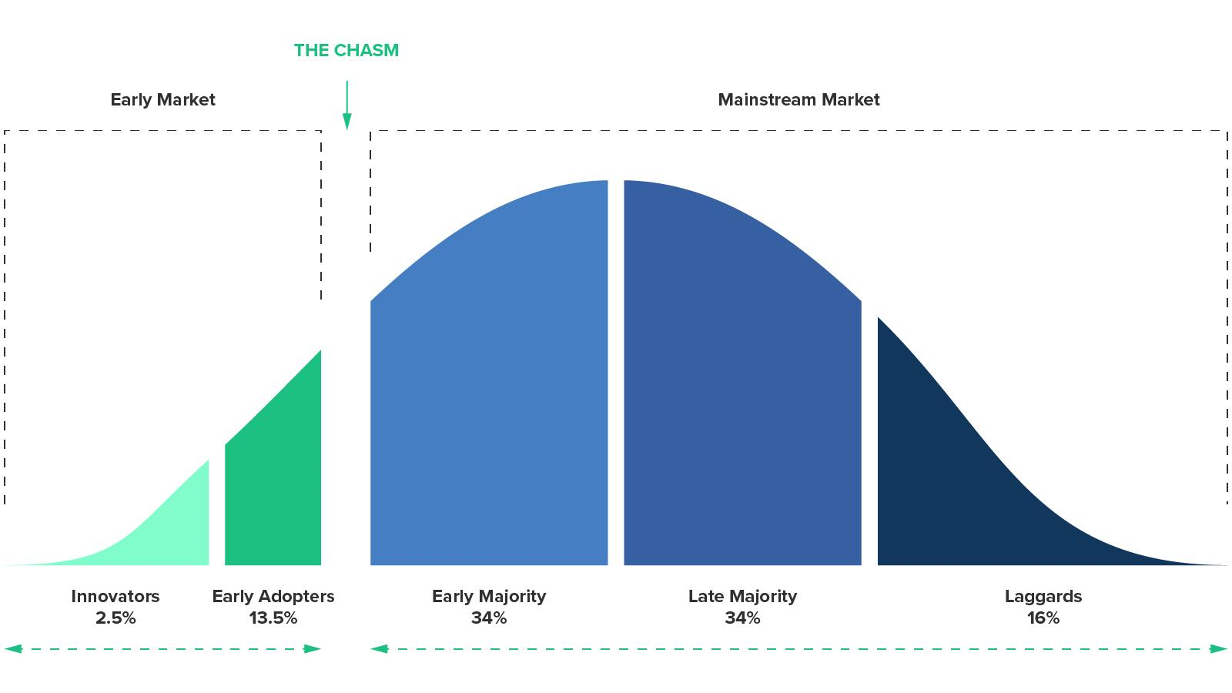
Business Models to Utilize
Stanford’s Design Thinking Model
Hype Cycle
Inclusive Leadership Traits
Creative on the cheap strategies to get your message out.
Roger’s Innovation Adoption Theory
Positivity, Authenticity & Story Telling

Slide 21
Thank You
Abigail Brannen-Wilson
607.746.4531
branneab@delhi.edu
“Start where you are. Use what you have. Do what you can.”
-Arthur Ashe
www.sunydelhi.edu

Slide 22
Resources
Stanford design thinking model. (2010).
Burnett, B. (n.d.). bill burnett design thinking method not magic video [Video file]. Retrieved from https://www.bing.com/videos/search?q=bill+burnett+design+thinking+method+not+magic&view=detail&mid=41900F68C3950972D6C841900F68C3950972D6C8&FORM=VIRE In‑text: (Burnett, 2016.)
Plattner, H. (n.d.). Bootcamp bootleg. Retrieved from http://creativecommons.org/licenses/by-nc-sa/3.0
Mcmurtrie, B. (n.d.). The hope the hype of the academic innovation center. Chronicle of Higher Education.
Bourke, J., & Dillon, B. (2016). The Six Signature Traits of Inclusive Leadership. Thriving in a Diverse New World. Deloitte University Press, 1-17.
SCHNEIDER ASSOCIATES & SENTIENT DECISION SCIENCE Most Memorable product launch report. (2017).
Stewart, C. (2014). Transforming Professional Development to Professional Learning. Journal of Adult Education, 43(1), 28-31.
Hype and technology adoption model. (1995).
Rogers theory of adoption. (2017). Retrieved from https://www.cblohm.com/wp-content/uploads/2017/11/AdoptionCurve.jpg

