Slide 1
Using a SUNY PIF Grant to establish an Applied Learning Program
Toby J. White
Director, Experiential Education
Lougheed Center for Applied Learning
SUNY Potsdam

Slide 2
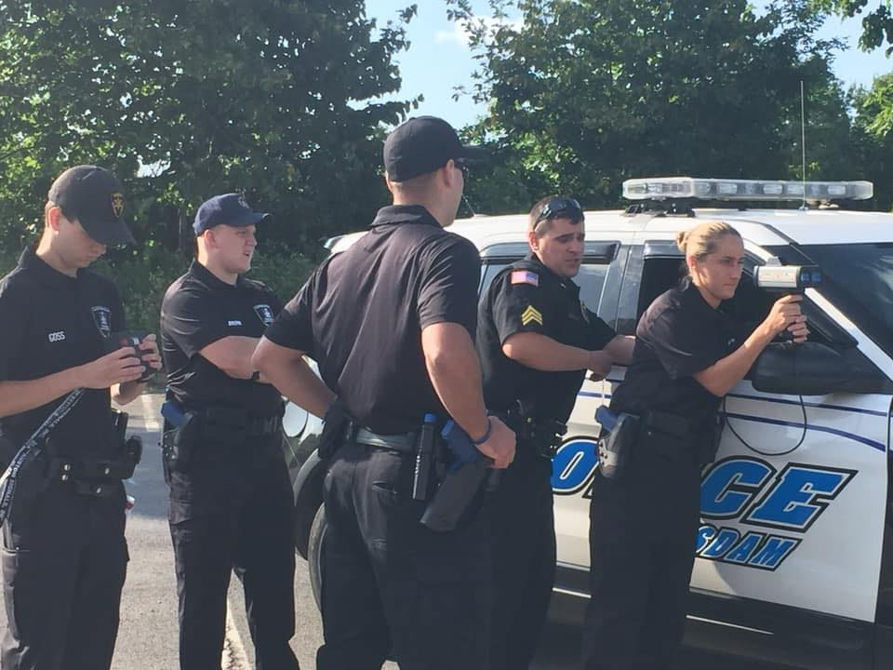
Need the program idea!
Student internship at SUNY Canton (2)
Director, Albert “Sonny” Duquette left his position as the Director of their Police Academy
Approached me with new idea! (Out of the box thinking)
Right time and right place

Slide 3
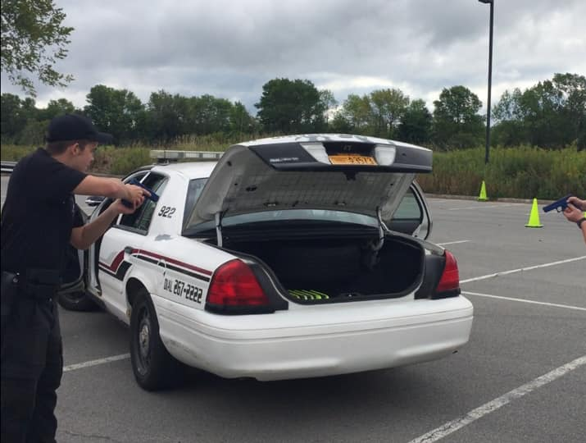
Administration Buy-In!
From the start, we had our Senior Administration on board
Needed FT line to start the program
Sponsor agency (SUNY Potsdam UP)
Find your space on campus
NYS DCJS was on board with our new idea

Slide 4
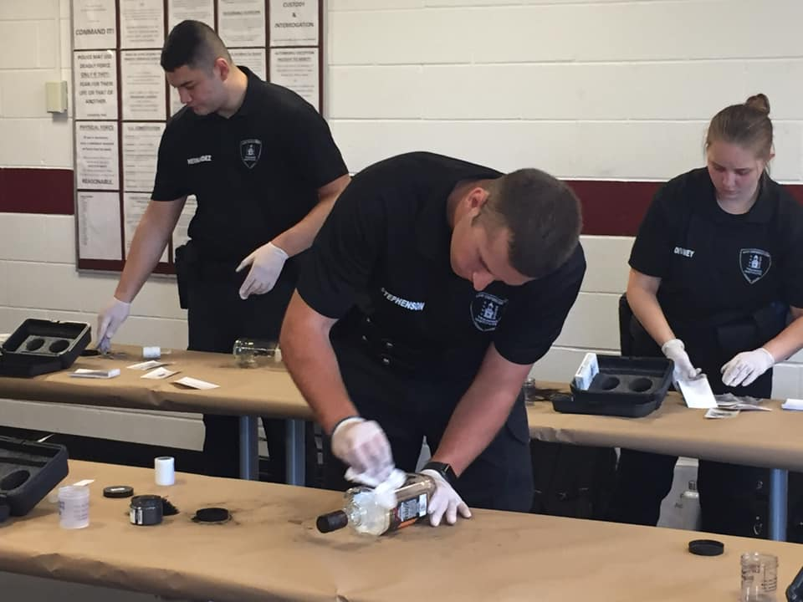
”SHOW ME THE MONEY”
SUNY PIF Grant: $750,000
Alumni Funding:
$5.25 Million Lougheed
$2.0 Million Dorf
Employer Funding?
College funding?

Slide 5
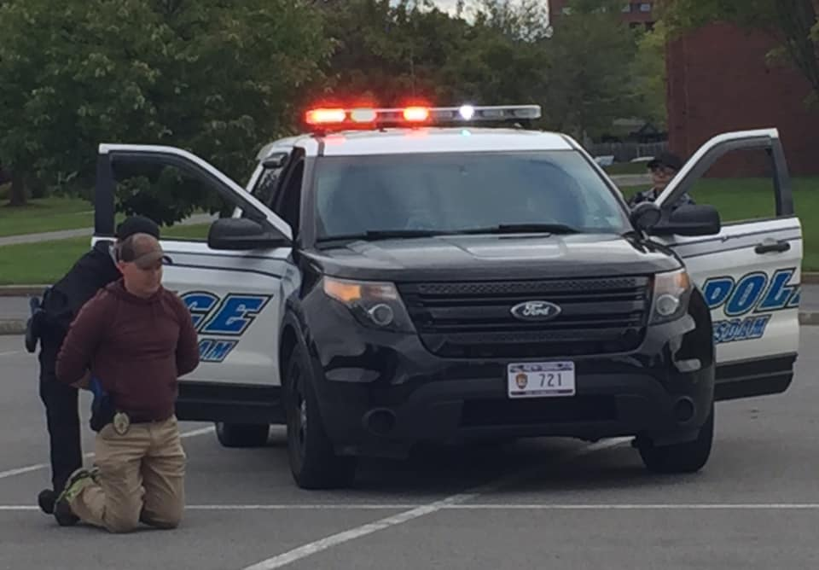
Start Up Funding!
$50,000 Start up supplies
$40,000 Shoot-Don’t Shoot Simulator
$38,000 Stress Vests
$2,000 CJ Transfer Visit
$16,000 LETI Summer Seminar
2-credits (BOCES Juniors)
Total: $146,000

Slide 6
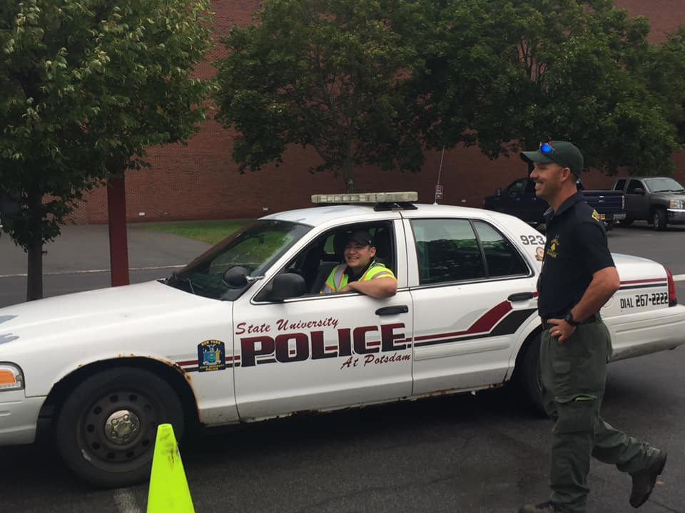
Budget/ Sustainability
$600 Mandatory fee per student
$4,000 Hired Officer (Not in our net-work)
Average budget: $7,800 per semester
FT Instructor: $36,000 per year
Total Budget: $43,800
Need 5 new CJ majors to cover FT Line!

Slide 7
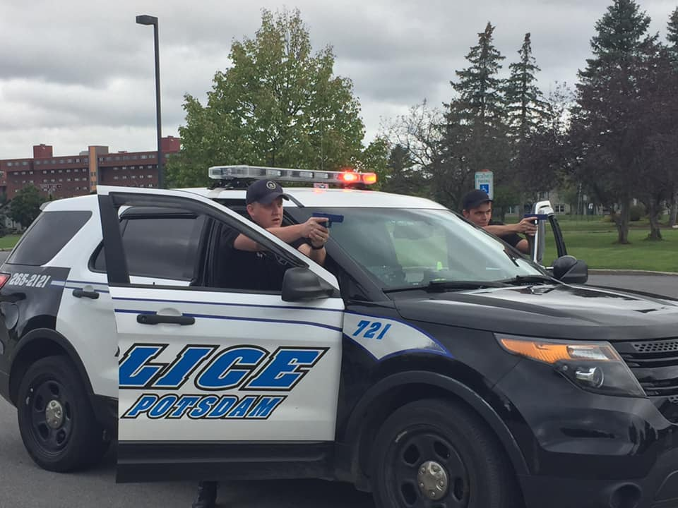
Recruitment Retention Assessment
Fall and Spring Admission Open Houses
BOCES CJ Programs in the North Country
Local community colleges
Qualtrics assessment given to each student at the end of the LETI
Wall of Fame
Wall of Fame

Slide 8
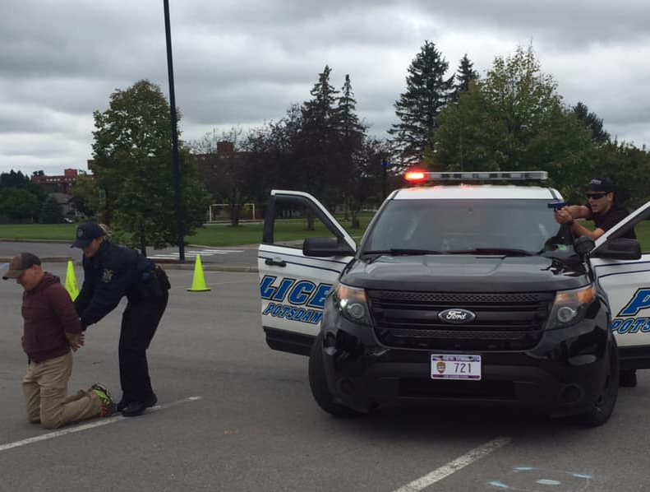
Applied Learning Pedagogy
12-credit Internship SOCI 470 @ 6 and INTD 491 @ 6 PE @ 2 credits
Moodle Journal Entries
Leadership Development Portfolio
Leadership Development White Paper
Career Experiences and Objectives
Résumé
Leadership Statement
5 Min White Paper Presentation at the end of the semester!

Slide 9
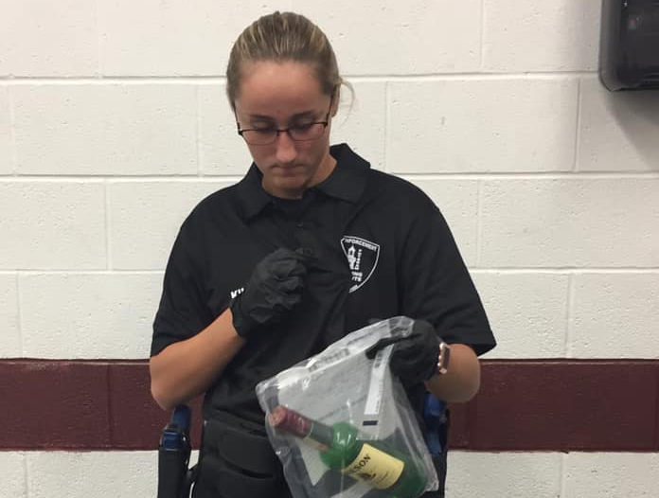
Stakeholders/ Campus Partners
LETI Advisory Board
SUNY UP
Maxcy Hall Staff
PACES Staff
Several Local Police Agencies (Our network)
Community Colleges
BOCES

Slide 10
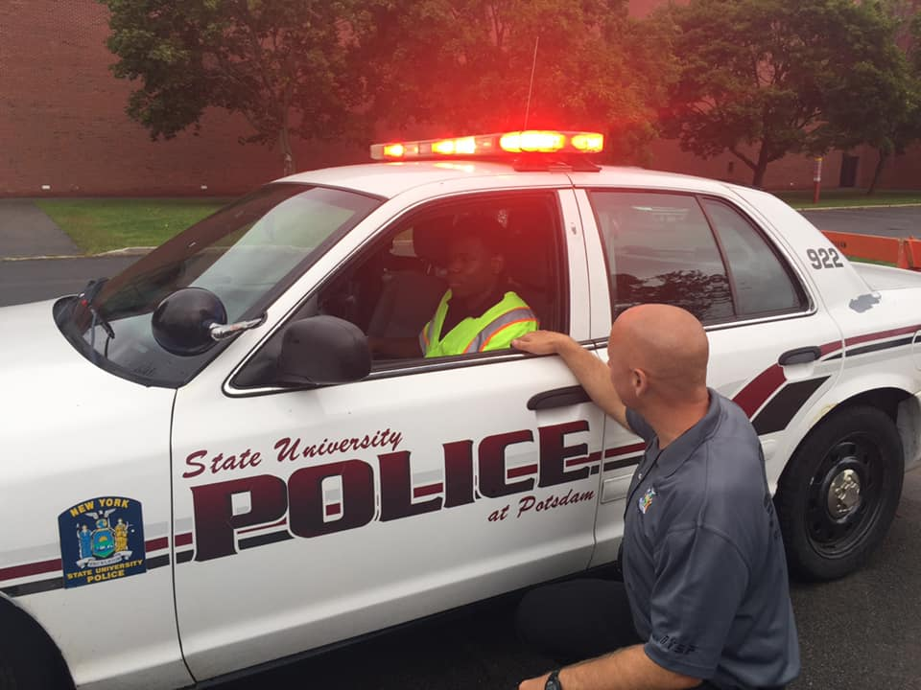
IDEAS!
H&R Block
Campus Bank
Laboratory training facility with a local hospital
AP creation center
At Risk Youth Center on Campus
Audience participation!!!!

Slide 11
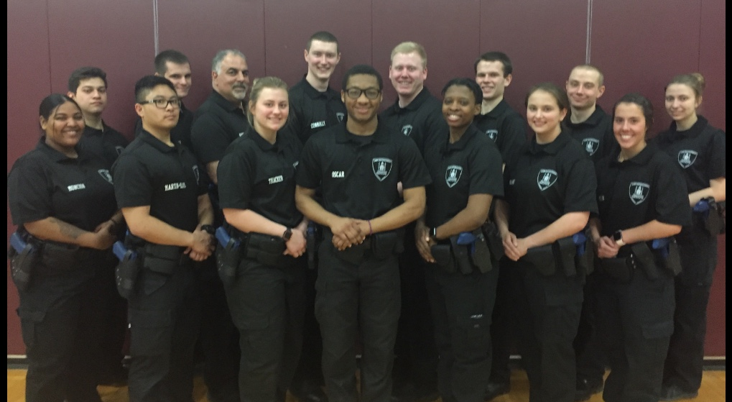
ANY QUESTIONS?

