Slide 1
Training Agenda:(content is the same for each training session)
Audio and Video setup
Zoom Webinar Roles
Design Considerations
Sharing content
Chat
Participant List
Q&A
cpdinfo@suny.edu u
www.cpd.suny.edu u

Slide 2
Audio and Video Setup
cpdinfo@suny.edu u
www.cpd.suny.edu u
Notes:
For the information session the webcam video has been turned off for panelists.
Info on Dual monitors - https://support.zoom.us/hc/en-us/articles/201362583-Using-Dual-Monitors-with-the-Zoom-Desktop-Client

Slide 3
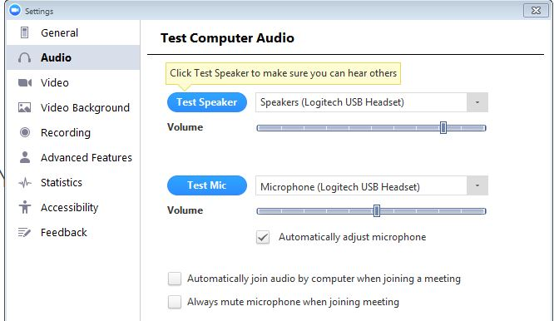
Adjust Audio and Video Settings
cpdinfo@suny.edu u
www.cpd.suny.edu u
Notes:
For the information session the webcam video has been turned off for panelists.
Info on Dual monitors - https://support.zoom.us/hc/en-us/articles/201362583-Using-Dual-Monitors-with-the-Zoom-Desktop-Client

Slide 4
Zoom Webinar Roles
 | Host | Co-host | Panelist | Attendee
Start Webinar
Mute/Unmute
Start/Stop own Video |  |  | *
View Attendee List
Share Screen
Chat |  |  |  | *
View All Q&A + Responds
Ask questions in Q&A
Create/Start/End Polls |  | *
Answer Polls |  |  | *
Raise Hand
cpdinfo@suny.edu u
www.cpd.suny.edu u
Notes:
Features with an asterisk (*) can be disable by the host.
Co-hosts cannot be assigned ahead of time. If you would like to designate someone as a co-host, invite them to the webinar as a panelist and then promote them to a co-host. Alternatively, you can assign them as an alternative host.

Slide 5
Webinar Recommendations
Google Chrome
USB Headset
Keep slides simple, colors, graphics, no animation or transitions
Keep ADA in mind when you are creating your content (Accessible PowerPoint Slides)
Arrive at least 20 minutes early for your info session
Close all other open programs or windows on your machine
Turn off your e-mail and phone ringer
Clear other distractions away from your work area
Notify co-workers/colleagues/family members that you are in a web session
cpdinfo@suny.edu u
www.cpd.suny.edu u
Notes:
https://support.microsoft.com/en-us/office/make-your-powerpoint-presentations-accessible-to-people-with-disabilities-6f7772b2-2f33-4bd2-8ca7-dae3b2b3ef25?ui=en-us&rs=en-us&ad=us

Slide 6
Share Content
cpdinfo@suny.edu u
www.cpd.suny.edu u
Notes:
https://www.youtube.com/watch?v=YA6SGQlVmcA&feature=youtu.be
Article share - https://support.zoom.us/hc/en-us/articles/201362153
Article Share PPT - https://support.zoom.us/hc/en-us/articles/203395347-Screen-Sharing-a-PowerPoint-Presentation

Slide 7
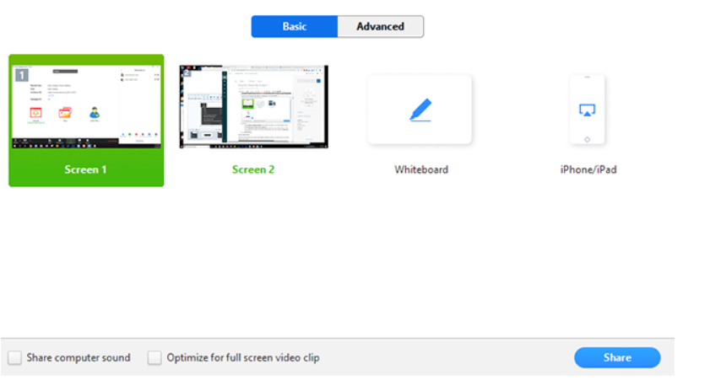
Sharing your screen
cpdinfo@suny.edu u
www.cpd.suny.edu u
Notes:
Zoom will automatically switch to full screen to optimize the shared screen view. To exit full-screen, click Exit Full Screen in the top-right corner or press the Esc key.

Slide 8
Sharing your screen
cpdinfo@suny.edu u
www.cpd.suny.edu u
Notes:
When you start sharing your screen, the meeting controls will move into a menu that you can drag around your screen.

Slide 9
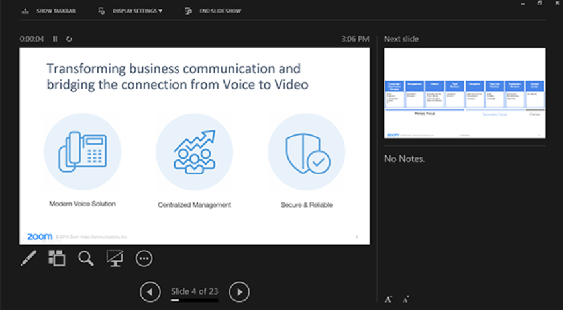
Sharing your screen
cpdinfo@suny.edu u
www.cpd.suny.edu u
Notes:
participants will see the PowerPoint in slide view. The green border indicates the monitor you are currently sharing.
While sharing your screen, switch PowerPoint to slide show mode by clicking the Slide Show tab > From Beginning or From Current Slide.
If you have dual monitor, the presenter's view will appear on your secondary monitor. Use this to view your slide notes and control the presentation.
https://support.zoom.us/hc/en-us/articles/203395347-Screen-Sharing-a-PowerPoint-Presentation

Slide 10
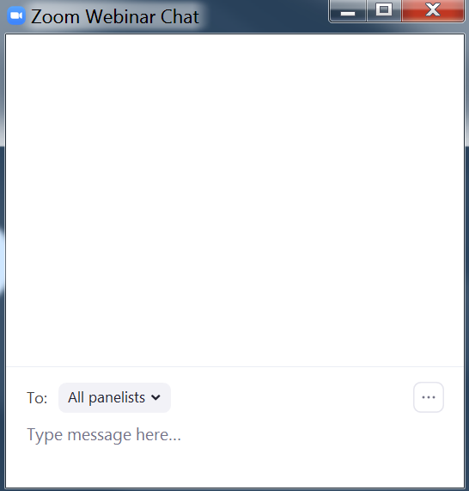
Chat
cpdinfo@suny.edu u
www.cpd.suny.edu u
Notes:
We have the option of only allowing chats to go to panelists or we can set it to allow all attendees and panelists to see chat. For the purpose of the information session only panelists will see the messages in chat.

Slide 11
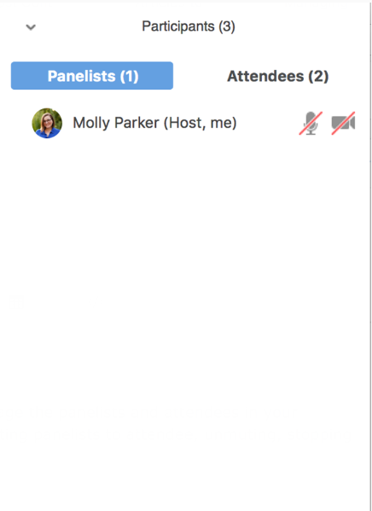
Participants List
cpdinfo@suny.edu u
www.cpd.suny.edu u

Slide 12
Managing Q&A during a webinar
Find the question you would like to answer
cpdinfo@suny.edu u
www.cpd.suny.edu u
Notes:
On hosts and panelists can see the questions being asked in the Q&A. We are doing this for privacy purposes

Slide 13
Questions?
cpdinfo@suny.edu u
www.cpd.suny.edu u
Notes:
On hosts and panelists can see the questions being asked in the Q&A. We are doing this for privacy purposes

