Slide 1
Drones for Teaching: Taking Fieldwork to a (Literally) Higher Level
Keith Landa, Purchase College SUNY

Slide 2
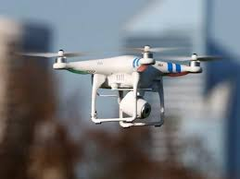
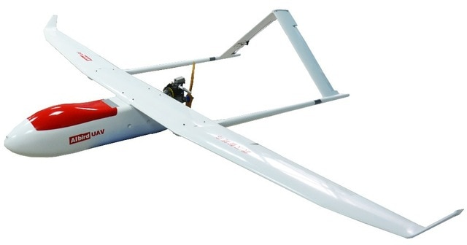
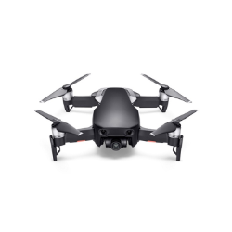
Expanding availability of drones (UAVs, UASs)
“Hot” consumer item in recent years
Decreasing price
Increasing capabilities
Cameras and other sensors

Slide 3
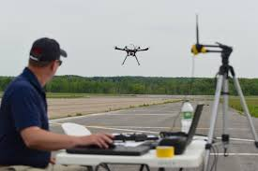
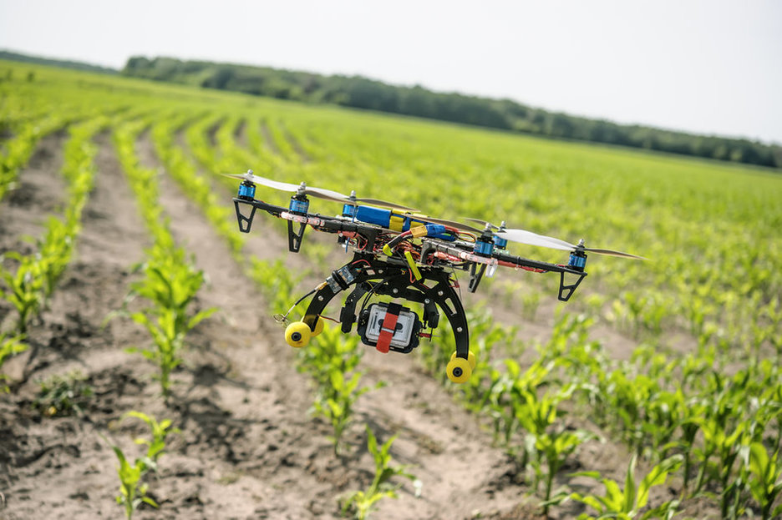
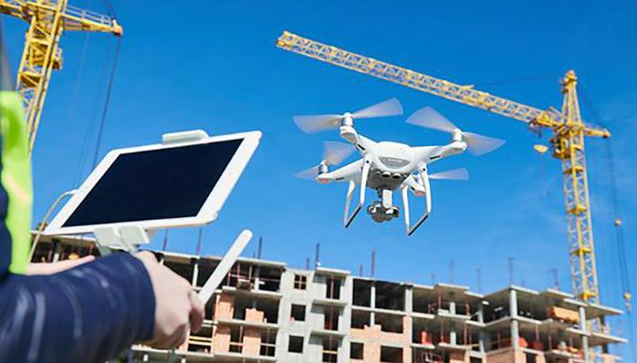
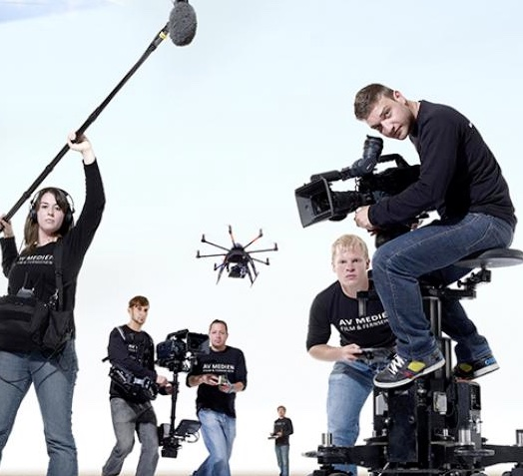
Educational uses of drones
Aeronautics
Robotics
Coding
Civil engineering
Construction
Campus facilities
Agriculture
Archeology
Wildlife ecology
GIS
Geology
Filmmaking
Dance
Theater

Slide 4
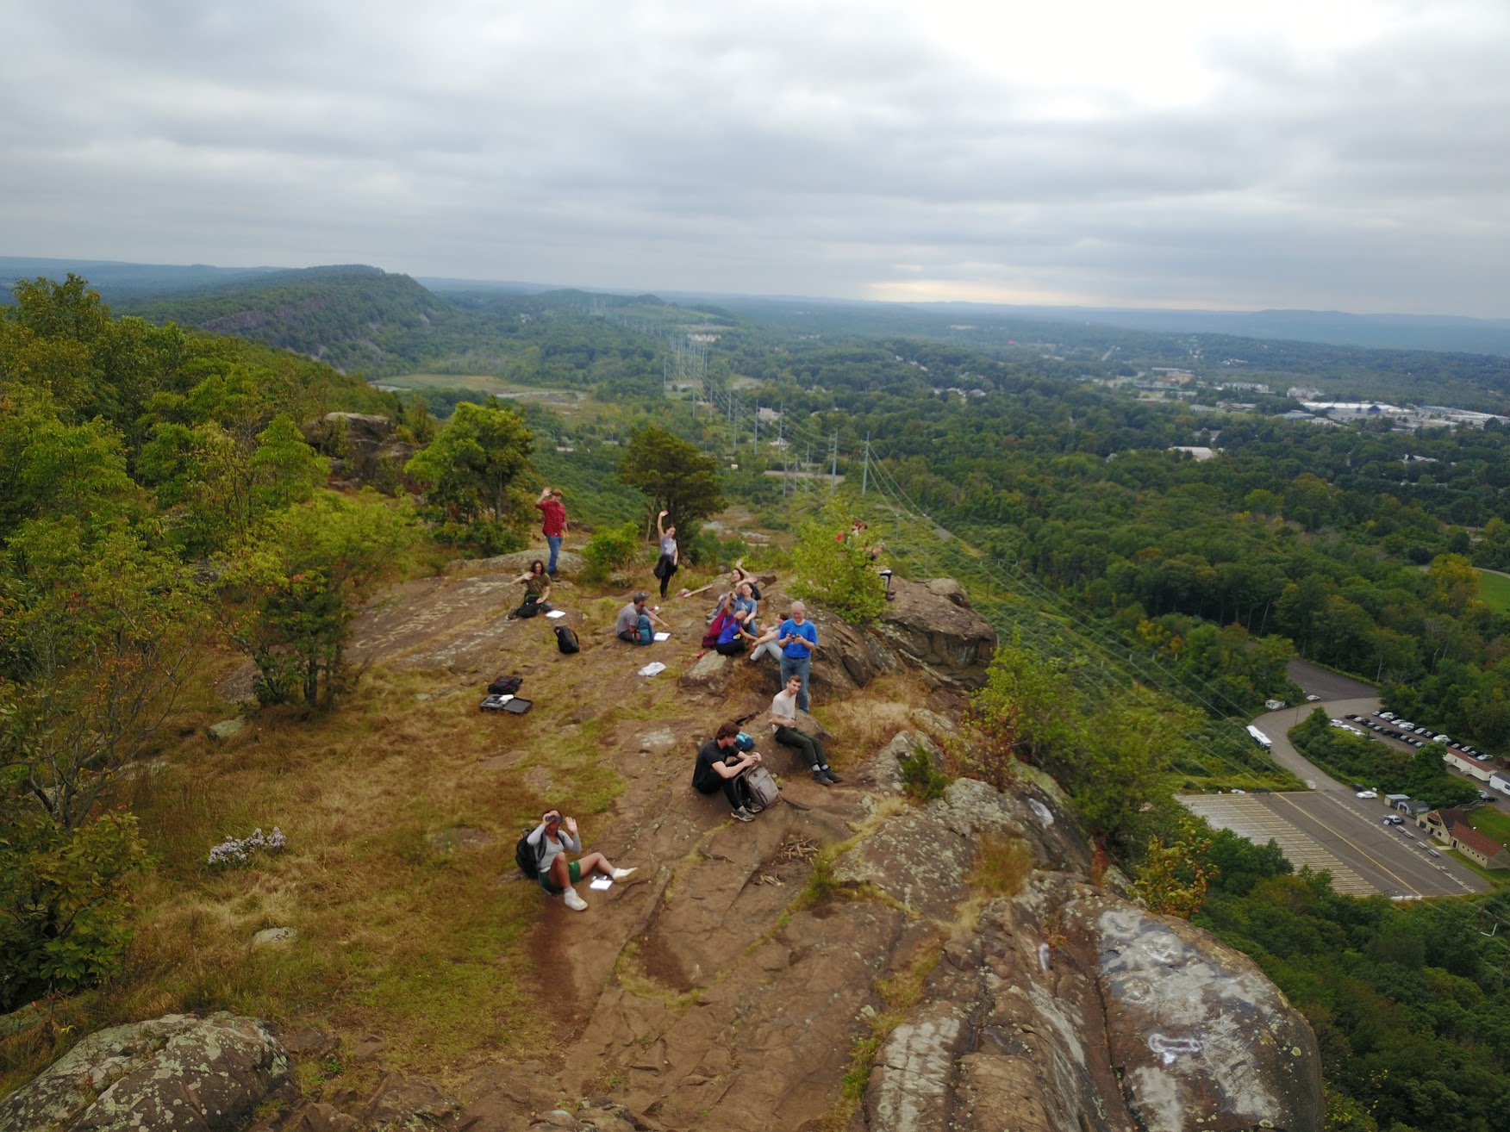
ENV 2720 Geology
“Sophomore-level”
ENV majors
Fall 2016
Lecture / lab course
Field component important
How to use drones to support fieldwork?

Slide 5
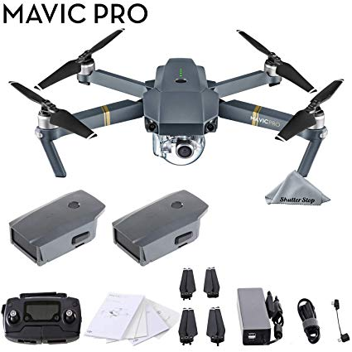
The drone we’ve been using
Quadcopter
Gimbal-mounted camera
Controller
Battery packs
Flight times

Slide 6
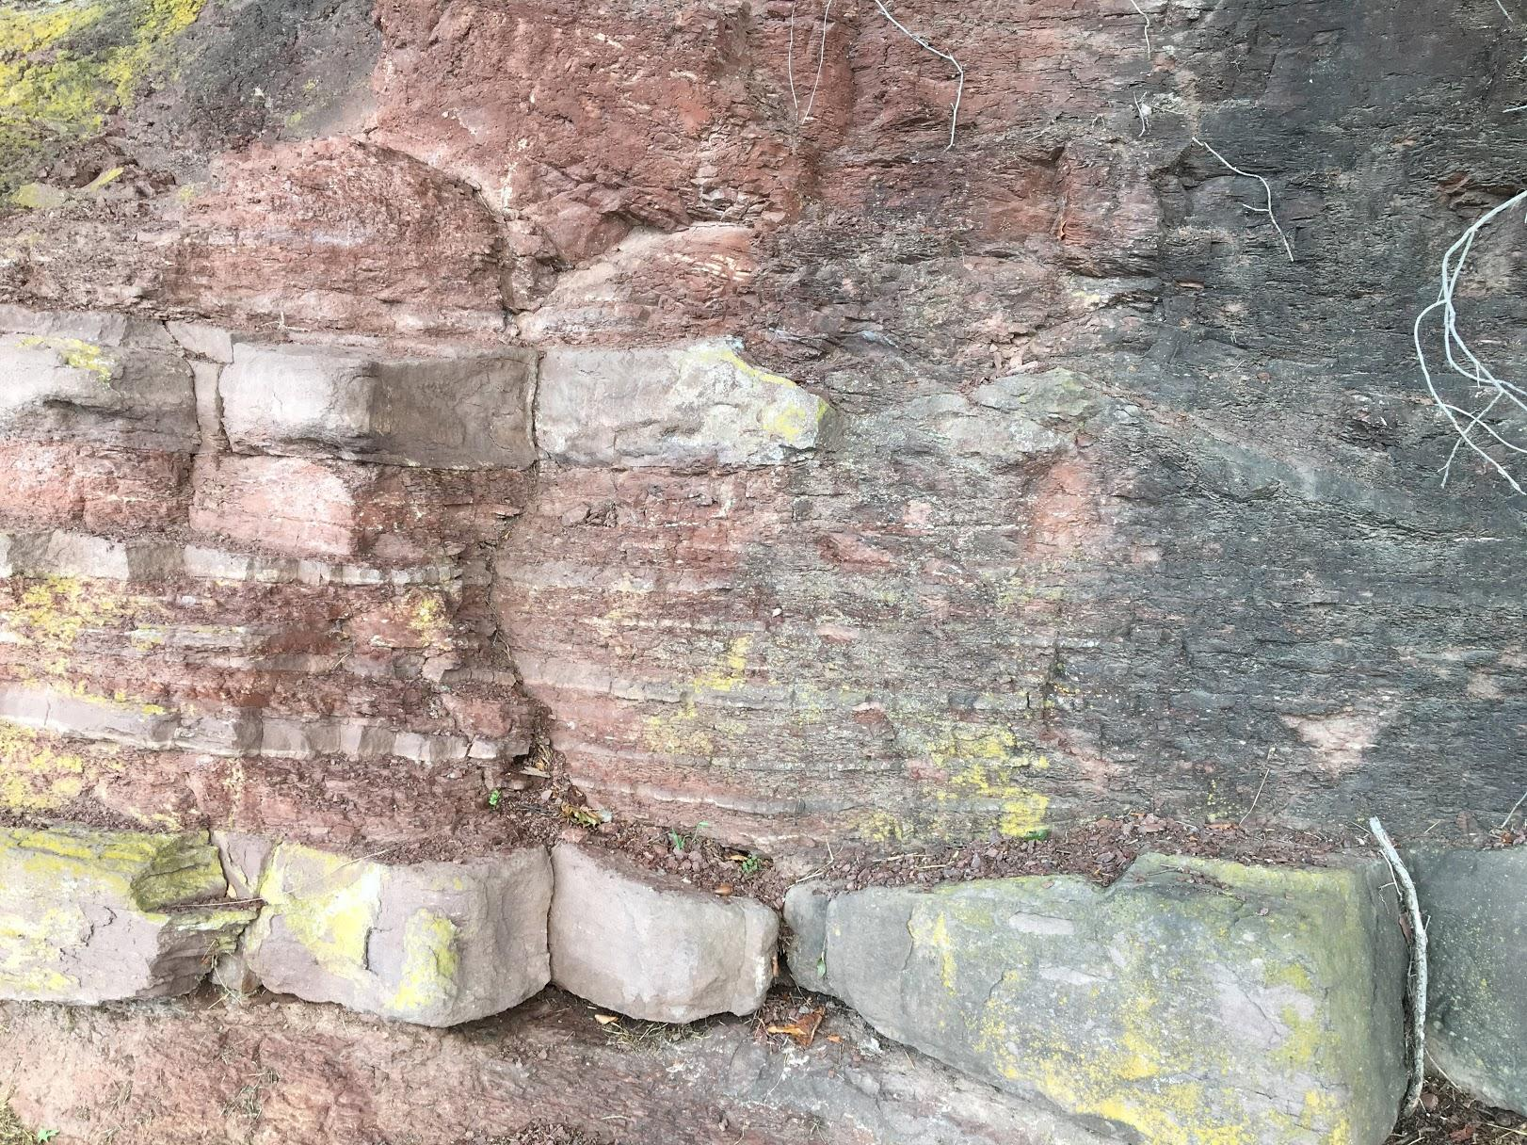
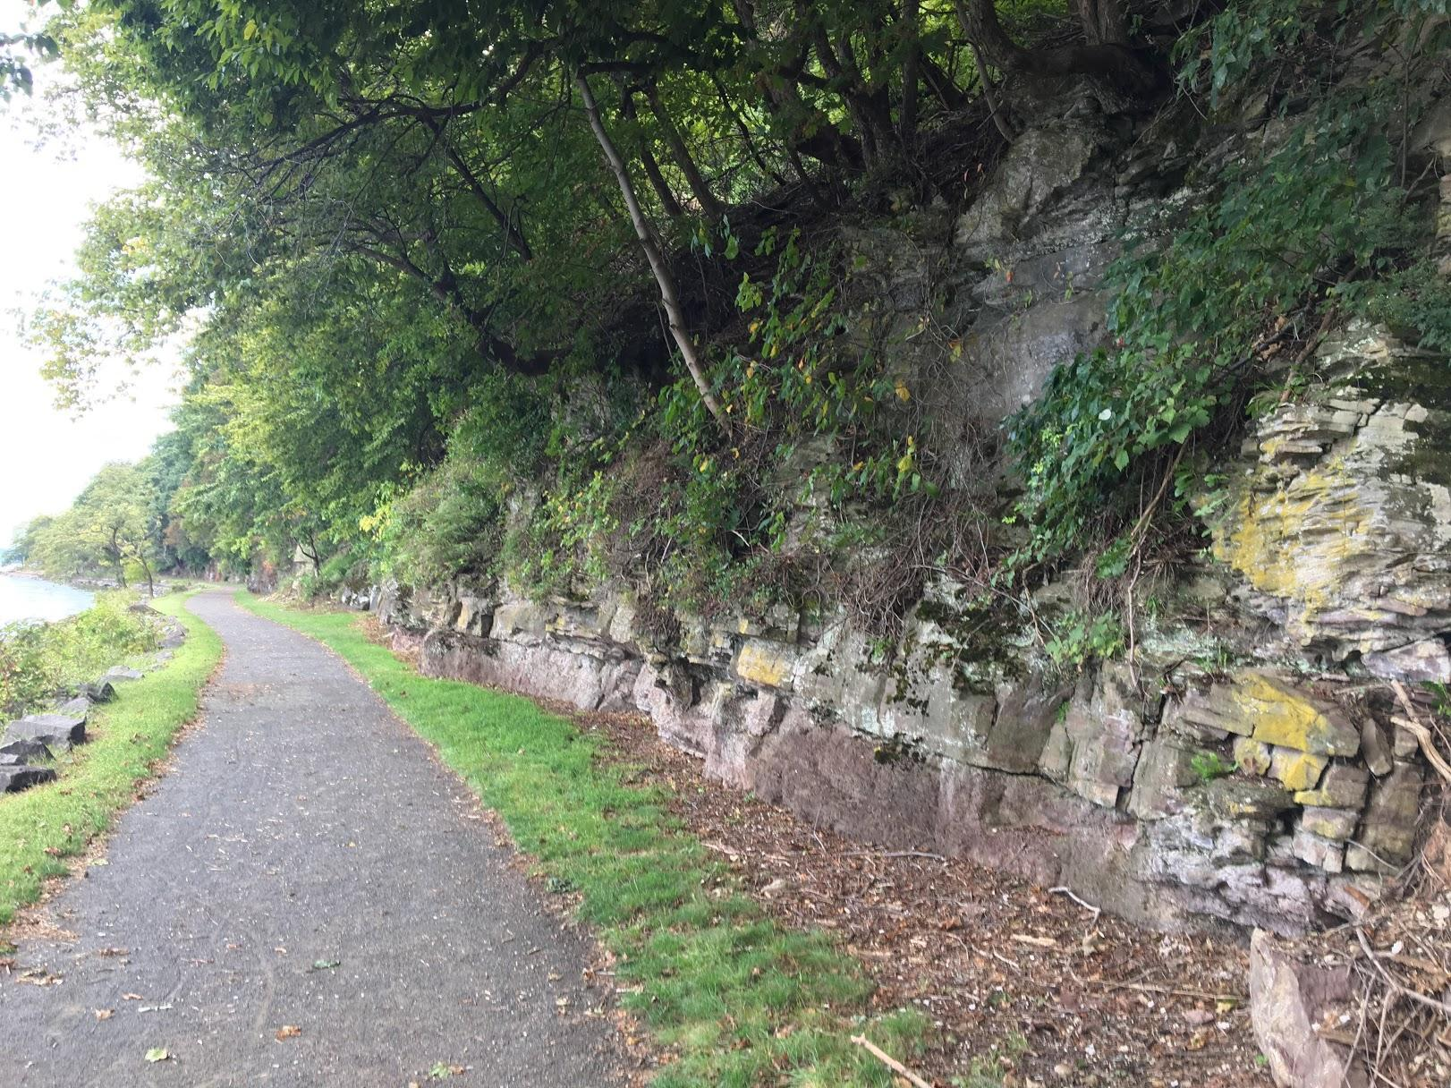
Field study of formations and landforms

Slide 7
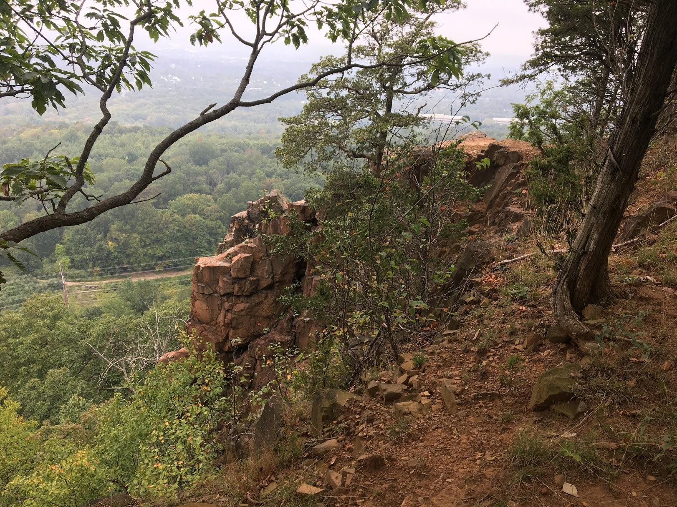
Accessibility issues

Slide 8
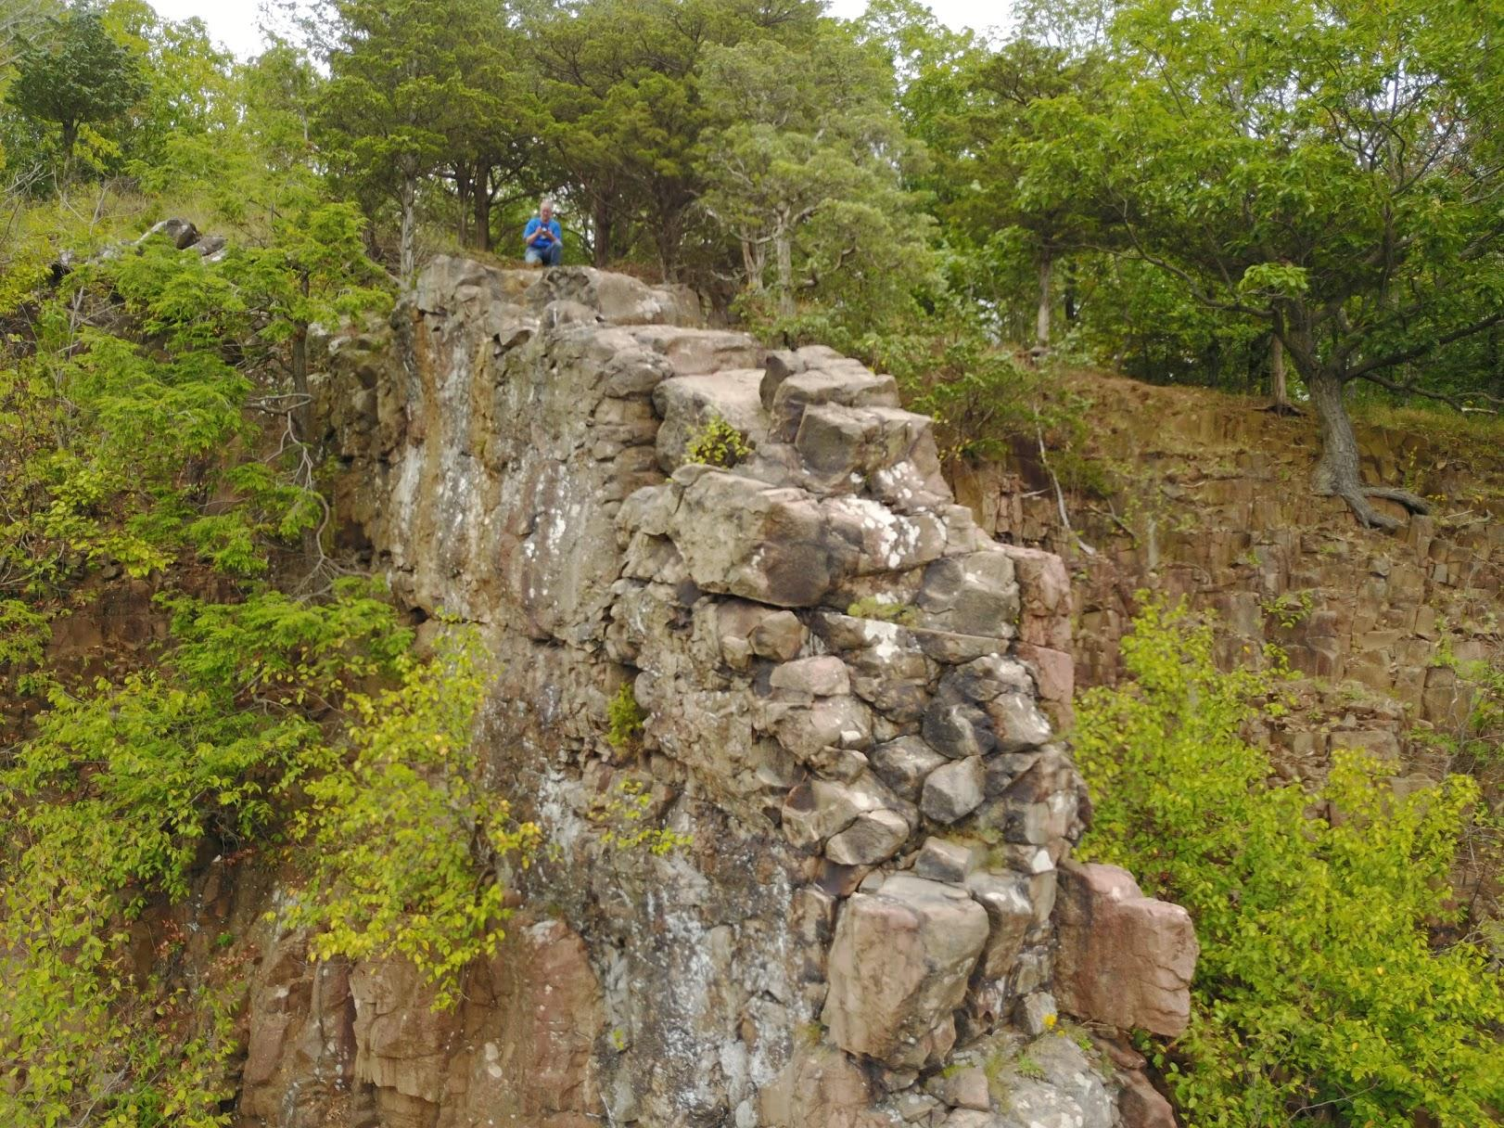
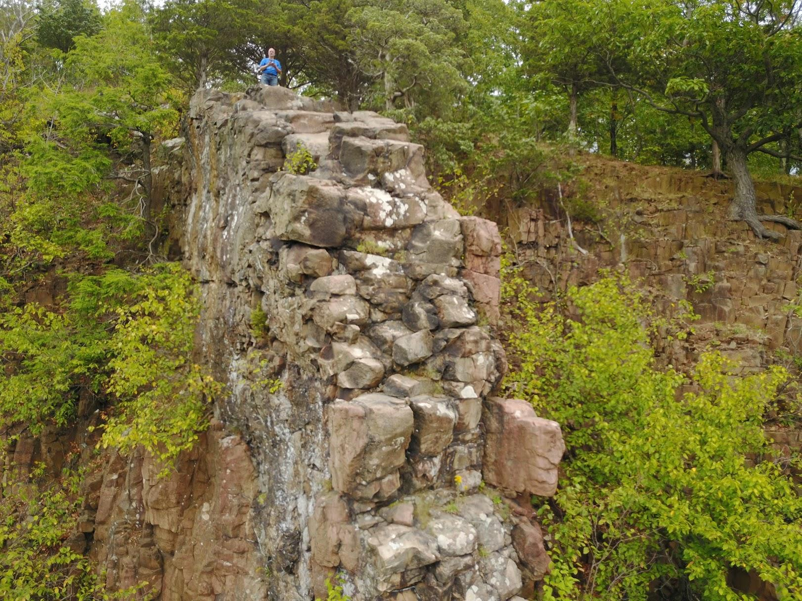
Unique perspectives

Slide 9
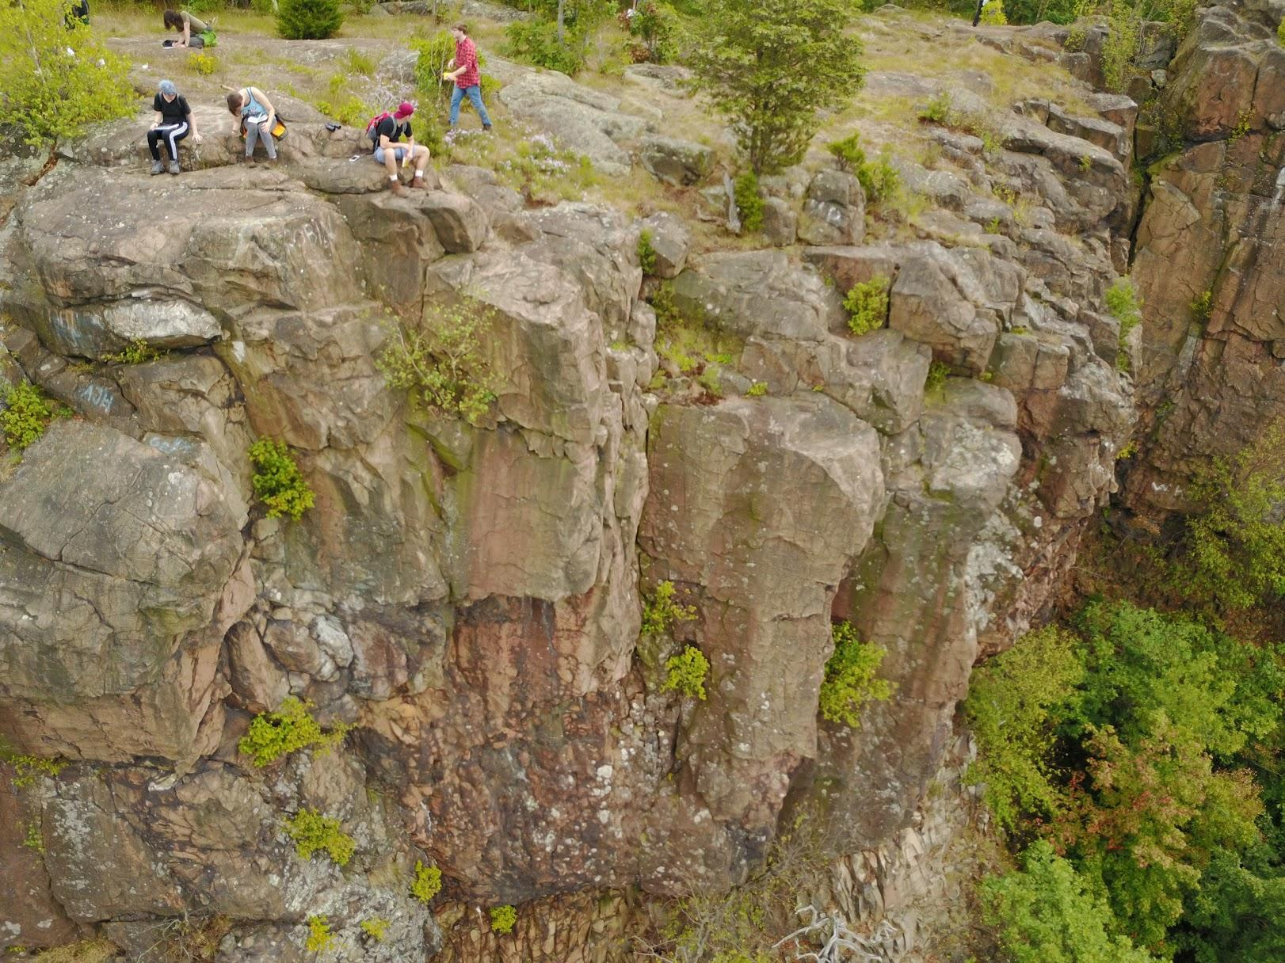
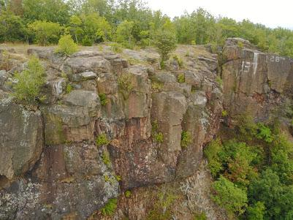
More perspective

Slide 10
Regulations
Used to be much more burdensome (licensing, etc)
Educational uses now treated like recreational uses
Need to be aware of where you are flying (and where you shouldn’t)

Slide 11
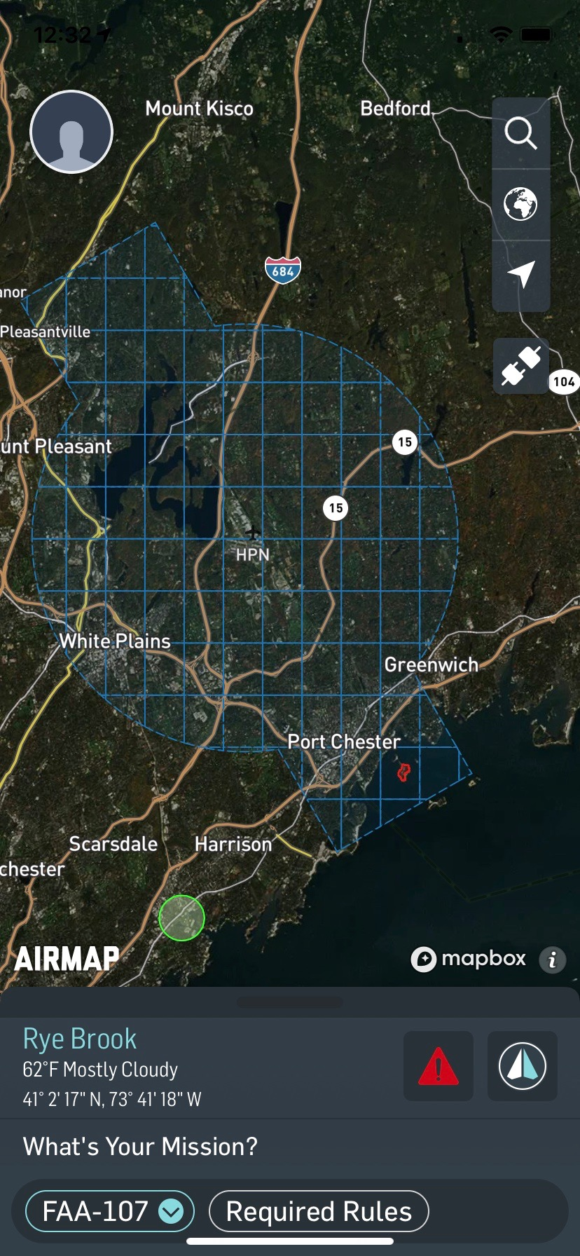
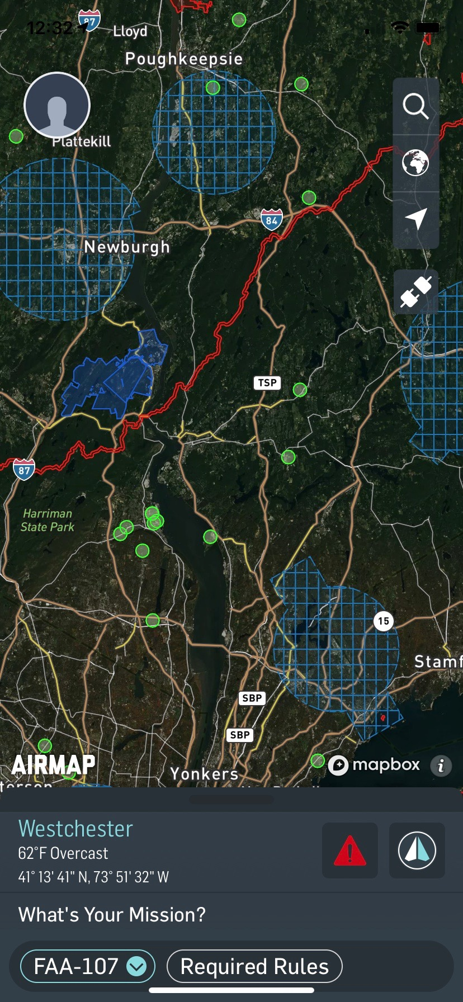
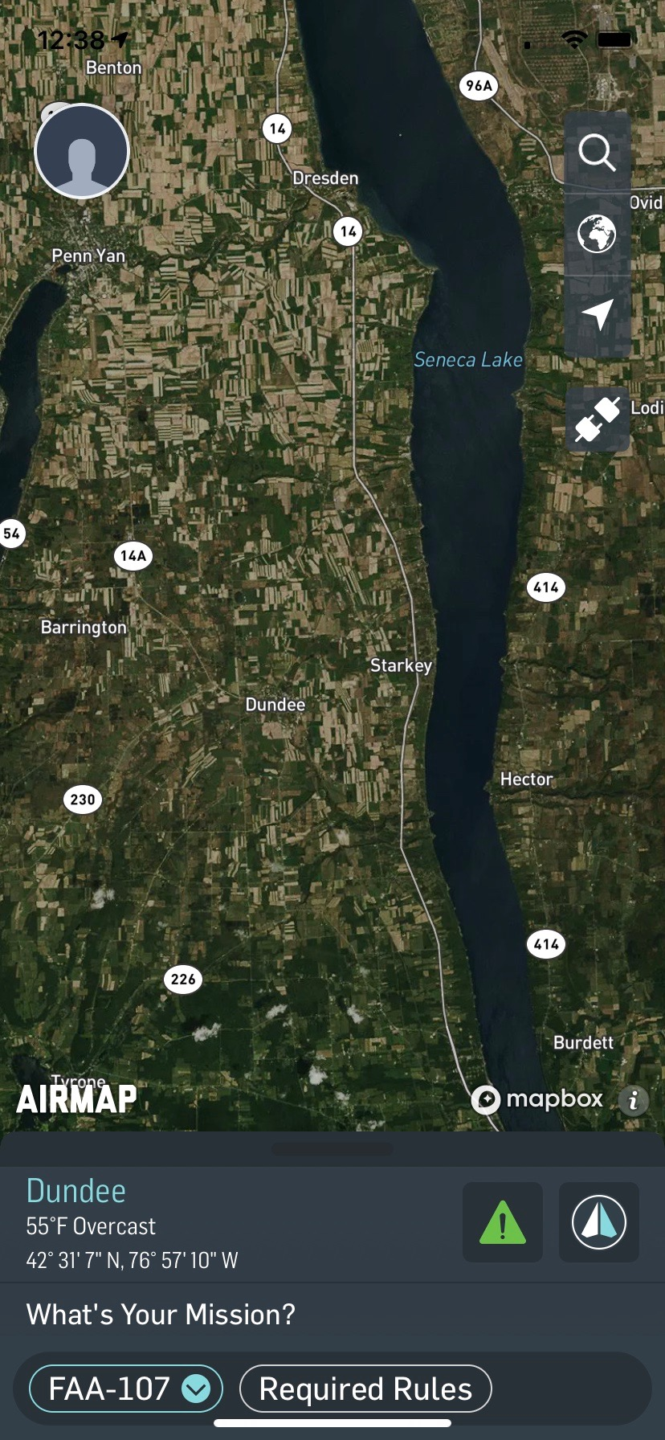
Flight restrictions

Slide 12
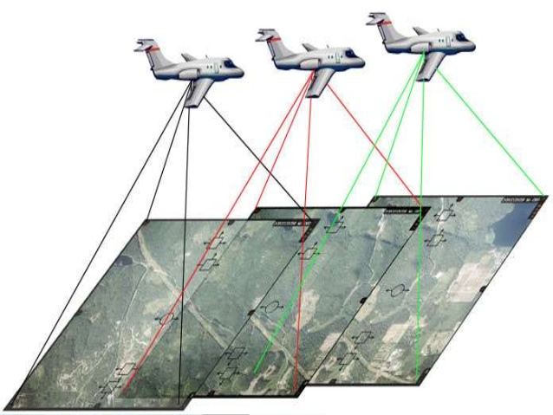
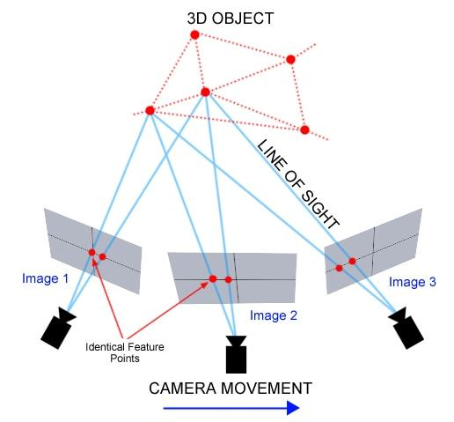
Photogrammetry

Slide 13
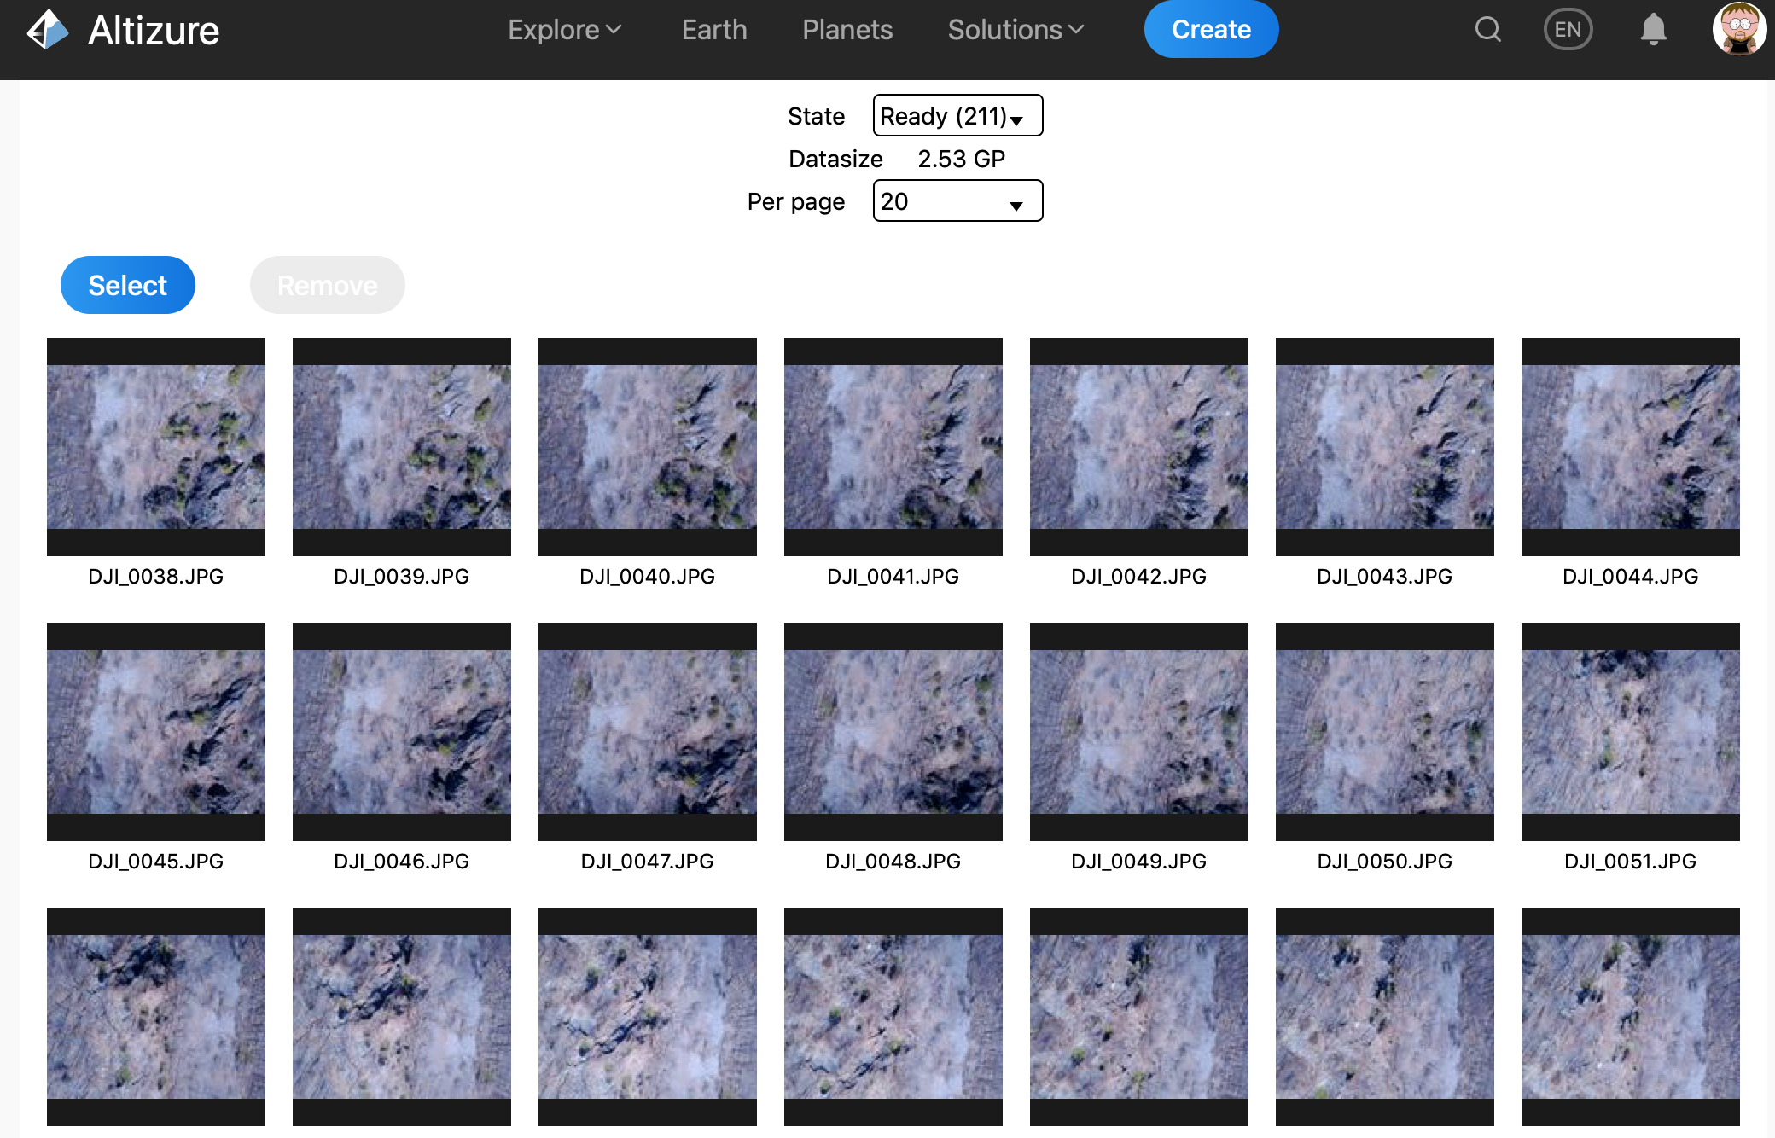
Higby Mountain example - raw images

Slide 14
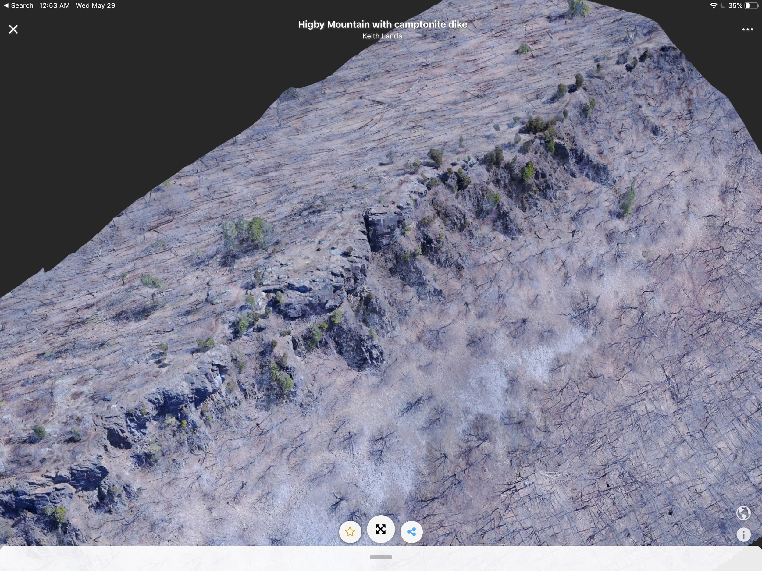
Higby Mountain example - 3D model

Slide 15
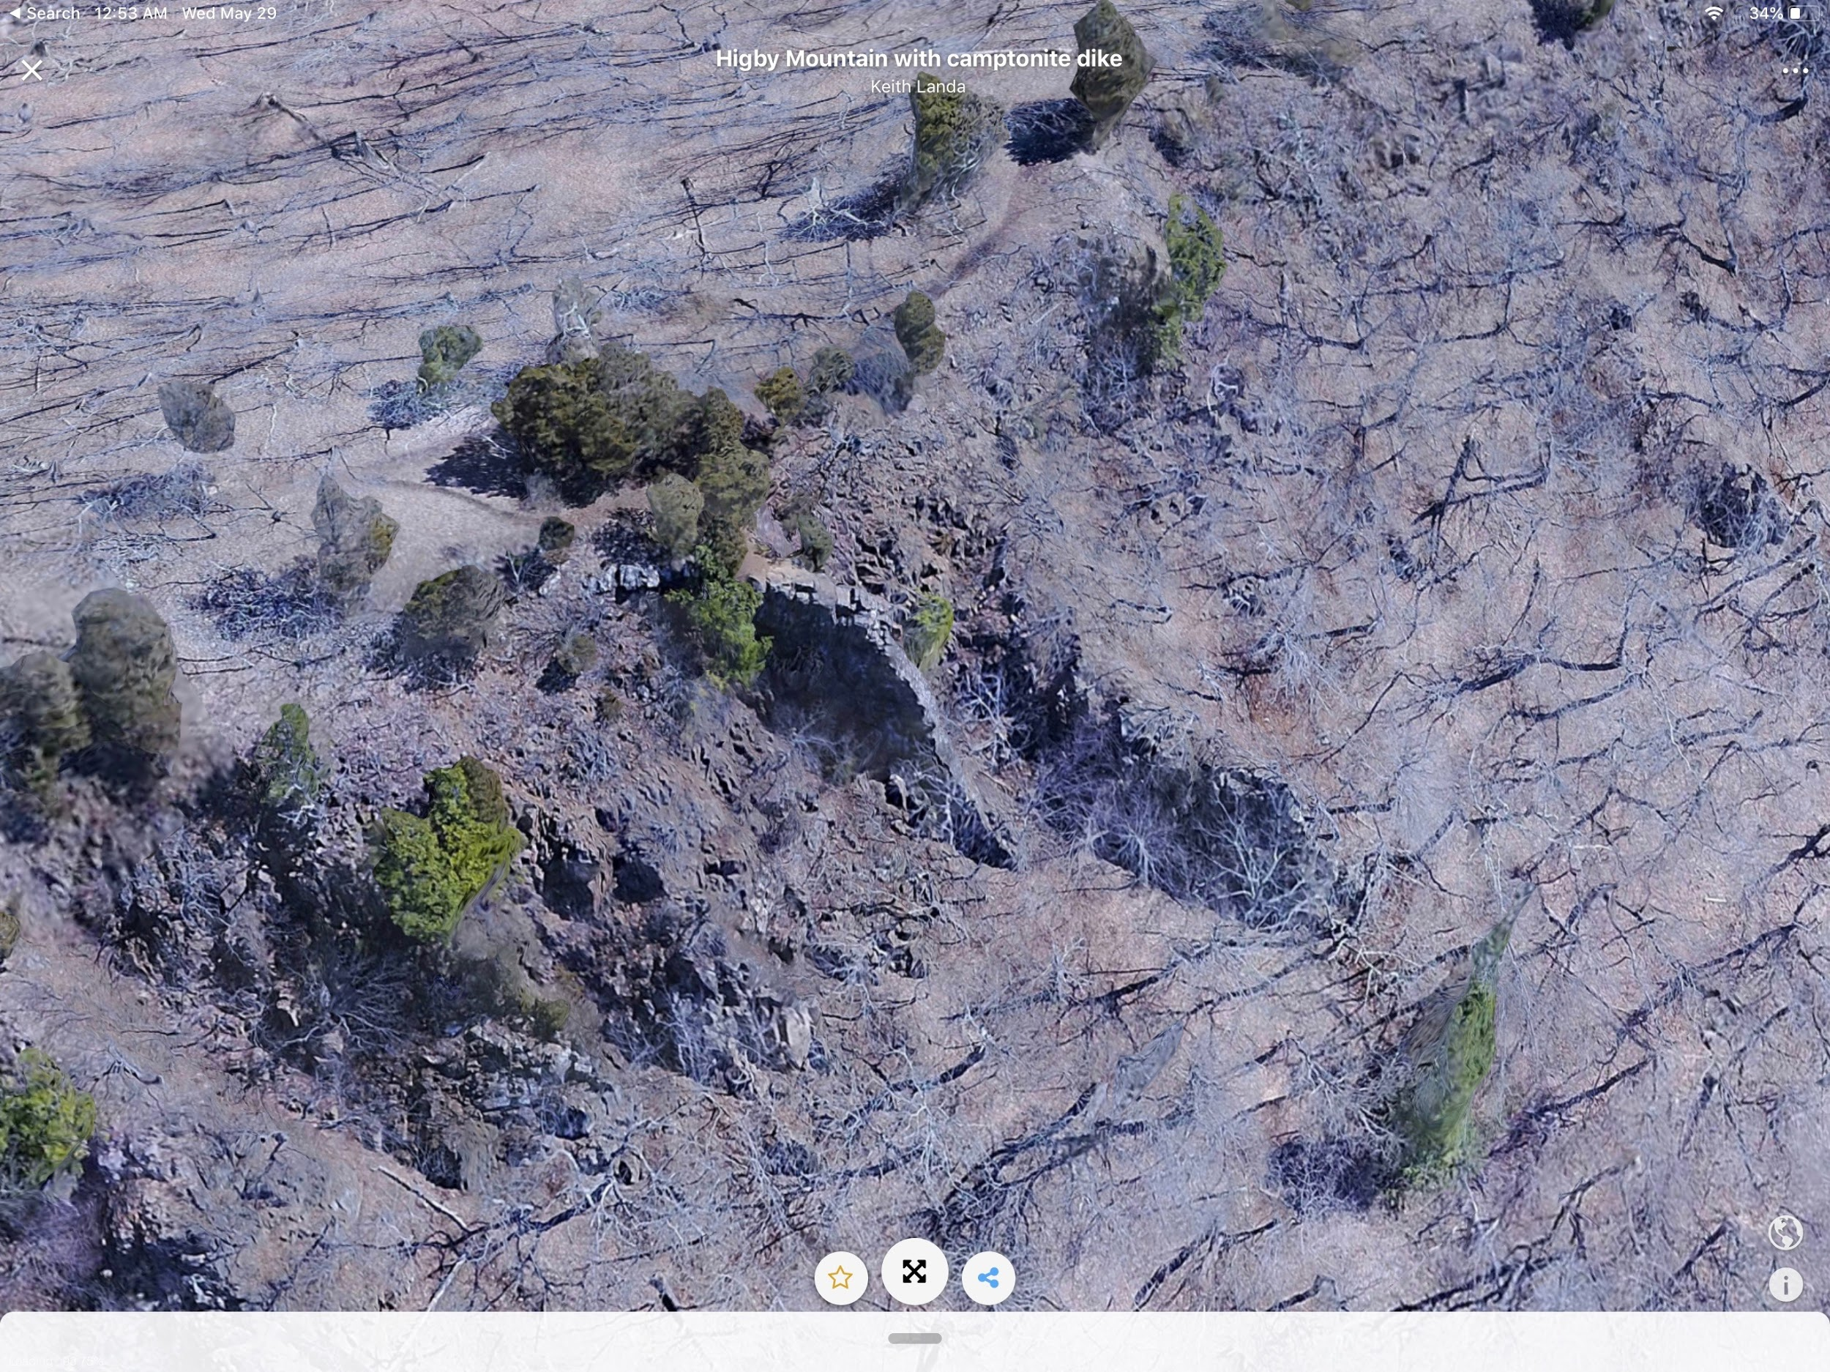
Higby Mountain example - camptonite dike

Slide 16
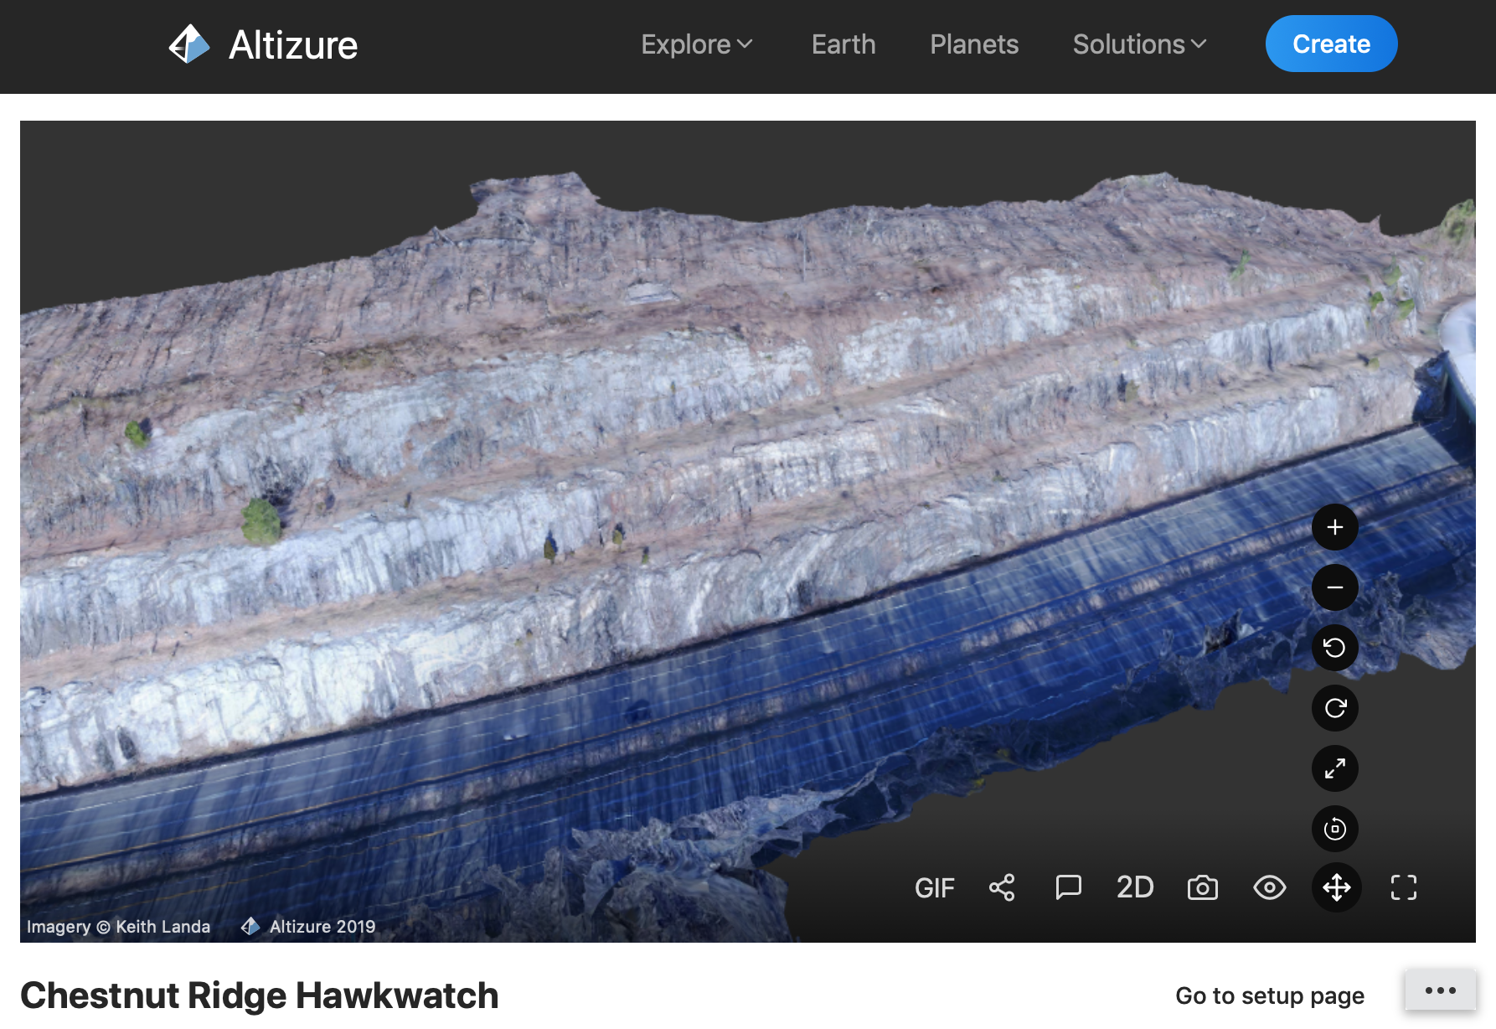
I-684 roadcut

Slide 17
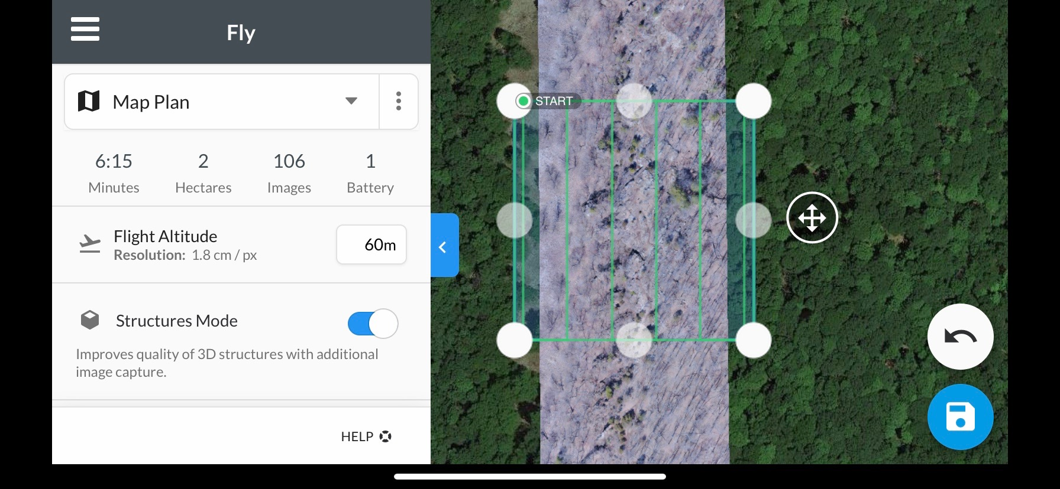
Flight control apps

Slide 18
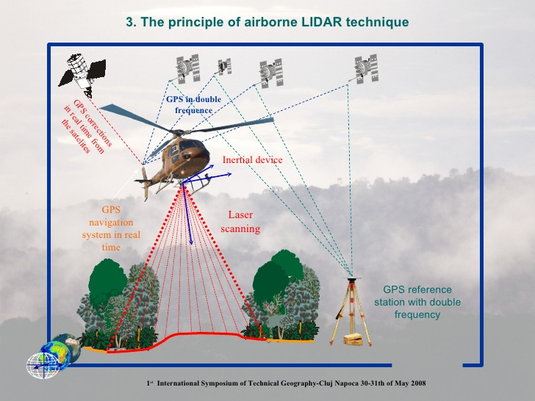
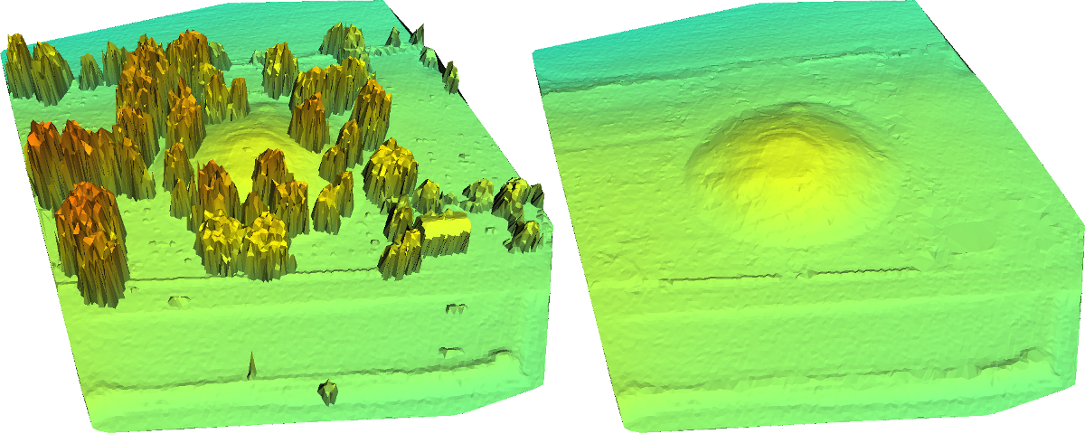
Lidar mapping

Slide 19
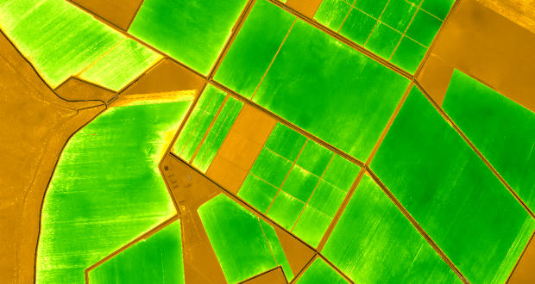
Multispectral mapping

Slide 20
Keith Landa - keith.landa@purchase.edu

