Slide 1
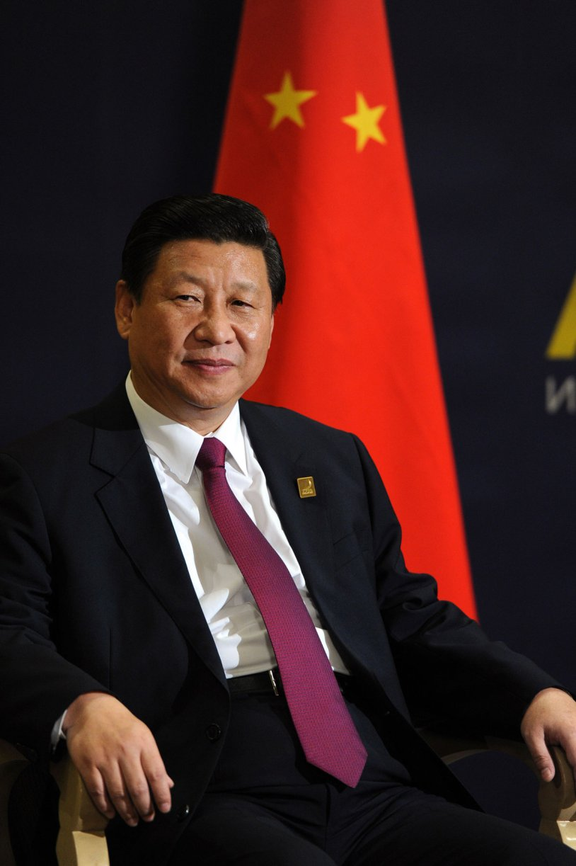
The Child is Father to the Man: A Political Psychology Profile of China's Xi Jinping Kenneth b. Dekleva, mD, McKenzie Foundation I chair in psychiatry and Assoc. Prof., Peter J. o’donnell Brain Institute, UT southwestern medical center, Dallas, TX ISPP Annual Meeting, July 5, 2018

Slide 2
OvervieW
Childhood/youth; trauma of the Cultural Revolution
Adulthood/Mid-Life
Politician, leader, and diplomat
China, North Korea, and Xi
The China Dream
Future

Slide 3
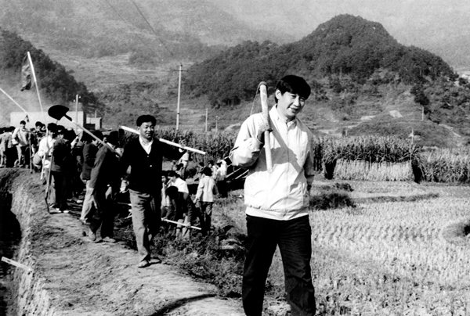
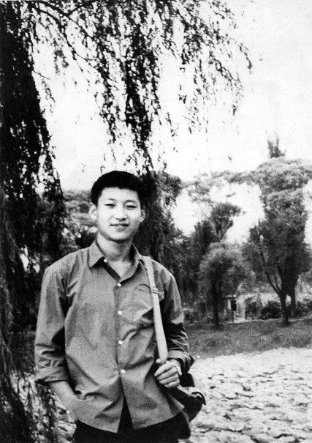
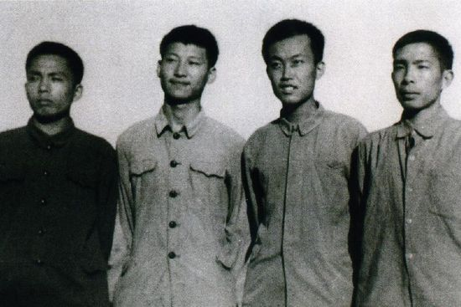
Childhood and youth

Slide 4
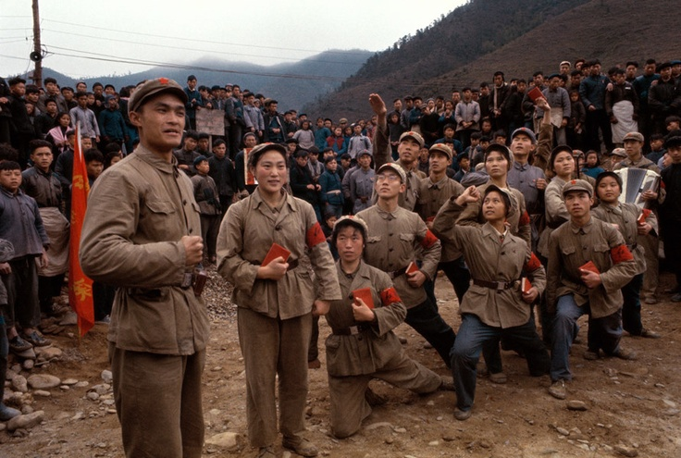
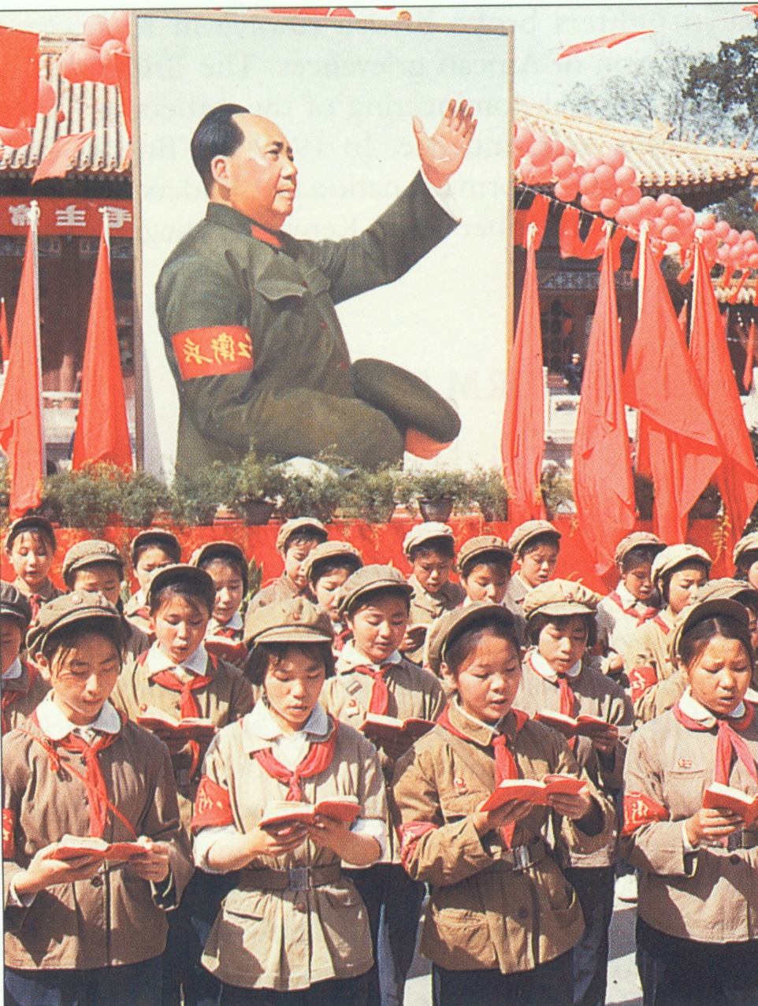
Cultural Revolution
“I grew up in the seven years I was in Shaanxi. I learned two important things. First, I had the opportunity to understand what real life looks like, what is right and wrong, and who ordinary people are. These were experiences for life. Second, I had my self-confidence built up. As they say: the knife is sharpened on a stone, people are strengthened in adversity. Seven years of hard life in the countryside developed me a lot. When later I have come across problems, I have never experienced them as big as then. Every man is to find his own strength.”

Slide 5
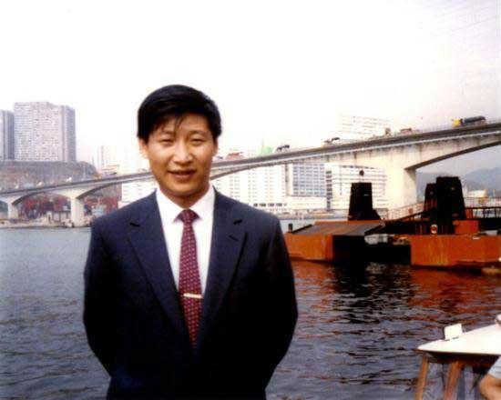
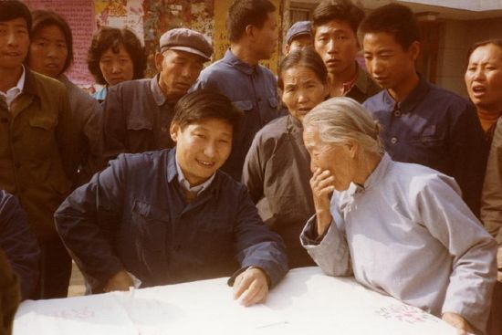
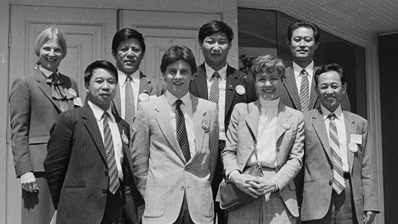
adulthood/Mid-Life

Slide 6
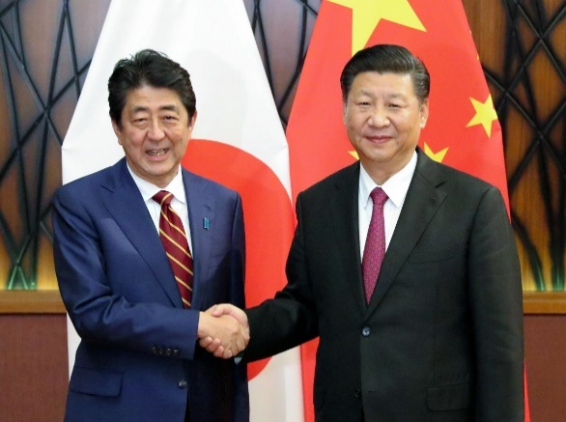
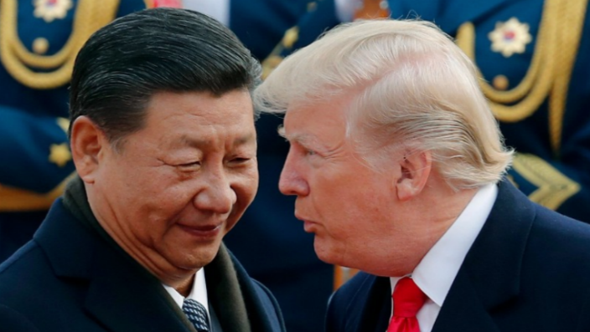
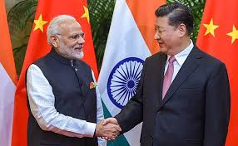
Politician and leader
Communist Party: 1974
Secretary to General Geng Biao (Sec’y-General, CMC): 1979-1982
Administrator: Hebei; Fujian; Zhejiang; Shanghai
Central Committee: 2002
Politburo Standing Committee, 2007
Vice-President, 2008-2013; Chair, Coordinating Committee, 2008 Olympics; Vice-Chair, CMC 2010-2013
President and General Secretary, 2013 – current
Comments of Henry Kissinger, Hank Paulson, Evan Osnos, Randal Phillips, Kerry Brown, Kevin Rudd, and Lee Kwan Yew

Slide 7
The China Dream
In 2012, after being elected President by the National People’s Congress, Xi spoke of the Chinese Dream of rejuvenation, as “the greatest dream of the Chinese people since the advent of modern times.” Xi stated that this dream would occur by 2049, the centenary of the founding of the People’s Republic of China, and would allow for the building of a prosperous, socialist, harmonious, and democratic society.
He also stated, “in the future, the Chinese nation will forge ahead like a gigantic ship breaking through strong winds and heavy waves.”

Slide 8
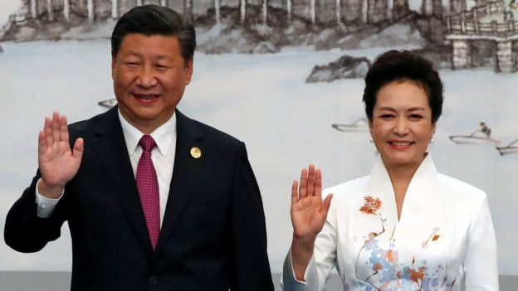
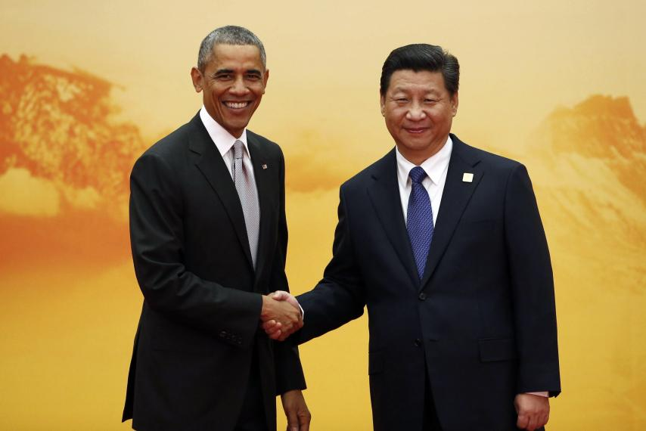
Diplomat

Slide 9
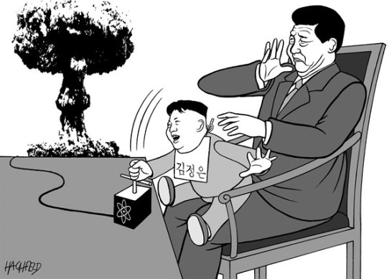
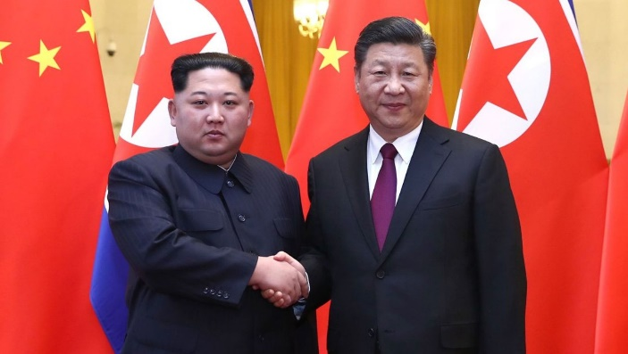
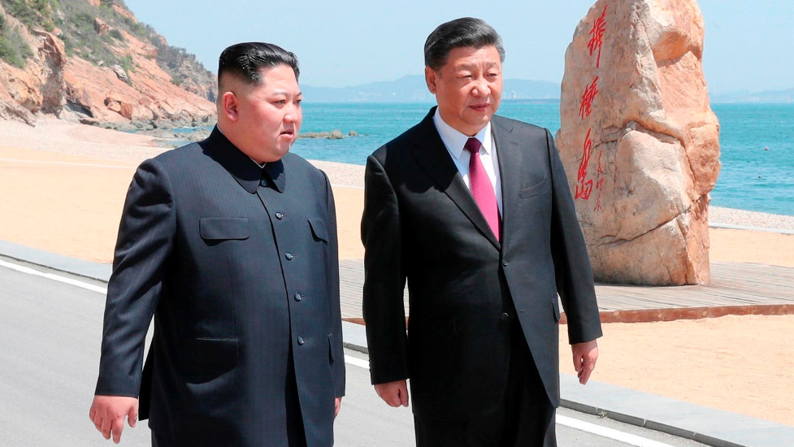
China, north korea, and xi
Mao: “as close as lips and teeth”
Xi’s 2009 trip to the DPRK and meeting with Kim Jong Il
2013-2017: souring of relations; support for UN sanctions
2018: improved relations and Xi-Kim meetings in Beijing and Dalian; China’s diplomatic role following the June 2018 Kim-Trump summit

Slide 10
China, north korea, and xi
Mao: “as close as lips and teeth”
Xi’s 2009 trip to the DPRK and meeting with Kim Jong Il
2013-2017: souring of relations; support for UN sanctions
2018: improved relations and Xi-Kim meetings in Beijing and Dalian; China’s diplomatic role following the June 2018 Kim-Trump summit

Slide 11
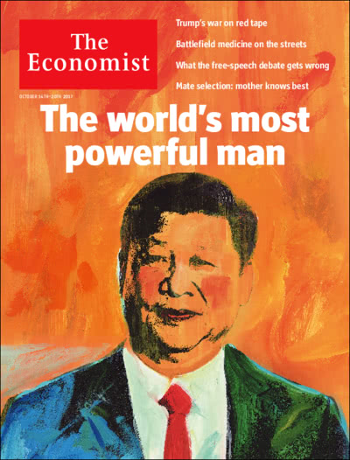
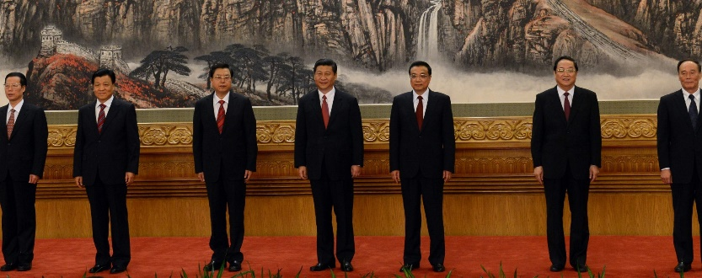
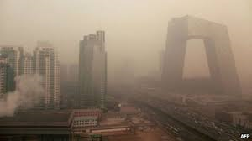
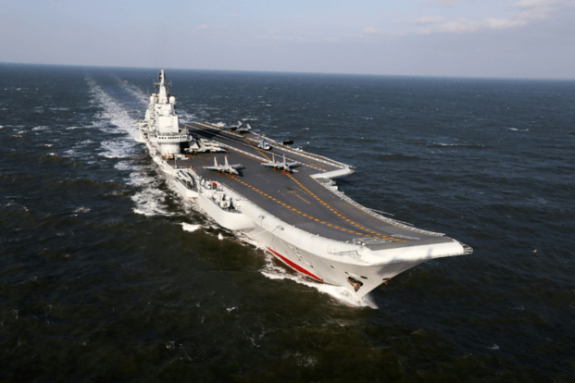
Future
China and the US: is China a strategic threat?
Davos 2017 speech; SCO; BRI
Challenges: Thucydides Trap; pollution; economy; south China Sea; corruption; cyber-theft; trade war(s); human rights; technology; North Korea
2017 19th CPC Congress: “Xi Jinping Thought”
2018 National People’s Congress: end of term limits

Slide 12
references
Kenneth Dekleva: https://www.thecipherbrief.com/column_article/path-not-preordained-profile-chinas-xi-jinping
Kerry Brown: CEO, China: The Rise of Xi Jinping
Evan Osnos: https://www.newyorker.com/magazine/2015/04/06/born-red
Mercy Kuo and Andrea Tang: https://thediplomat.com/2016/02/chinas-leadership-fault-lines-progress-vs-power/
Robert Blackwill and Kurt Campbell: https://www.cfr.org/sites/default/files/pdf/2016/02/CSR74_Blackwill_Campbell_Xi_Jinping.pdf
PORTRAIT OF VICE PRESIDENT XI JINPING - "AMBITIOUS SURVIVOR" OF THE CULTURAL REVOLUTION: https://wikileaks.org/plusd/cables/09BEIJING3128_a.html
Kevin Rudd: http://kevinrudd.com/blog/2018/05/10/kevin-rudd-writes-in-foreign-affairs-how-xi-jinping-views-the-world/

