Slide 1
Breaking Bottlenecks for
Low Carbon Pathway
Alice Yiu
SLOCAT Partnership

Slide 2
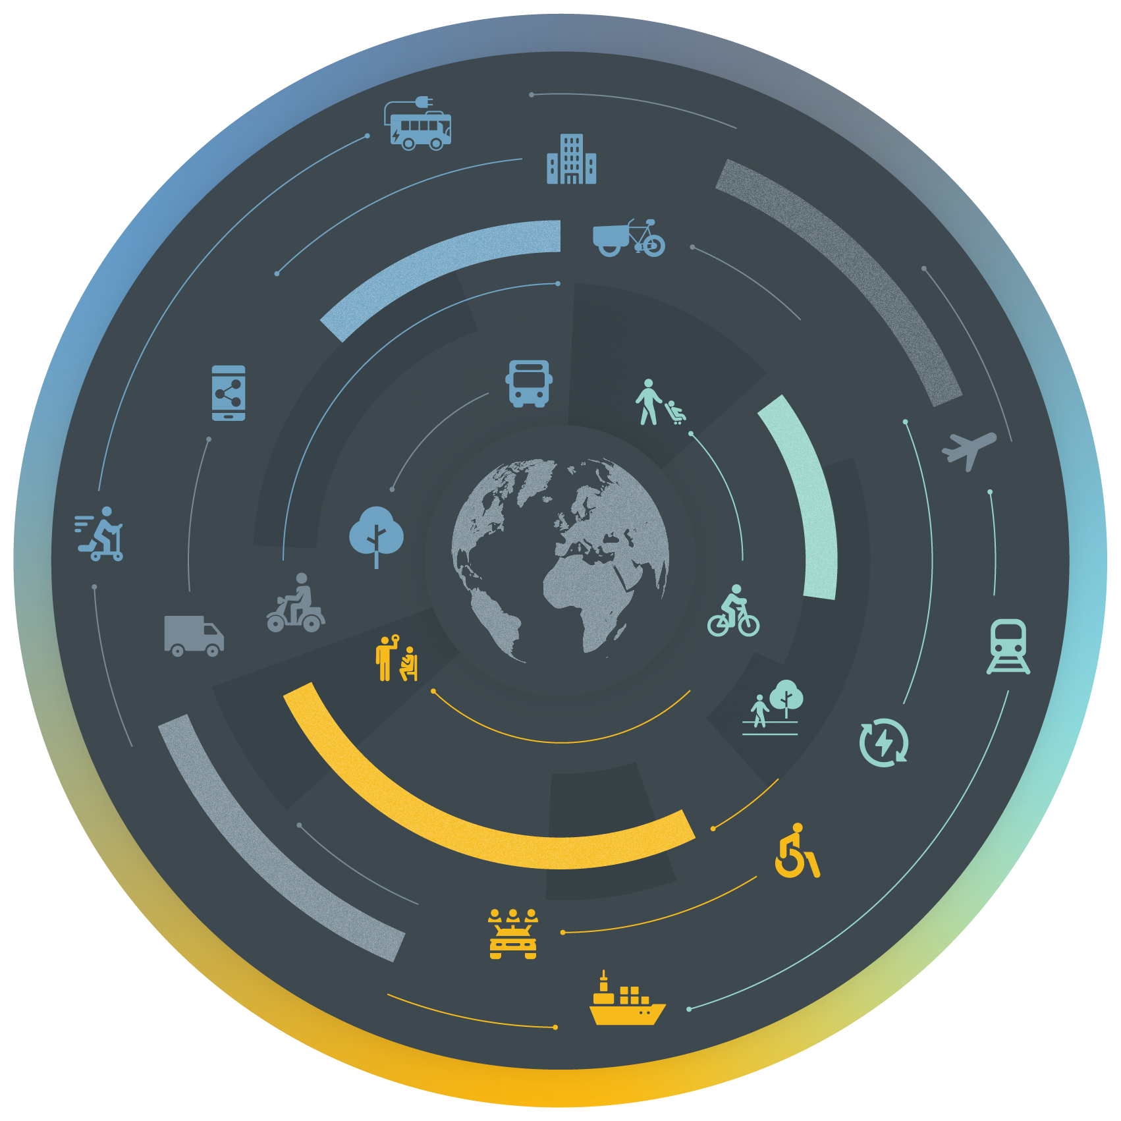
Region with fastest growth of transport CO₂ emissions
SLOCAT Transport, Climate and Sustainability
Global Status Report - 3 edition
www.tcc-gsr.com I #TransportClimateStatus
Growing momentum towards a net zero future
14 Asian countries had made economy-wide pledges towards net zero emissions
Asia
Surge in public transport & bikesharing
From 2015 to 2021:
Cities with BRT: 36%
Cities with metros and light-rail transit: 49%
World’s largest bike sharing market: 800+ schemes
Highest regional transport CO₂ emitter since 2011
Global leader of electric mobility
92% of electric vehicles in Asia are two-wheelers
Emissions trajectory not reaching the net zero pathway
Transport CO₂ emissions would not peak before 2050
Rapid renewables uptake in transport
Fastest annual growth among all regions: 14%

Slide 3
THANK YOU!
www.slocat.net
@slocatofficial
SLOCAT Transport, Climate and Sustainability
Global Status Report - 3 edition
www.tcc-gsr.com I #TransportClimateStatus

