Slide 1
Smart Mobilities
Kanzo Nakai, Asian Development Bank

Slide 2
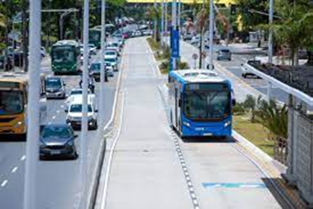
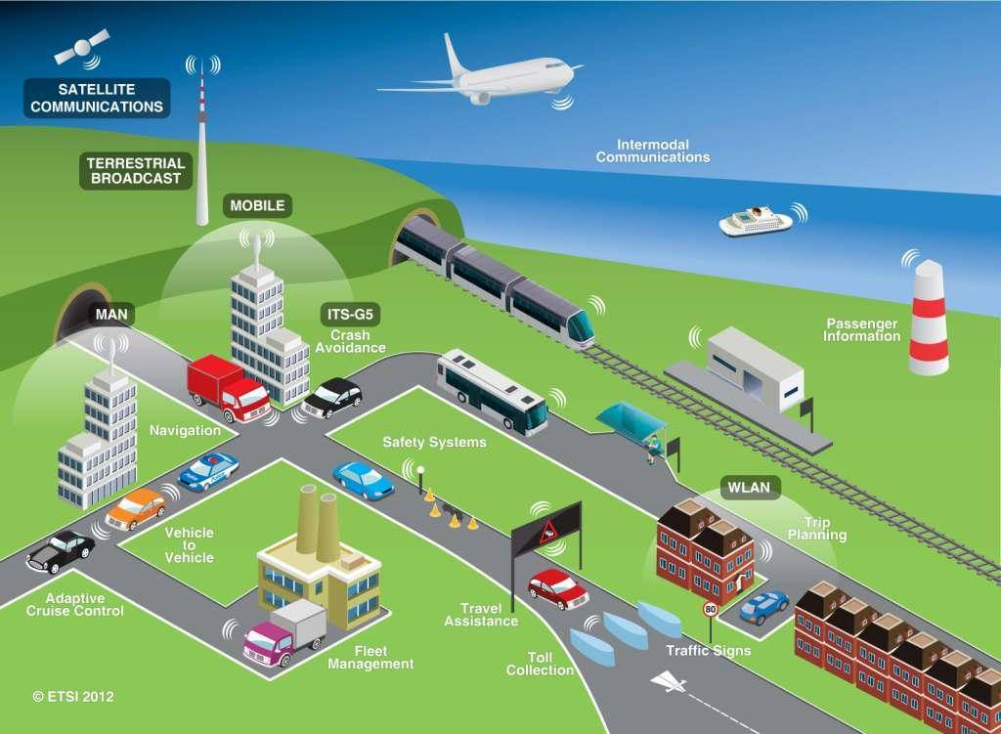
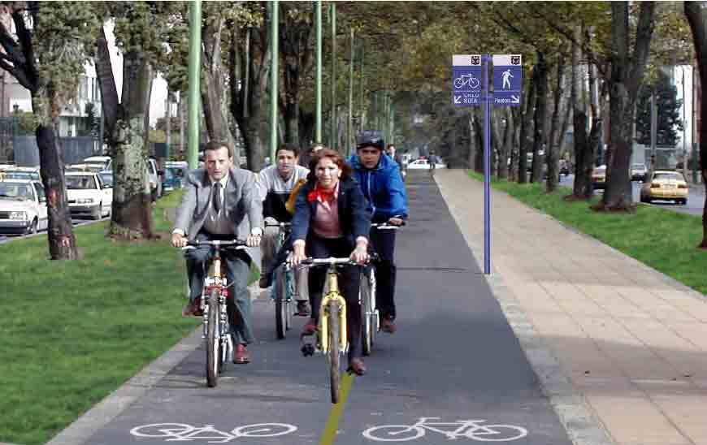
Provide solutions to urban mobility problems through high-quality transport services with digital, advanced, and low-carbon technologies
Opportunities
- Transform portfolio to low-carbon transport – public transport [metro, BRT, public buses], E-mobility, NMT - ADB climate bank $100B by 2030 and lending amount increase by $10B
- Emerging technologies – EV, on-demand, connected/ autonomous, ITS/ traffic management
- Integrated and multimodal approach – TOD, LEZ, Multimodal facilities, NMT
- From infrastructure to high-quality transport services with private sector involvement
Challenges
- Emerging area - lack of policy/ regulatory framework, weak EA/IA capacity, new clients
- Need longer time to prepare and implement projects
- Complex urban issues with multi-sectoral approach and coordination
- Rapidly evolving technologies – internal resources, procurement

Slide 3
THANK YOU!

