Slide 1
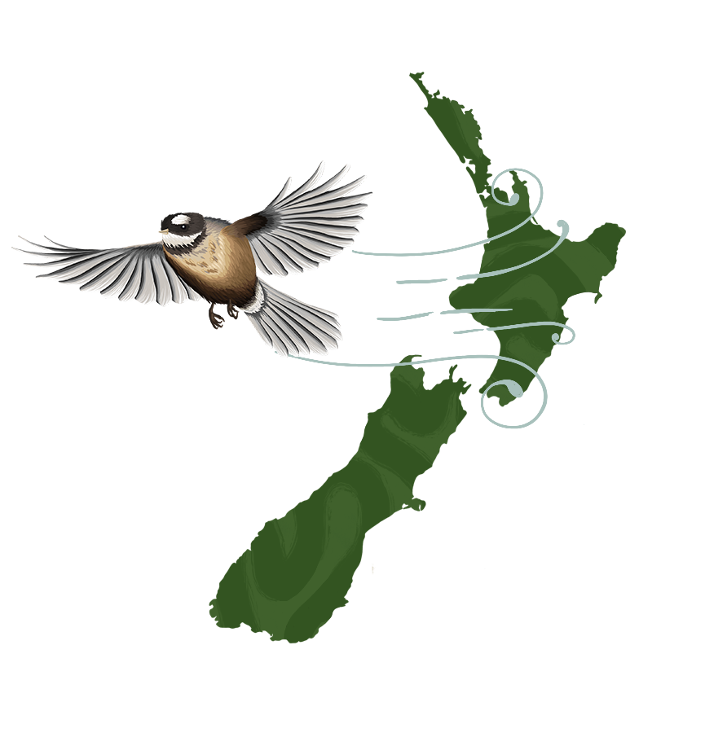
An Adaptation Roadmap for the New Zealand Tourism Sector
Laurissa Cooney, Co-Chair
Tourism Policy School, 24th March 2023

Slide 2
In today’s update …
Who
Sector-led waka
Why
Navigating our future
How
Being regenerative
What
Next steps

Slide 3
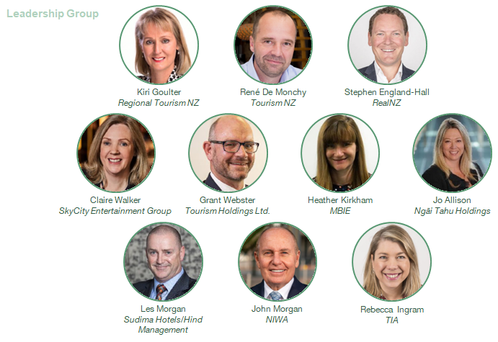
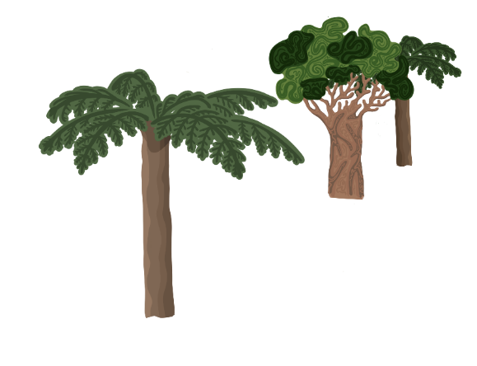
Who: Sector Collaboration
Kaupapa led by industry professionals
Technical Advisors:
Susanne Becken
Trent Yeo

Slide 4
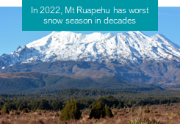
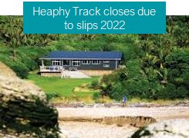
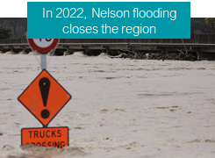
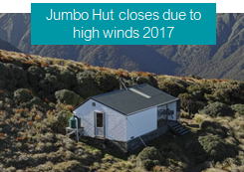
Why should we plan for our future?
Change in our climate is already afoot – severe disruption will be felt across the entire tourism sector and value chain
New Zealand is projected to warm between 0.7 and 3°C by 2090 relative to 1995, depending on the level of future emissions
Hot extremes will become more frequent and intense, particularly in the north and east. Risks of pests and biodiversity loss
Changes in rainfall patterns are variable, with most of the south and west becoming wetter and the north and east drier
2023, Akd floods, Cyclone Gabrielle
Health and safety concerns for visitors increase and insurance will become more difficult to obtain.
Extreme rainfall is expected to become more intense. Low lying land is susceptible to storm surges.
Did you know?
1
45 of 72 (or 63% of) ecosystems are threatened
2
82% of resident native birds and 94% of reptiles are threatened or at risk
3
72% of native freshwater fish are threatened or at risk
Right now, in Aotearoa New Zealand …

Slide 5
There are many risks to the sector from climate change - but that brings opportunity if you act now
Risks
New Zealand is already experiencing extreme weather events and disruptions: this is set to worsen with increased reduction in operating days
The majority of infrastructure is unlikely to be able to cope with the increased frequency and severity of acute climate events
Environmental degradation is already impacting New Zealand’s clean, green reputation
Natural environments that have supported New Zealand’s tourism industry are under threat
Visitors are having an increasingly negative impact on the environment
Investment and insurance will become increasingly difficult to access as the sector faces disruption
Opportunity
Operators can ‘future-proof’ their business by embedding more adaptive, regenerative, and resilient practices into their business operations.
As the sector recovers from COVID-19, there is a rare opportunity to move from volume to value - building in regenerative practices to protect biodiversity
The sector can assess its vulnerabilities, and plan for major infrastructure investment
The sector can be an early adopter of new technologies for more sustainable travel as a destination marketing strategy
By using data and performing scenario analysis to understand the changes to the climate/weather patterns and their subsequent impacts, the sector can plan ahead to minimise lost operating days.
Deloitte Turning Point Report – Decisive Climate action could add $64B to NZ GDP by 2050 if limited to 1.5C

Slide 6
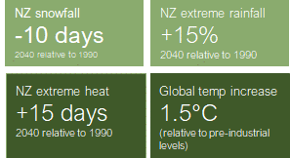
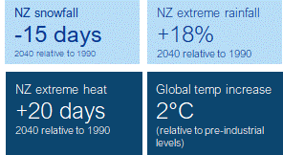
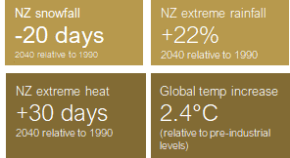
We explored three possible plausible futures for the tourism sector
Hiahia – Net Zero 2050
Limits global warming to +1.5ºC by the end of the century through stringent climate policies and innovation. Getting to net zero is an ambitious scenario.
International travel transformed and tourism sector a world-leader that flourishes by joining nature and visitors in a regenerative approach.
Pokanoa – Disorderly 2050
A disorderly transition with little policy action until after 2030 when strong, rapid action is then needed to limit warming to +2°C.
Physical and transition risks are higher. Tourism operating costs increase. This is a costly and disruptive transition.
Wharewera – Hothouse 2050
No additional climate change policies are introduced, and emissions continue to rise. Warming expected to reach +2.4°C (and +3°C by 2080).
Physical impacts of climate change are severe, with irreversible changes like glacial melt and sea level rise. Frequent damage and disruptions to transport, infrastructure, and food supply.

Slide 7
How: Framing a path with Taiao (nature) in mind
Tiwaiwaka Principles
Developed by Rob McGowan
It is time to do things differently
The six principles are a symbol of hope. They show us how we can be regenerative every step of the way
To nourish Papatūānuku and fill the world with life, Tane Mahuta created the Trees of the Forest, birds (our elder sibling), and humans
Tane reminded us of being restorative in what we do
Birds are symbolic of the visitor economy
Visitors bring mauri, they care for mauri and in doing so mauri takes care of them
The concept of mauri signify the connection and commitment we see in this roadmap to nature
Papatūānuku is the source of all life
1
2
3
We are not the centre of the Universe, we are part of it
The mauri is the web of connections that sustains life
People are not masters of the mauri; we are part of the mauri and embraced by it
No individual person is more important than any other
We give special care to the tiniest living creatures
4
5
6

Slide 8
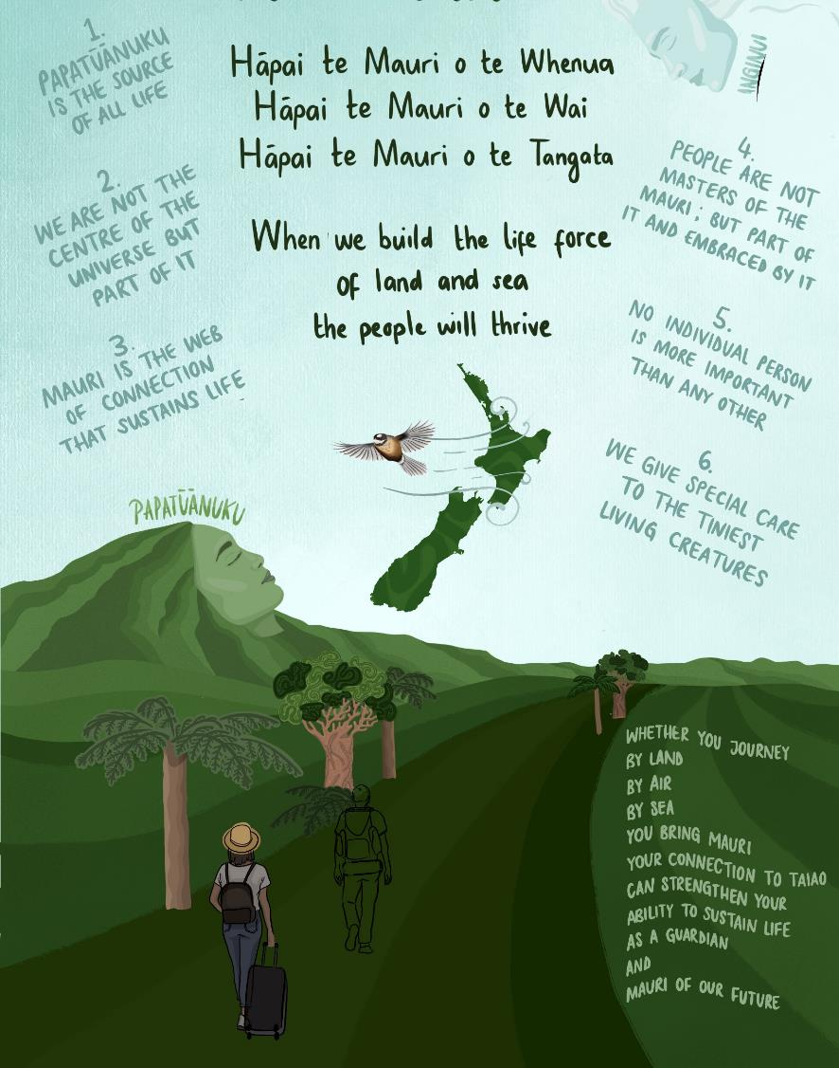
What we will do to enhance the mauri of our future!
Paddle the waka together and share ideas to tackle our challenges
Display courageous leadership as a tourism sector that builds system resilience
Make decisions that regenerate nature informed by vulnerability assessments
Ensure purposeful investment
Advance knowledge, skills, and capability

Slide 9
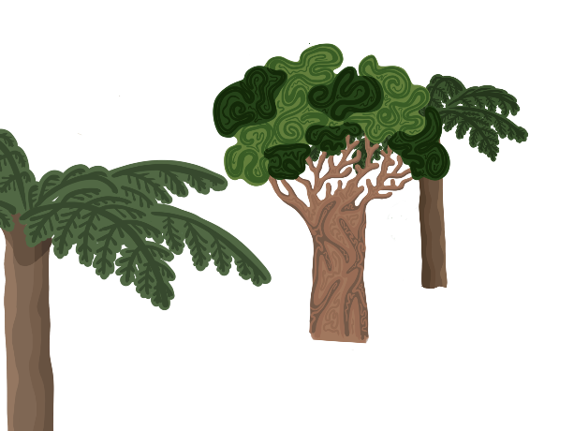
Our next steps
24th March 2023: Release of Part 1: Tourism Sector Climate Change Scenarios Report
2023 May : Release of Part 2: Road map
2023 June/July: Awareness / Sector conversations to take the actions forward
2023 Q1-Q2: This mahi will form a significant input to the Environment Phase of the Industry Transformation Plan, in its broader scope of supporting the tourism industry to understand and respond to climate change (adaptation and mitigation) and create positive environmental outcomes
Throughout 2023: Aotearoa Circle involvement
A whakatauki of Te Awa Tupua Iwi brings our learning to life at place…
Ko au te Awa, ko te Awa ko au
I am the River and the River is me

