Slide 1
SIMPLE MSK INJECTION TECHNIQUES
-Dr Masiiwa M. Njawaya B.Med, PGDip SportsMedicine
ASCEP Senior Registrar
South East Sydney Sports Medicine & Orthopaedics (SESMO), Double Bay, Sydney, NSW
Nepean Specialist Sports Medicine (NSSM), Penrith, NSW

Slide 2
VISUALISE IT !
PICTURE THE ANATOMY OR…
THROW A DART

Slide 3
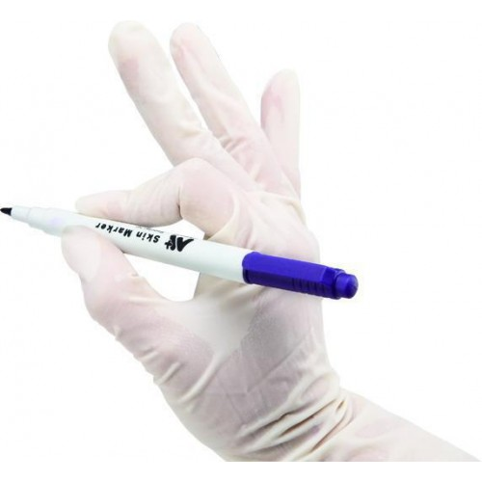
PREPARE

Slide 4
Overview
Injection basics
Indications. CI. Complications. Recommendations
Preparation
Consent. Equipment. Patient position. Landmarks. Techniques. Post-injection care. Follow Up
Practical LL injections
Hip (GTB), Knee,
Practical UL injections
Shoulder (SAB), [Elbow (CEO) – if time],

Slide 5
Injection Basics
Uses
Diagnostic – infection (septic joint), trauma (haemarthrosis), crystal arthropathy (gout, ps.gout)
Therapeutic – aspirate effusion, pain-relief (OA, inflammatory arthropathy)
General Practice - CSI, Hyaluronic acid
Sports Medicine - PRP, prolotherapy
CI
Infection, bleeding diathesis, h/o AVN, previous flare, uncontrolled DM,
Notes:
Uses: Pus, blood, or crystals
Always aspirate:
Csi effect fast last 4 weeks V HA effect 6 weeks→ >3 months effect. Pre ski.

Slide 6
Injection Basics
Complications (IA)
Trauma – neurovascular, cartilage (direct, steroid arthropathy, LA chondropathy)
Infection -1 in 10,000. No touch technique. Hospital.
Flare – <5%
CSI – 24-48hrs, steroid crystals, ice, analgesia
HA- 72hrs aseptic acute arthritis with subsequent inj. Aspirate-? Infection or crystals
Diabetes- worsen sugar control ( up to 5 days)
Failure (hit & miss, wrong diagnosis)
Local-pigmentation, soft tissue atrophy,
AVN
Allergy
Complications (EA) – tendon rupture (*link)
Notes:
Infection rates vary 1’3000-1’50000 ( gen uncommon)
Csi crystals = pro-inflammatory ( irritant) →”flare”. Crystals x rxn w methylparabens(bacteriostaic) inLA. Less bioavail.

Slide 7
Injection Basics
Recommendations
Number
≤3 injections/year (especially weight bearing joints)
Rheumatologists. Surgeons - caution pre joint replacement
Medication choice
LA – Reduce/Avoid IA – subcutaneous only! Ropivacaine (naropin) better than lignocaine/bupivacaine ( marcain)
Steroid choice – betamethasone(celestone) V methylprednisolone (depo-medrol) V triamcinolone (kenacort)
HA – synvisc (avian), durolane. Knees.
Placement …Honesty.
Peritendinous (consider U/S or experienced)
EA (If in doubt,take it out. Repeat (U/S)
No resistance
Notes:
#: rheu,atologists: Ra 1/ month for 3 months => 4/yr V Oa q 3m →3/yr. None 12mths Pre TKR some surgeons
Med: Personal pref!
PLACEMENT: Look (site, patient). Feel (resistance). Move (During:aspirate, reposition, Post: clinical signs/test)

Slide 8
LA options
Notes:
Lignocaine rapid onset <5 mins→ <2 hrs effect V Ropiva 1-15mins →2-6h V Bupivacaine slower 5-10mins →6-8h
Ropivacaine less chondrotoxic than ligno (no preservs). Less cardiotoxic than bupiv (cardiac arrest)!

Slide 9
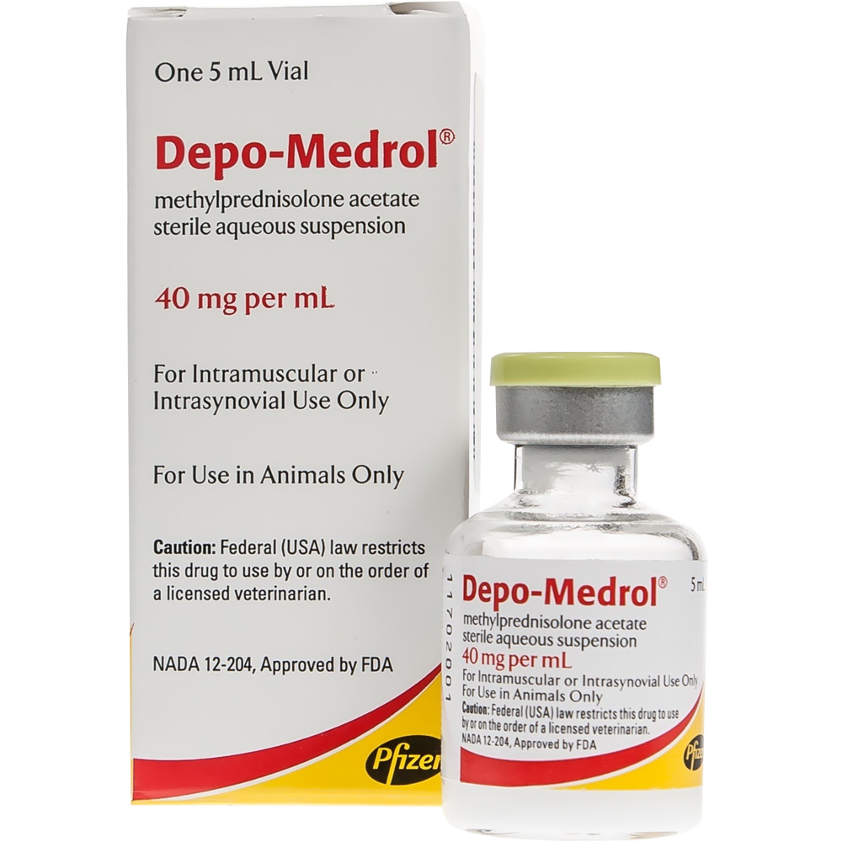
CSI Options
Notes:
Kenacort & depo less post injection flare

Slide 10
Preparation
Consent – verbal or written
Equipment
Patient Position
Landmarks
Techniques - NO TOUCH STERILE
Post-injection care
Paperwork – clear documentation of above.
Patient
Effect: Today – Gd. Tomorrow -sore. Day aft tomorrow –better. 2wks –best. 4wks –beat. 6wks -repeat
Exercise: Today-rest. 1 week later – Exercise
Follow Up – 2 weeks, 6 weeks
Notes:
Tomorrow : 24-48hrs Monitor ?Flare ( ice, analgesia) V Scare (infection)- tracking cellulitis, pain/stiff, fevers (hospital- aspirate, washout)
Effect I tell my pts: “ Sore tomorrow. Better day after tomorrow. Best at 2 weeks. Beat at 4weeks. Repeat at 6 weeks”

Slide 11
Practical LL Injections

Slide 12
Hip(Trochanteric bursitis)
Presentation
Chronic overuse > Acute (trauma)
Lateral hip/thigh pain. Can’t lie laterally.
Test: Tender over GT. Resisted hip abduction –pain & weak.
Preparation
1 amp betamethasone(5.7mg/ml) + *lignocaine 1% (50mg/5ml). 5ml syringe. 21G (green) x 1.5-2in(4-5cm)
Notes:
Female middle aged, SUDDEN increase in walk( hills stairs)or gym to fight the many moons. Usu assoc tendinopathy main issue,

Slide 13
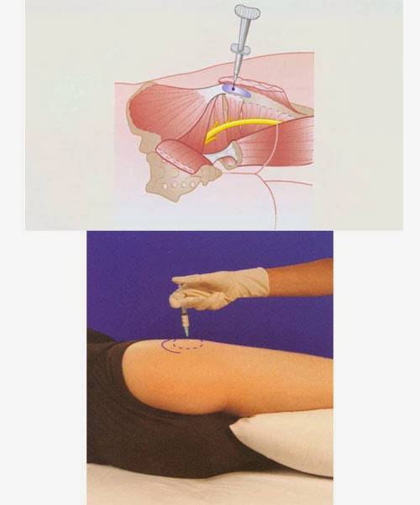
Visualise the anatomy!
Patient position
Lying lateral
Palpate & Mark
GT-quadrangular shape. (Bursa btw GT & Glut max tendon).
Palpate superolateral GT for tender spot.
Mark tender spot (golf).
NO TOUCH Technique
Needle perpendicular.
Touch bone, withdraw slightly.

Slide 14
Trochanteric bursitis
Re-examine
Hip ROM/ massage area
Advice
Relative rest 2 weeks
Avoid
Hill/stair/repetitive exercise. Walk flat instead.
Crossing leg over
Pillow between legs nocte
?ITB stretches
PHYSIO.

Slide 15
Knee
Presentation
Diffuse knee swelling – atraumatic
Anterior +/- posterior pain –Arthropathy: OA/Inflammatory/Crystal
Reduced ROM. Unable to squat.
Test (L,F,M,ST) ROM. Swipe Test.
Preparation
Aspirate: 10ml syringe + 21G needle or 20ml syringe + 18G. Yellow jar –M/C/S. Lavendar tube-cell count & crystals.
1 amp betamethasone(5.7mg/ml) + *lignocaine 1% (50mg/5ml). 5ml syringe. 21G (green) x 1.5(4cm)

Slide 16
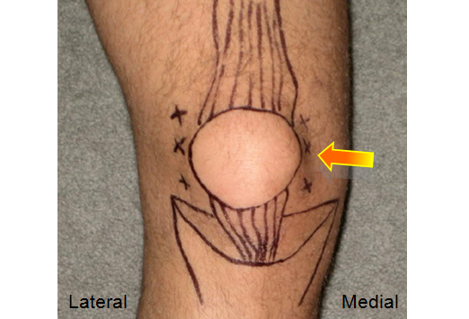
VISUALISE THE ANATOMY!
Patient Position -Supine Knee extended or slightly flexed (15°) over rolled towel
Palpate & Mark -Patella, patellar tendon, (tibial plateau, tibial tuberosity)
Notes:
Check ? Infective looking (cloudy) V straw yellow colour

Slide 17
Knee
NO TOUCH Techniques (6)
Don’t approach too close to patella
Bevel up
Aspirate 1st & check!
Suprapatellar (2)
Mid Patella (2)
Inferior Patella (Anterior) (2)
Re-examine! –ROM (flexion/squat)
Notes:
Distributes fluid. Checks effect LA / aspiration effect.

Slide 18
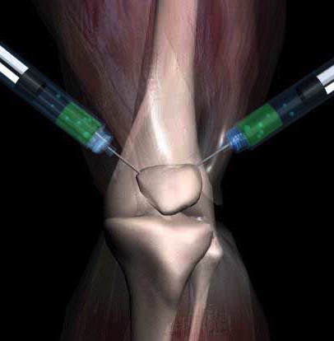
Suprapatellar approach
Suprapatellar (2) – Easiest!
Lateral suprapatellar approach
1 cm above superior pole patella + 1cm lateral to patella
Medial suprapatellar approach
1 cm above superior pole patella + 1cm medial to patella
Soft spot
Needle 45° angle towards middle of patella

Slide 19
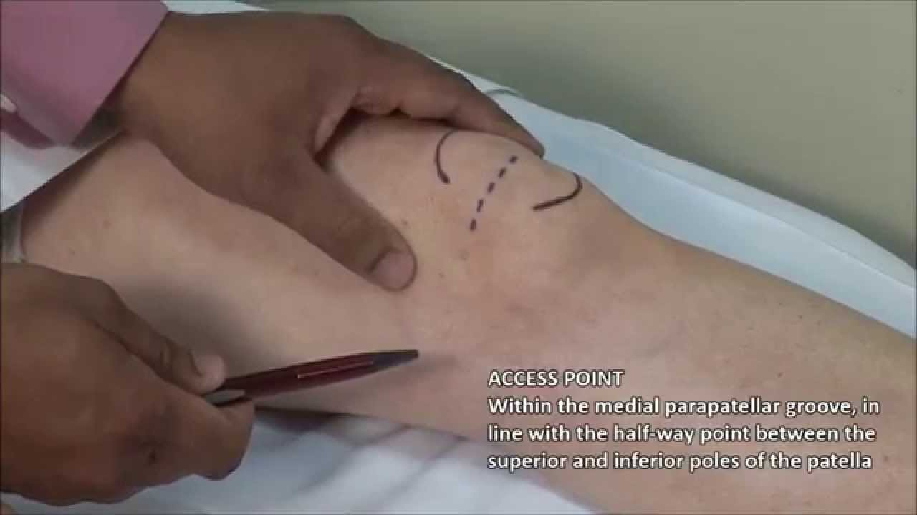
Mid Patella Approach
Mid patella (2)- easy
Lateral mid patella approach
1cm lateral to mid patella
Palpate patella then glide & tilt it laterally
Medial mid patellar approach
1cm medial to mid patella
Palpate patella then glide & tilt it medially
Needle 90° to skin → angle needle slightly posterior
Patellar facets convex
Notes:
AKA Retro Patellar

Slide 20
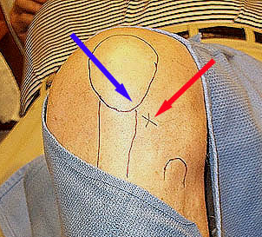
Inferior Patella (Anterior) approach
Anterior(2) – least accurate!
Best for advanced patellofemoral OA
Worst for aspiration
Knee flexed 90° / over edge bed
Inferior to Patella apex
Finger breath above Tibial plateau (finger-breath)
Slide thumb up tibia to soft spot
Anterolateral (AL) approach
Lateral to patella tendon (finger-breath)
Anteromedial (AM) approach
Medial to patella tendon (finger-breadth)
Needle parallel to floor
Aim posteromedial (AL)/posterolateral(AM).
‘Pop’. 3cm depth. No resistance.
Notes:
Finger- breath Tries to avoid meniscus
Withdraw slighty if hit bone

Slide 21
Knee
Advice
No exercise 1 week.
NWB exercise 2nd week
Graduated Return to previous exercise
Topical NSAIDS/panadol/ice prn
PHYSIO

Slide 22
Practical UL Injections

Slide 23
Shoulder (SAB)
Presentation
Acute (trauma) or chronic (biomechanics) impingement
Deltoid pain - reaching at shoulder height, lying lateral, pushing. Analgesia.
Test: Painful arc (~70-120° abduction)
Preparation
1 amp betamethasone(5.7mg/ml) + lignocaine 1% (50mg/5ml). 5ml syringe. 23G (blue) x 1.5in(4cm)
Notes:
Presentation : NSAIDs, ice
Prognosis: Self limiting acute 1- 6 wks. Address biomechanics

Slide 24
VISUALISE THE ANATOMY!
Position - Comfortably seated, arm by side
Palpate & mark – scapular spine, lateral border acromion, coracoid process, X/indent

Slide 25
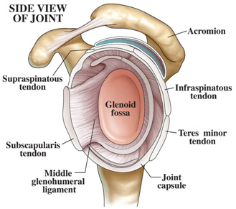
SAB
NO TOUCH Techniques (Aspirate 1st)
✔Posterior – just below (1-2cm) posterior angle acromion. Needle 30° to skin (up). Aim AL corner acromion
✓Lateral – mid-acromion, ‘soft-spot’ (groove btw acromion & humeral head). Angle needle slightly upwards.
✗Anterior –most accurate BUT NV bundle
Re-Examine!
Painful arc
Advice -Avoid above shoulder activity. PHYSIO.

Slide 26
CEO (Tennis elbow)
Presentation
Chronic (overuse), repeated gripping/supination & pronation, tools
Pain lateral elbow (radiate forearm), grip pain & weak
Test in elbow extension + FA pronation, while palpating at lateral epicondyle:
Resisted extension of- middle finger (ED/ECRB-Maudsley’s T), wrist.
Passive full wrist flexion (Mill’s Test)
Chair lift - 3 finger pinch
Notes:
ECRB

Slide 27
Tennis elbow (CEO)
Preparation
1ml betamethasone(5.7mg/ml) + 1ml *lignocaine 1% (20mg/2ml). 2ml syringe. 25G (orange) x 5/8in(16mm)
May only need 1 ml total

Slide 28
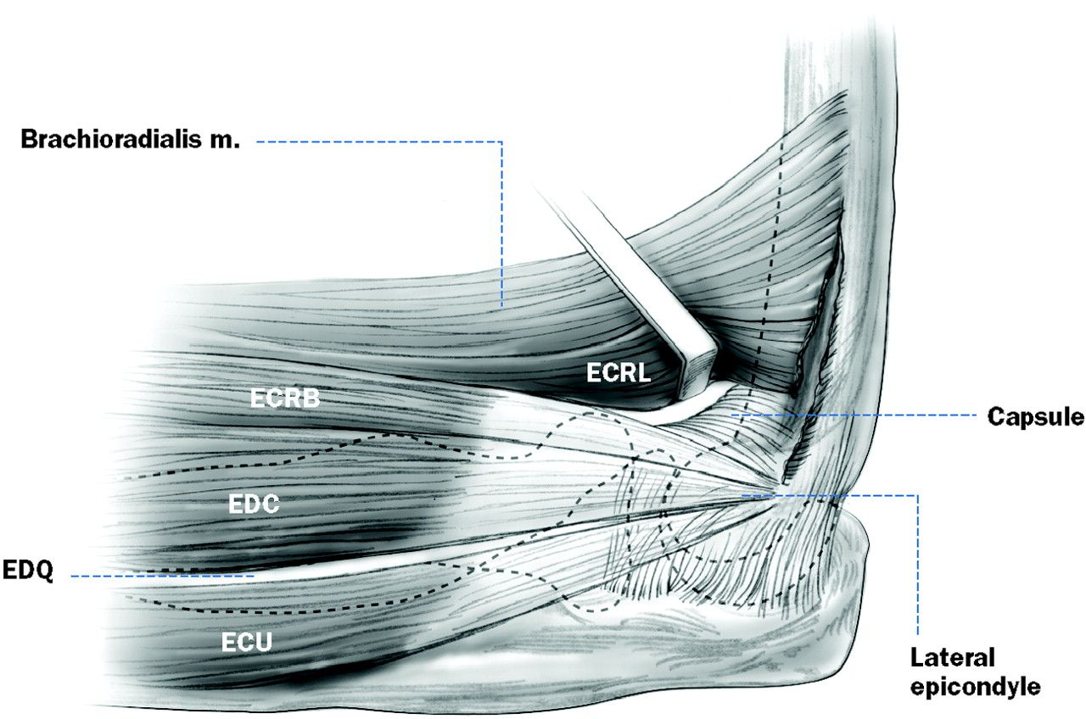
Visualise the anatomy!
Patient position (2)
Supine -arm at side, elbow 45 ° flx, FA pronated OR
Seated on chair. Elbow 90° flexion. FA supinated & supported by desk/bed.
Palpate & mark
Lateral epicondyle (LE), radial head.
Tender spot
NB. If seated +supinated: Roll onto anterior surface LE, palpate tender tendon insertion.
Mark mid-tender point (0.5-2cm distal to LE)
Notes:
90* + Supinated positions tendon to run directly forwards from ant facet LE

Slide 29
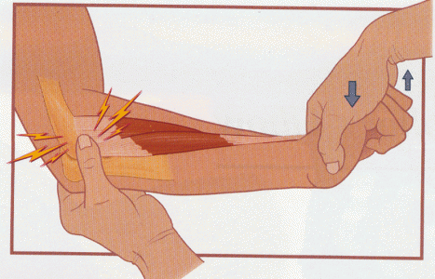
CEO
NO TOUCH Technique (Aspirate 1st, Peritendinous!)
If Pronated position – tender spot, needle 90° OR
If Supinated –i/o needle from anterior, perpendicular to anterior facet LE
Pull back 1-2 mm from bone
Bolus or multiple, (Peppering with PRP only)
Avoid subcutaneous or intratendinous injection
Re-examine – wrist extension
Advice
Relative rest 2 weeks
Palm up grip/hold
Avoid repetitive wrist & elbow motions -grip/extension/twist. Bigger grip size. Workstation.
Counterforce brace
Wrist splint
PHYSIO
Notes:
Counterforce brace 1 thumb breath below tender point. Comfortable Not too tight.

Slide 30
TAKE HOME MESSAGES
PATIENT POSITION
VISUALISE THE ANATOMY
PRACTICE ….Just Do It ✓!
THANK-YOU!
Notes:
Practice makes Perfect!

Slide 31
References
Hollander JL, Jessar RA, Brown EM Jr. Intra-synovial corticosteroid therapy: a decade of use. Bull Rheum Dis. 1961;11:239-40.
Raynauld JP et al. Safety and efficacy of long-term intraarticular steroid injections in osteoarthritis of the knee: a randomized, double-blind, placebo-controlled trial. Arthritis Rheum. 2003;48(2):370–377.
Askari A et al. Hyaluronic acid compared with corticosteroid injections for the treatment of osteoarthritis of the knee: a randomized control trial. SpringerPlus. 2016;5:442.
He, Wei-wei et al. Efficacy and safety of intraarticular hyaluronic acid and corticosteroid for knee osteoarthritis: A meta-analysis.International Journal of Surgery 2017, Volume 39 , 95 – 103
Bellamy, et al. Intraarticular corticosteroid for treatment of osteoarthritis of the knee. The Cochrane Library, Issue 4, 2006.
McNabb, James. A Practical Guide to Joint & Soft Tissue Injection & Aspiration. 2 nd Ed.LWW; Pfenninger, JL Procedures in Primary Care 2 nd Ed. 2003

